Slide 1
Review of
Probability and
Estimators
Arun Das, Jason Rebello
16/05/2017
Jason Rebello | Waterloo Autonomous Vehicles Lab

Slide 2
Probability Review | Why is probability used in Robotics ?
State of robot (position, velocity ) and state of its environment are unknown and only noisy sensors available (GPS, IMU)
Probability helps to fuse sensory information
Provides a distribution over possible states of the robot and environment
Jason Rebello | Waterloo Autonomous Vehicles Lab
Notes:
Dynamics is often stochastic, hence can’t optimize for a particular outcome, but only optimize to obtain a good distribution over outcomes ! Probability provides a framework to reason in this setting " Result: ability to find good control policies for stochastic dynamics and environments

Slide 3
Probability Axioms |
Probability for any event A in the set of all possible outcomes.
Probability over the set of all possible outcomes
Probability of the Union of events
If the events are mutually exclusive
Jason Rebello | Waterloo Autonomous Vehicles Lab

Slide 4
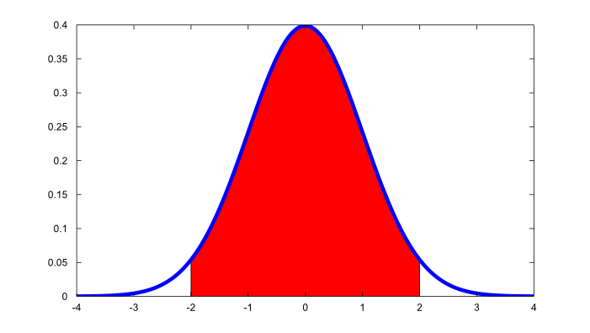
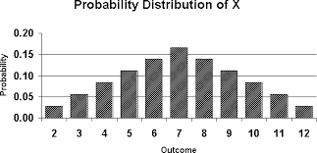
Random Variables |
Random Variable assigns a value to each possible outcome of a probabilistic experiment. Example: Toss 2 dice: random Variable X is the sum of the numbers on the dice
Discrete
Distinct Values
Probability Mass function
Eg: X = (1) Heads, (0) Tails
Y = Year a random student was born
(2000,2001,2002,..)
Continuous
Any value in some interval
Probability Density function
Eg: Weight of random animal
Jason Rebello | Waterloo Autonomous Vehicles Lab
Notes:
Suppose that to each point of a sample space we assign a number. We then have a function defined on the sample space. This function is called a random variable (or stochastic variable) or more precisely a random function (stochastic function). It is usually denoted by a capital letter such as X or Y. In general, a random variable has some specified physical, geometrical, or other significance
In probability and statistics, a probability mass function (pmf) is a function that gives the probability that a discrete random variable is exactly equal to some value.^{[1]} The probability mass function is often the primary means of defining a discrete probability distribution, and such functions exist for either scalar or multivariate random variables whose domain is discrete
In probability theory, a probability density function (PDF), or density of a continuous random variable, is a function, whose value at any given sample (or point) in the sample space (the set of possible values taken by the random variable) can be interpreted as providing a relative likelihood that the value of the random variable would equal that sample.

Slide 5
Random Variables | Expected Value
It is the long-run average value of repetitions of the experiment it represents.
Expectation is the probability weighted average of all possible values.
E[X] = ∑_{x} x * P(x)
Eg. For a dice. E(X) = (⅙)*1 + (⅙)*2 + (⅙)*3 + (⅙)*4 + (⅙)*5 + (⅙)*6 = 3.5
Properties:
E[c] = c … where ‘c’ is a constant
E[X+Y] = E[X] + E[Y] and E[aX] = aE[X] .. Expected value operator is linear
E[X | Y=y] = ∑_{x} x * P(X=x | Y=y) … Conditional Expectation
E[X] ≤ E[Y] if X ≤ Y … Inequality condition
Jason Rebello | Waterloo Autonomous Vehicles Lab
Notes:
Suppose that to each point of a sample space we assign a number. We then have a function defined on the sample space. This function is called a random variable (or stochastic variable) or more precisely a random function (stochastic function). It is usually denoted by a capital letter such as X or Y. In general, a random variable has some specified physical, geometrical, or other significance
In probability and statistics, a probability mass function (pmf) is a function that gives the probability that a discrete random variable is exactly equal to some value.^{[1]} The probability mass function is often the primary means of defining a discrete probability distribution, and such functions exist for either scalar or multivariate random variables whose domain is discrete
In probability theory, a probability density function (PDF), or density of a continuous random variable, is a function, whose value at any given sample (or point) in the sample space (the set of possible values taken by the random variable) can be interpreted as providing a relative likelihood that the value of the random variable would equal that sample.

Slide 6
Random Variables | Variance
Variance measures the dispersion around the mean value.
Var[X] = 𝜎² = E [ X- 𝜇 ]²
Var[X] = E[ X² ] - E[ X ]²
Eg: For a dice.
E[ X² ] = (⅙)*1² + (⅙)*2² + (⅙)*3² + (⅙)*4² + (⅙)*5² + (⅙)*6² = 91/6
E[ X ] = 7/2
Var[X] = (91/6) - (7/2)² = 2.9166667
Properties:
Var[ aX+b ] = a² Var[X] .. Variance is not linear
Var[X+Y] = Var[X] + Var[Y] .. If X and Y are independent
Jason Rebello | Waterloo Autonomous Vehicles Lab
Notes:
Suppose that to each point of a sample space we assign a number. We then have a function defined on the sample space. This function is called a random variable (or stochastic variable) or more precisely a random function (stochastic function). It is usually denoted by a capital letter such as X or Y. In general, a random variable has some specified physical, geometrical, or other significance
In probability and statistics, a probability mass function (pmf) is a function that gives the probability that a discrete random variable is exactly equal to some value.^{[1]} The probability mass function is often the primary means of defining a discrete probability distribution, and such functions exist for either scalar or multivariate random variables whose domain is discrete
In probability theory, a probability density function (PDF), or density of a continuous random variable, is a function, whose value at any given sample (or point) in the sample space (the set of possible values taken by the random variable) can be interpreted as providing a relative likelihood that the value of the random variable would equal that sample.

Slide 7
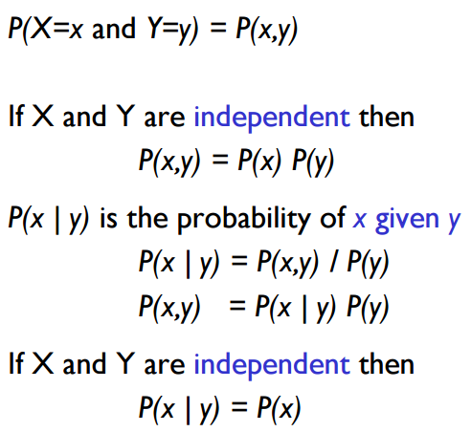
Joint and Conditional Probability |
Joint Probability
Joint Probability of
Independent random variables
Conditional Probability
Conditional Probability of Independent random variables
Jason Rebello | Waterloo Autonomous Vehicles Lab
Notes:
A joint probability is a statistical measure where the likelihood of two events occurring together and at the same point in time are calculated. Joint probability is the probability of event Y occurring at the same time event X occurs.

Slide 8
Mutually Exclusive, Independent Events |
What is the difference between Mutually exclusive events and Independent Events ?
Jason Rebello | Waterloo Autonomous Vehicles Lab

Slide 9
Mutually Exclusive, Independent Events |
Events are mutually exclusive if the occurrence of one event excludes the occurrence of other events. Eg Tossing a coin. The result can either be heads or tails but not both
P(A U B) = P(A) + P(B)
P(A,B) = 0
Events are independent if the occurrence of one event does not influence the occurrence of the other event. Eg Tossing two coins. The result of first flip does not affect the result of the second
P(A U B) = P(A) + P(B) - P(A)*P(B)
P(A,B) = P(A)*P(B)
Jason Rebello | Waterloo Autonomous Vehicles Lab

Slide 10
Law of Total Probability and Marginals |
Jason Rebello | Waterloo Autonomous Vehicles Lab
Notes:
The distribution of the marginal variables (the marginal distribution) is obtained by marginalizing over the distribution of the variables being discarded, and the discarded variables are said to have been marginalized out.
Given two random variables X and Y whose joint distribution is known, the marginal distribution of X is simply the probability distribution of X averaging over information about Y. It is the probability distribution of X when the value of Y is not known.

Slide 11
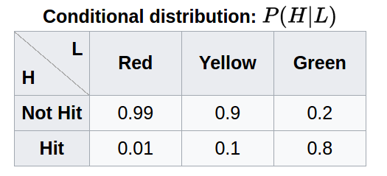
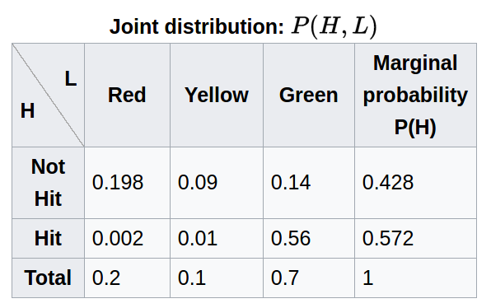
Probability Example |
Calculate Marginal Probability of person being hit by car without paying attention to traffic light ?
Assume P(L=red) = 0.2, P(L=yellow)=0.1, P(L=green)=0.7
P(hit | colour)+P(not hit | colour) = 1
P(hit, L=red) = P(hit | L=red) * P(L=red) = 0.01*0.2 = 0.002
∑_{colour}P(hit) = ∑_{colour}P(hit,all colour)
= ∑_{colour}P(hit | any colour) * P(any colour)
= P(hit | red) * P(red) + P(hit | yellow) * P(yellow)+
P(hit | green) * P(green)
= 0.01*0.2 + 0.1*0.1 + 0.8*0.7 = 0.572
Jason Rebello | Waterloo Autonomous Vehicles Lab

Slide 12
Parameter Inference |
Experiment: We flip a coin 10 times and have the following outcome.
What is the Probability that the next coin flip is T ?
≅ 0.3 ≅ 0.38 ≅ 0.5 ≅ 0.76
Jason Rebello | Waterloo Autonomous Vehicles Lab

Slide 13
Parameter Inference | Why is 0.3 a good estimate
Every flip is random. So every sequence of flips is random. We have a parameter that tells us if the next flip is going to be tails.
The sequence is modeled by the parameters 𝜃₁, ….. 𝜃₁₀
Find 𝜃_{i}’s such that the above probability is as high as possible.
Maximize the likelihood of our observation (Maximum Likelihood)
Jason Rebello | Waterloo Autonomous Vehicles Lab

Slide 14
Parameter Inference | Assumptions
Assumption 1 (Independence): The coin flips do not affect each other
Assumption 2 (Identically Distributed): The coin flips are qualitatively the same
Independent and Identically Distributed : Each random variable has the same probability distribution as others and all are mutually independent
Jason Rebello | Waterloo Autonomous Vehicles Lab

Slide 15
Parameter Inference |
Find critical point of the above function.
Monotonic functions preserve critical points. Use log to make things simpler
argmax_{𝜃} ln [ 𝜃³ (1-𝜃)⁷ ]
= argmax_{𝜃} |T| ln 𝜃 + |H| ln (1-𝜃)
Taking the derivative and equating to 0.
= 3/10 = 0.3
This justifies the answer of 0.3 to the original question.
Jason Rebello | Waterloo Autonomous Vehicles Lab
Notes:
We prefer natural logs (that is, logarithms base ee) because, as described above, coefficients on the natural-log scale are directly interpretable as approximate proportional differences: with a coefficient of 0.06, a difference of 1 in xx corresponds to an approximate 6% difference in yy, and so forth.

Slide 16
Parameter Inference | Maximum Likelihood Estimation
Suppose there is a sample 𝑥₁ .. 𝑥_{n} of n independent and identically distributed observations coming from a distribution with an unknown probability density function.
Joint Density Function:
Consider the observed values to be fixed parameters and allow 𝜃 to vary freely
Likelihood:
More convenient to work with natural log of the likelihood function
Log-Likelihood:
Average Log-Likelihood:
Maximum Likelihood Estimator:
Jason Rebello | Waterloo Autonomous Vehicles Lab

Slide 17
Parameter Inference | Problems with MLE
Let’s assume we tossed the coin twice and got the following sequence
The probability of seeing a tails in the next toss is
Since no tails observed 𝜃_{MLE} = 0
MLE is a point estimator and is prone to Overfitting.
How do we solve this ? Assume a prior on 𝜃
Jason Rebello | Waterloo Autonomous Vehicles Lab

Slide 18
Parameter Inference | Bayes Rule
Bayes Rule
: Likelihood
: Prior
: Evidence
: Posterior
Jason Rebello | Waterloo Autonomous Vehicles Lab

Slide 19
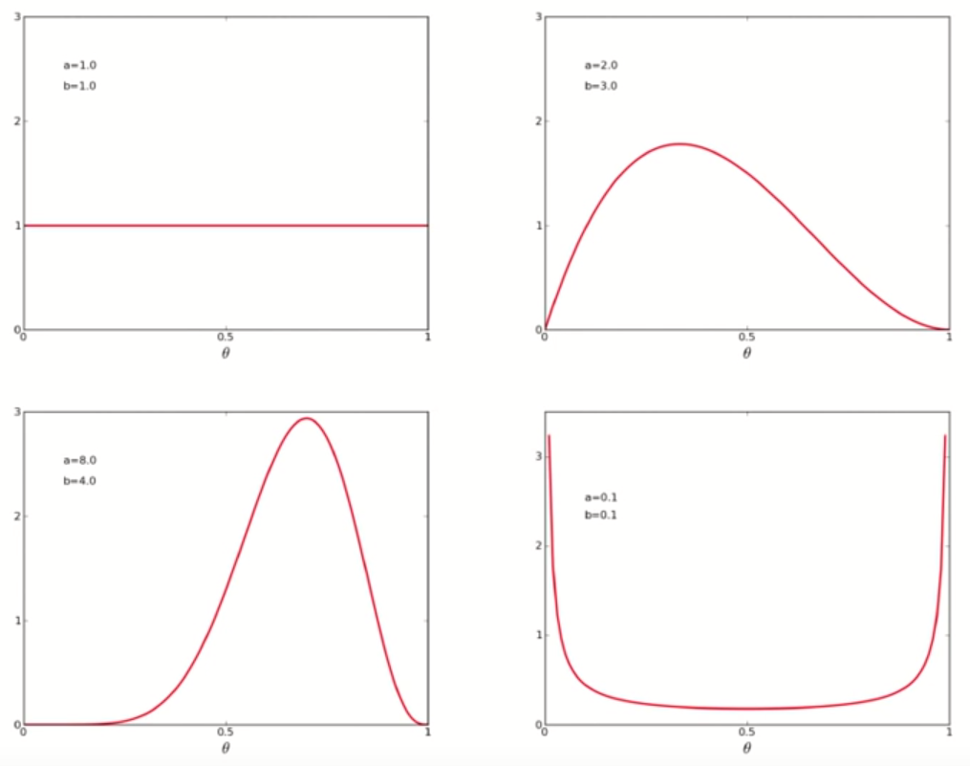
Parameter Inference | Choosing the Prior
Choosing the Prior
(a-1) and (b-1) are the number of T and H we think we would see, if we made (a+b-2) many coin flips
a = 1.0 a = 2.0
b = 1.0 b = 3.0
a = 8.0 a = 0.1
b = 4.0 b = 0.1
Jason Rebello | Waterloo Autonomous Vehicles Lab

Slide 20
Parameter Inference | Maximum - A - Posteriori
Evidence Likelihood Prior
Maximum A Posteriori Estimation
Jason Rebello | Waterloo Autonomous Vehicles Lab

Slide 21
Homework |
Determine the Maximum Likelihood Estimator for the mean and variance of a Gaussian Distribution
Jason Rebello | Waterloo Autonomous Vehicles Lab

