Slide 1
Estimator Properties and Linear Least Squares
Arun Das
06/05/2017
Arun Das | Waterloo Autonomous Vehicles Lab

Slide 2
Definitions| Important concepts
Expected Value:
Variance
Cauchy–Schwarz inequality
Arun Das | Waterloo Autonomous Vehicles Lab

Slide 3
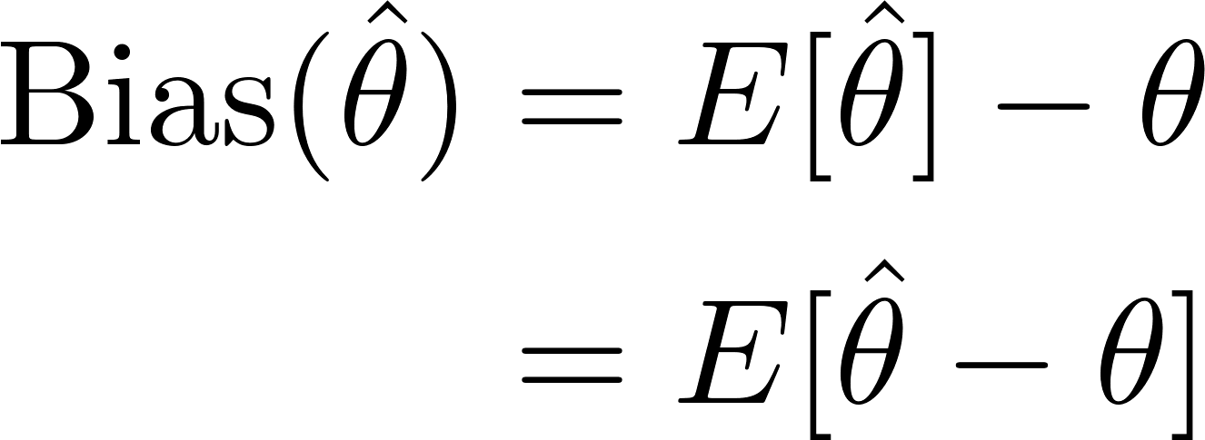
Properties of Estimators| Bias
The estimator Bias is defined as:
Called unbiased if:
Let’s do an example with the sample mean
Arun Das | Waterloo Autonomous Vehicles Lab

Slide 4
Estimation| How Good Can the Estimate Be?
Suppose we have an unbiased estimator
Let’s manipulate the above equation a bit…
Arun Das | Waterloo Autonomous Vehicles Lab

Slide 5
Definitions| Important concepts
Expected Value:
Variance
Cauchy–Schwarz inequality
Log identity
Arun Das | Waterloo Autonomous Vehicles Lab

Slide 6
Cramer Rao Lower Bound|
We have just derived the Cramer Rao Lower Bound
Bounds the variance of the estimator as a function
Of the derivative of the log likelihood function
An estimator that meets this bound is called Efficient
Arun Das | Waterloo Autonomous Vehicles Lab

Slide 7
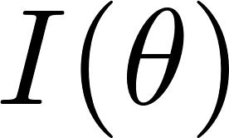
Cramer Rao Lower Bound|
Can also derive multivariate case:
Where is called the Fisher Information Matrix
Arun Das | Waterloo Autonomous Vehicles Lab

Slide 8
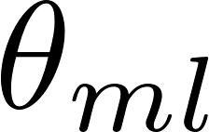
Cramer Rao Lower Bound| Graphical Interpretation
Arun Das | Waterloo Autonomous Vehicles Lab

Slide 9
Cramer Rao Lower Bound| Graphical Interpretation
More sharpness
Less Variance
High Information
Less sharpness
High Variance
Lower Information
Arun Das | Waterloo Autonomous Vehicles Lab

Slide 10
CRLB| Graphical Interpretation
Estimator Variance has inverse relationship to curvature of log likelihood!
Arun Das | Waterloo Autonomous Vehicles Lab

Slide 11
Linear Least Squares| Problem Setup
Suppose we have an overdetermined system of equations
Measurement Model
State
Measurements
Arun Das | Waterloo Autonomous Vehicles Lab

Slide 12
Linear Least Squares| Problem Setup
No exact solution, so we want to define a cost function that
allows us to best fit the model to the data
Arun Das | Waterloo Autonomous Vehicles Lab

Slide 13
Linear Least Squares| Problem Setup
No exact solution, so we want to define a cost function that
allows us to best fit the model to the data
Let’s pick squared deviation of the measurements from the
modelled measurements
Arun Das | Waterloo Autonomous Vehicles Lab

Slide 14
Linear Least Squares| Solution
Expanding out the quadratic term:
Note that:
and is scalar. Thus:
Arun Das | Waterloo Autonomous Vehicles Lab

Slide 15
Linear Least Squares| Solution
Take derivative and set equal to zero:
Result is least-squares normal equations
Arun Das | Waterloo Autonomous Vehicles Lab

Slide 16
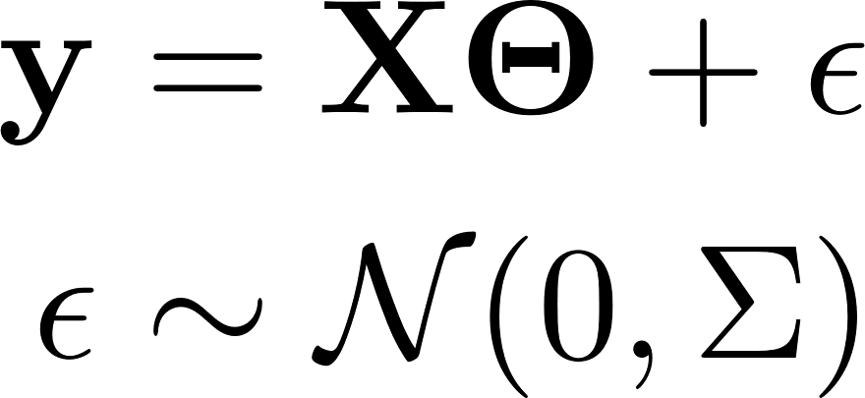
Linear Least Squares| Connection to Maximum Likelihood
Recall maximum likelihood:
We can model the measurements as follows:
Which gives us the following likelihood function we want to maximize
Arun Das | Waterloo Autonomous Vehicles Lab

Slide 17
Linear Least Squares| Connection to Maximum Likelihood
Which gives us the following likelihood function we want to maximize
Maximizing the above is equivalent to minimizing:
Arun Das | Waterloo Autonomous Vehicles Lab

Slide 18
Linear Least Squares| Connection to Maximum Likelihood
Which gives us the following likelihood function we want to maximize
Maximizing the above is equivalent to minimizing:
Which is also our quadratic (weighted) least squares cost!
So, for Gaussian Likelihood, the least squares estimate is also the
maximum likelihood estimate!
Arun Das | Waterloo Autonomous Vehicles Lab

Slide 19
Linear Least Squares| Linear Least Squares and CRLB
Possible to show that the Least Squares estimate is efficient,
with information matrix:
Arun Das | Waterloo Autonomous Vehicles Lab

Slide 20
Homework|
Show that these two forms of the CRLB are equivalent
Arun Das | Waterloo Autonomous Vehicles Lab

