Slide 1

Review of
Computer Vision
Techniques
Jason Rebello
16/05/2017
Jason Rebello | Waterloo Autonomous Vehicles Lab

Slide 2
Outline |
Part I : What is Computer Vision and how is an image formed
Part || : Feature Detection and Feature Matching
Part ||| : Feature Tracking and Prediction
Part IV : Applications (Bag Of Words)
Jason Rebello | Waterloo Autonomous Vehicles Lab

Slide 3
Part I |
What is Computer Vision and How is an Image Formed
Jason Rebello | Waterloo Autonomous Vehicles Lab

Slide 4
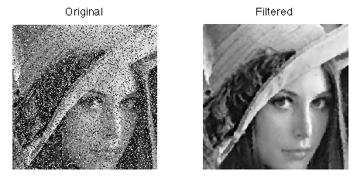
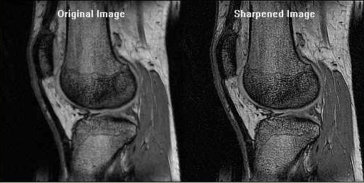
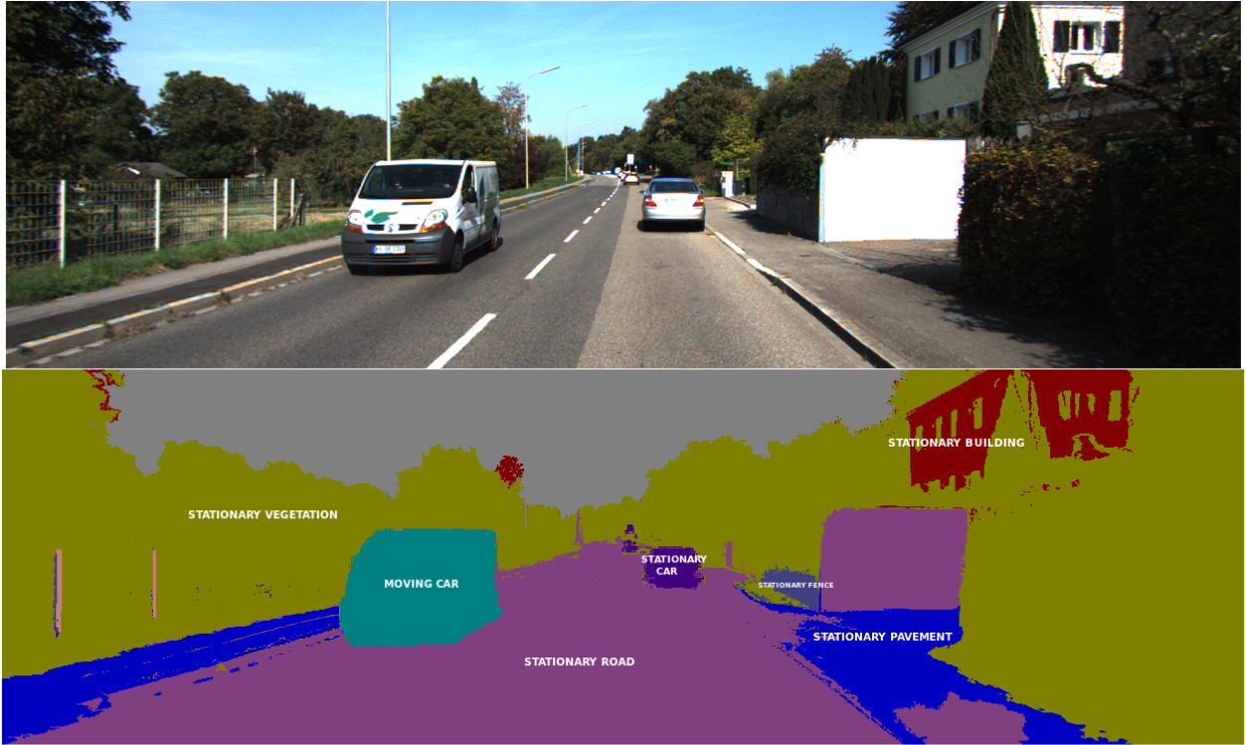
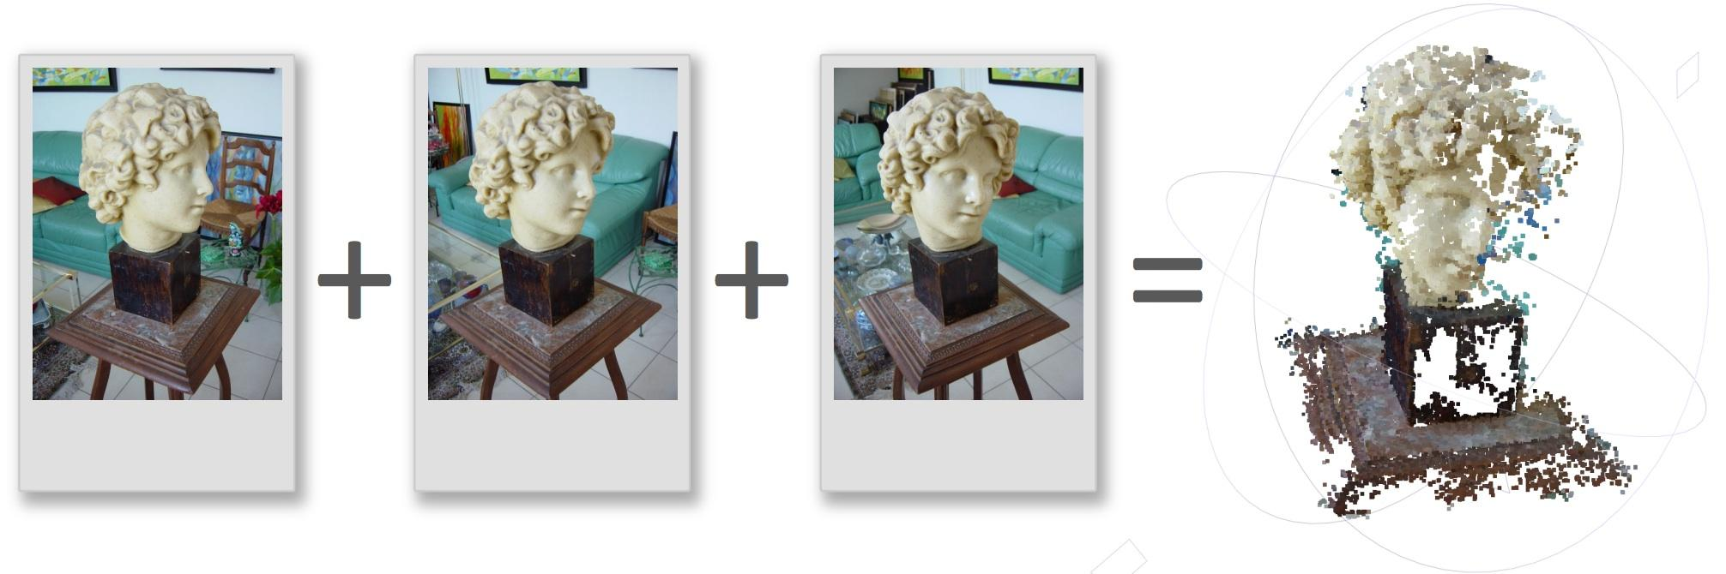
Introduction |
Image Processing: Image Manipulation (Motion compensation, Filtering)
Noise Removal
Image Sharpening
Computer Vision: Scene Interpretation
Semantic Segmentation
3D Reconstruction
Jason Rebello | Waterloo Autonomous Vehicles Lab

Slide 5
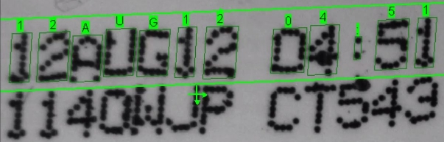
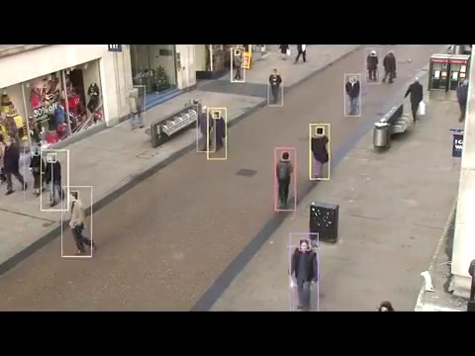
Introduction | Computer Vision systems
Optical Character Recognition
Autonomous driving Source: Tesla
Structure from Motion Source: DrCalleOlsson
Surveillance Source: Ben Benfold & Ian Reid
Jason Rebello | Waterloo Autonomous Vehicles Lab

Slide 6
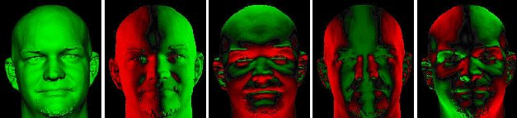
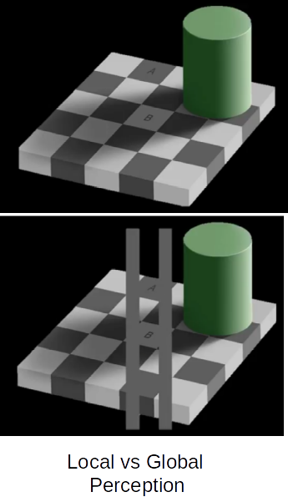
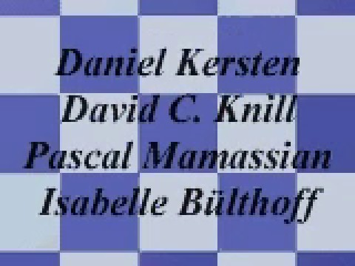
Introduction | Computer Vision is hard
Shadow Effects
Motion from shadows
Source: Dan Kersten
Jason Rebello | Waterloo Autonomous Vehicles Lab

Slide 7
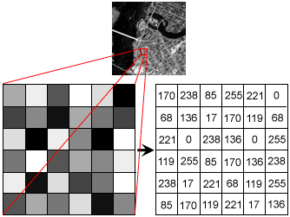
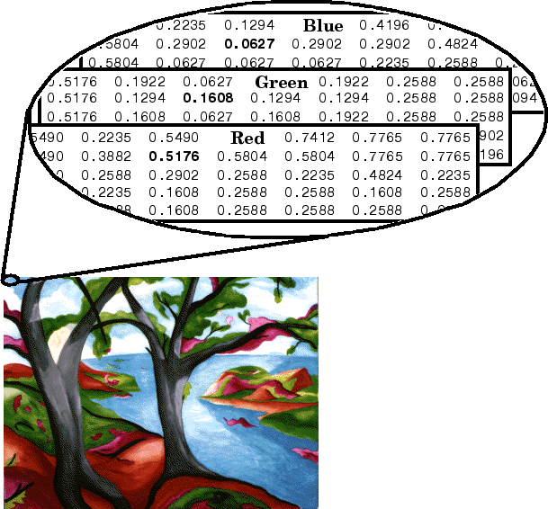
Introduction | Image Representations
Gray Scale
Colour Image
Images are thought of Functions
Images:
Sample 2D space
Quantize Intensity
Noise is another function combined with original function
Salt and Pepper Noise
Jason Rebello | Waterloo Autonomous Vehicles Lab

Slide 8
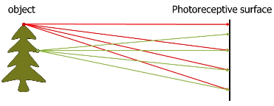
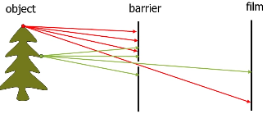
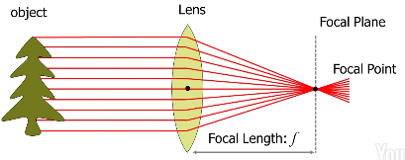
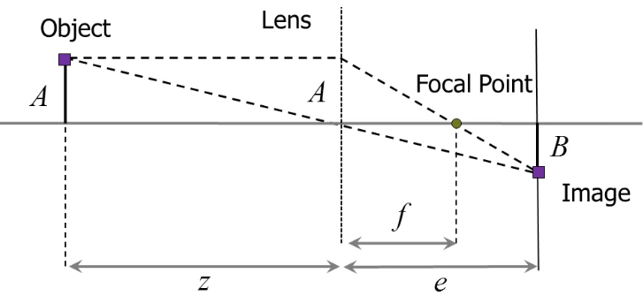

Image Formation | Cameras and Lenses
No Aperture
Single Ray: Dim Image, Diffraction
Lens: Multiple Light Rays
Thin Lens Diagram
Thin Lens Equation
Source: Scaramuzza, AMRx
Jason Rebello | Waterloo Autonomous Vehicles Lab

Slide 9
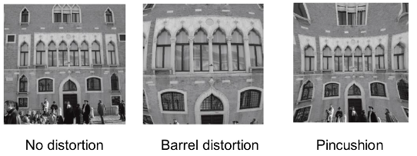
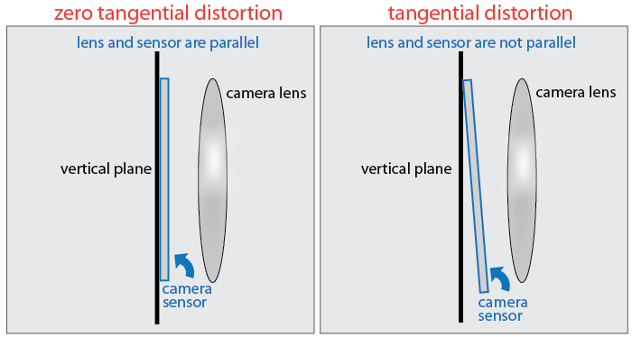
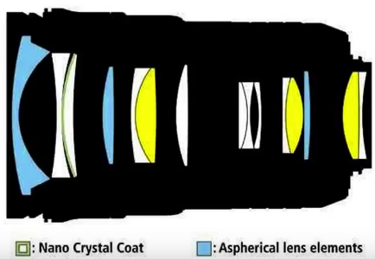
Image Formation | Distortions
Radial Distortion
Source: Scaramuzza
Tangential Distortion
Source: MathWorks
Nikon Lens System
Source: Aaron Bobik
Jason Rebello | Waterloo Autonomous Vehicles Lab

Slide 10
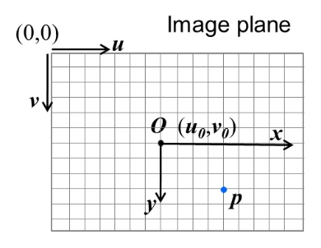
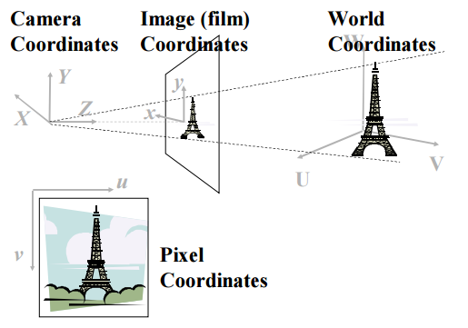
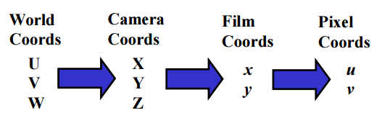
Image Formation | Projection pipeline
Forward Projection
Image to Pixel Coordinates
(a)
(b)
(c)
Source: Robert Collins, CSE486
Jason Rebello | Waterloo Autonomous Vehicles Lab

Slide 11

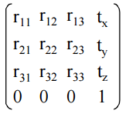

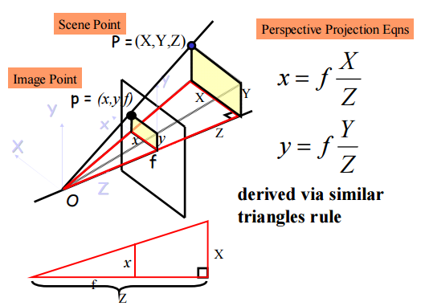
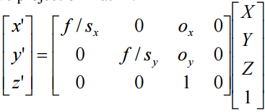

Image Formation | Camera Parameters
Extrinsic Transformation (Rotation + Translation)
Transforms points from
World to Camera coordinate
Frame
Homogeneous coordinates
allow for easy matrix multiplication
(b),(c) Perspective Projection
Camera Coordinates
Pixel Coordinates
Source: Robert Collins, CSE486
Jason Rebello | Waterloo Autonomous Vehicles Lab

Slide 12

End of Part I |
Jason Rebello | Waterloo Autonomous Vehicles Lab

Slide 13
Part II |
Feature Detection and
Feature Matching
Jason Rebello | Waterloo Autonomous Vehicles Lab

Slide 14
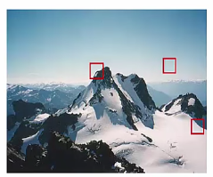
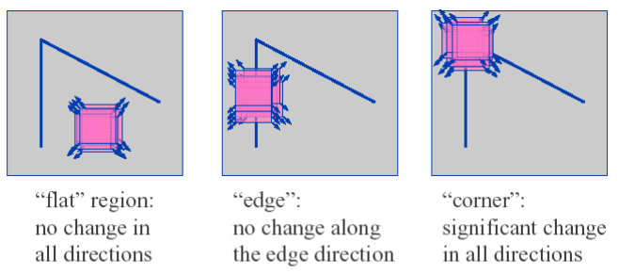

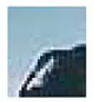
Feature Detectors |
Need to find reliably detectable and discriminable locations in images
Repeatability ( Across images )
Precise ( Location )
Saliency ( Distinctive description )
Compactness ( Few features )
Locality ( Size of descriptor region)
Source: Mubarak Shah
Jason Rebello | Waterloo Autonomous Vehicles Lab
Notes:
What makes a corner good ? Why dont we use edges

Slide 15
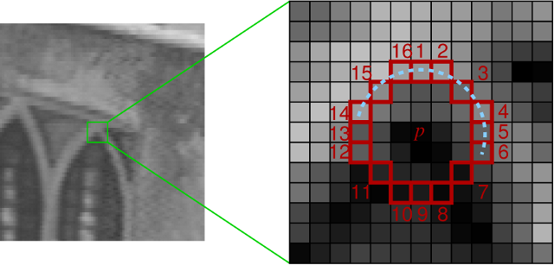
Feature Detectors | FAST corner detector
Let ‘P’ be point of interest
Select threshold ‘t’
Consider 16 pixels around
Point ‘P’
‘P’ is a corner if ‘n’ consecutive pixels with corresponding intensity greater or less than intensity of ‘P’ exist
Shi-Tomasi, GFTT, BRIEF, SURF, SIFT
Features from Accelerated Segment Test
Source: OpenCV
Jason Rebello | Waterloo Autonomous Vehicles Lab

Slide 16
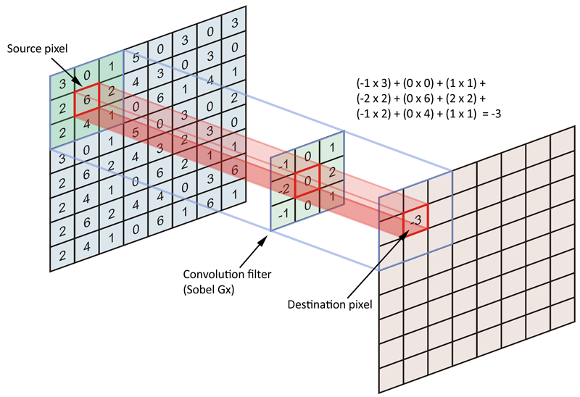





Feature Detectors | Harris Corner Detector
Image Convolution using Sobel Operator
Consider a grayscale image I. Calculate the variation in the gradient by sweeping a window in x and y direction
Approximation in matrix form
Determine Score for each window
Score using Eigen values
Jason Rebello | Waterloo Autonomous Vehicles Lab
Notes:
Harris corner and fast corner detector
Not invariant to scale, but invariant to rotation and intensity changes

Slide 17
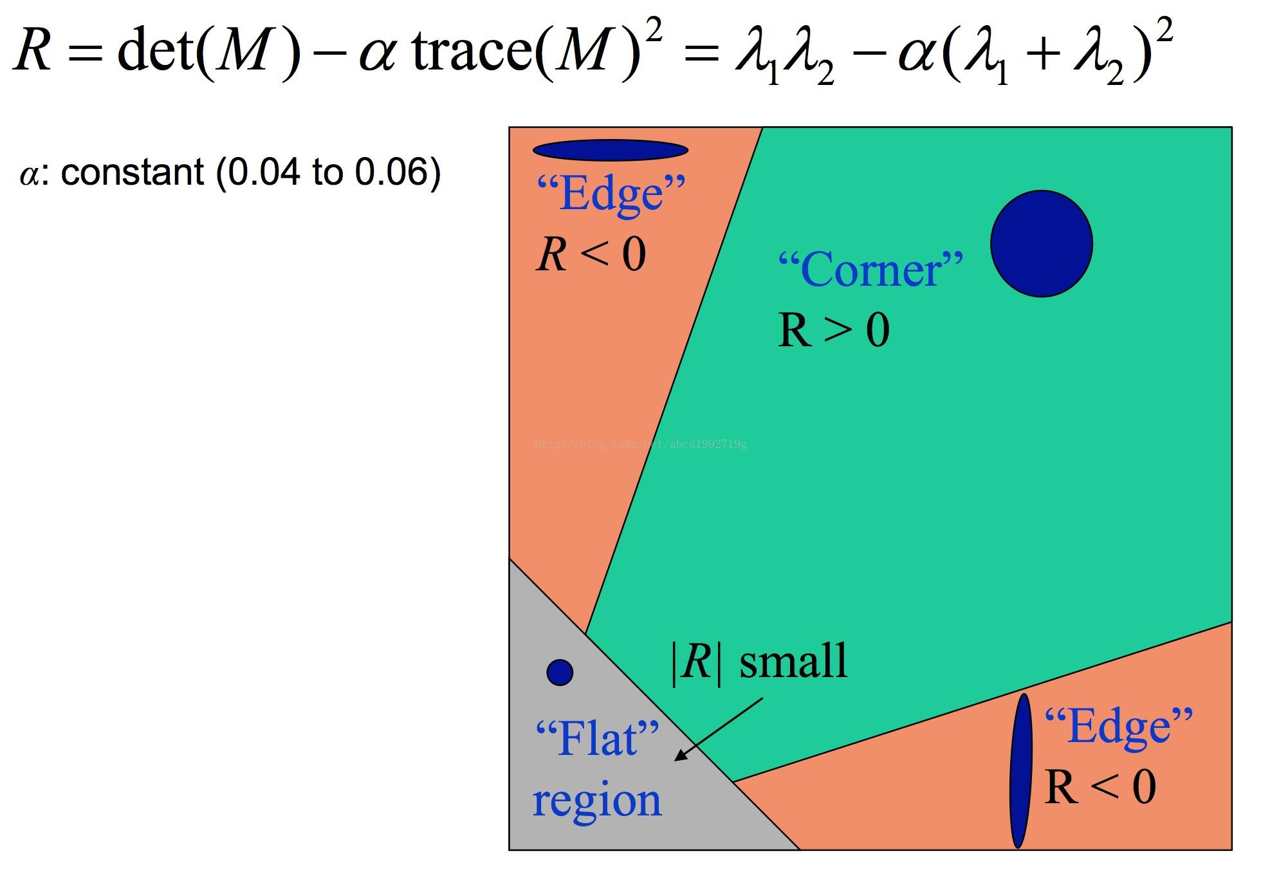
Feature Detectors | Harris Score Value
Jason Rebello | Waterloo Autonomous Vehicles Lab

Slide 18
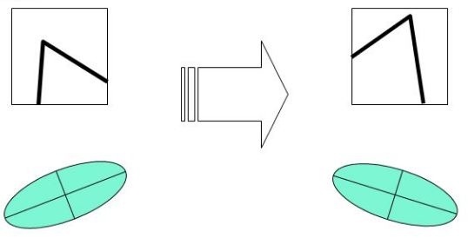
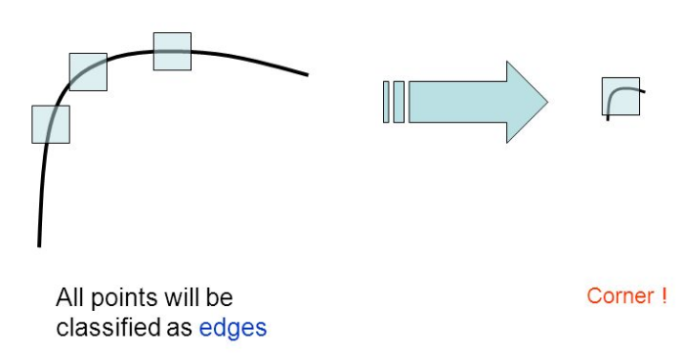
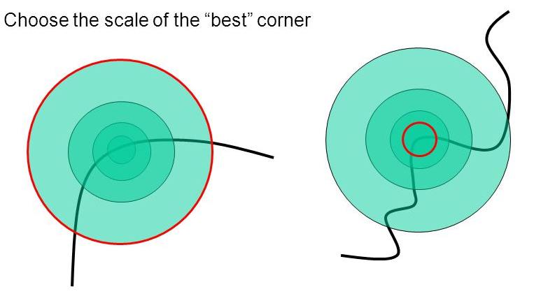
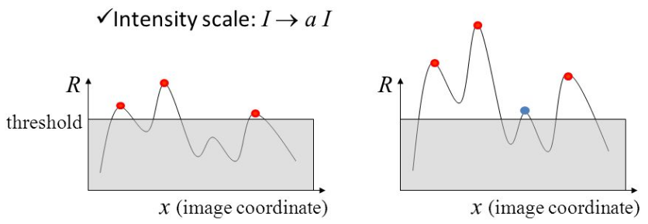
Feature Detectors | Harris Corner Properties
Rotation Invariant
Not Scale Invariant
Uniform Intensity Invariance
Scale Invariant Detection
Jason Rebello | Waterloo Autonomous Vehicles Lab

Slide 19
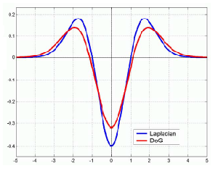
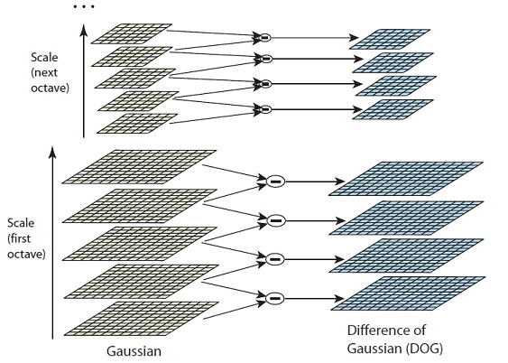
Feature Detectors | SIFT Detector
Laplacian of Gaussian vs
Difference of Gaussian
Scale Space Generation
Jason Rebello | Waterloo Autonomous Vehicles Lab

Slide 20
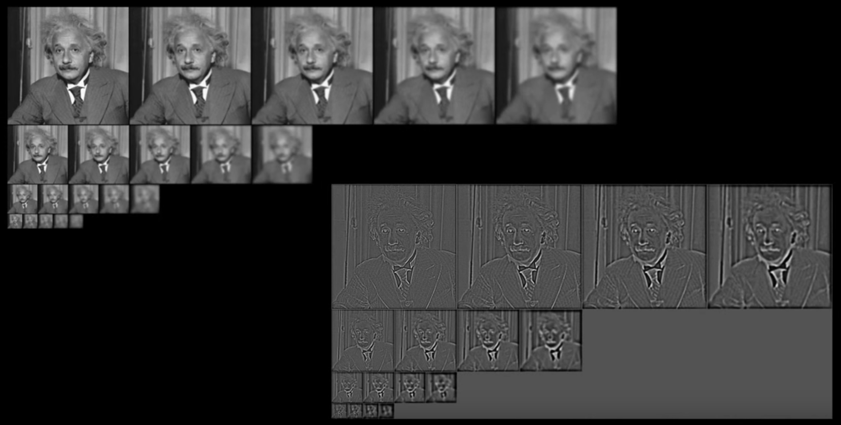
Feature Detectors | SIFT Detector
Extrema at different scales
Source: Aaron Bobik
Jason Rebello | Waterloo Autonomous Vehicles Lab

Slide 21
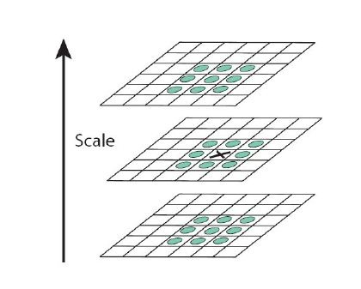
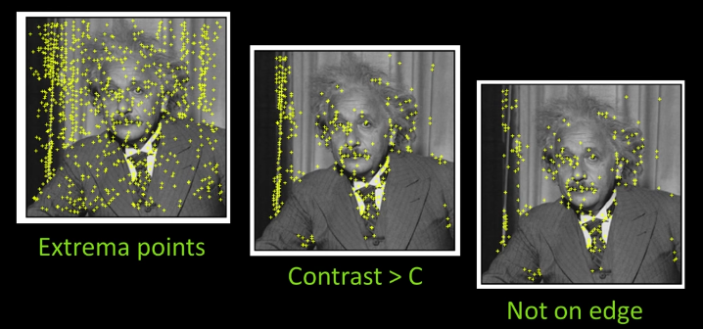
Feature Detectors | SIFT Detector
Find Maxima in Scale Space
SIFT Feature Points
Source: Aaron Bobik
Jason Rebello | Waterloo Autonomous Vehicles Lab

Slide 22
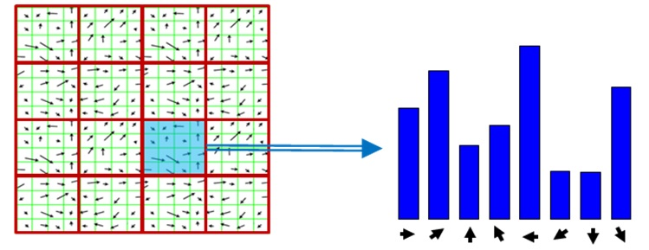
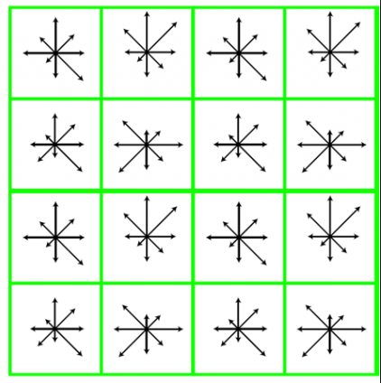
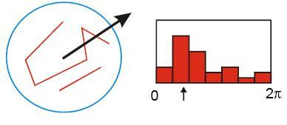
Feature Descriptors | SIFT Descriptor
Find Gradients of image patch
Get Dominant Orientation using 36 bins and applying gaussian weighting.
Highest Peak is dominant orientation
Take 16x16 region around Keypoint and rotate to dominant orientation
Divide into 16 sub-blocks of 4x4 and create orientation histogram with 8 bins
Stack histogram to get 128 Dimensional Descriptor
Histogram Orientation
Dominant Orientation
128 Dimensional Descriptor
Jason Rebello | Waterloo Autonomous Vehicles Lab

Slide 23
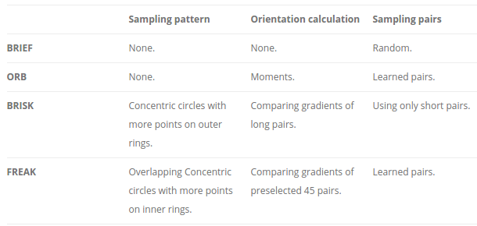
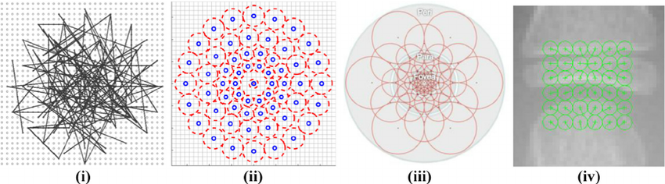
Feature Descriptors | Descriptor Comparison
(i) BRIEF
(ii) BRISK
(iii) FREAK
Source: Gil
Jason Rebello | Waterloo Autonomous Vehicles Lab

Slide 24

Questions |
Jason Rebello | Waterloo Autonomous Vehicles Lab

Slide 25
Part III |
Feature Tracking
and Prediction
Jason Rebello | Waterloo Autonomous Vehicles Lab

Slide 26
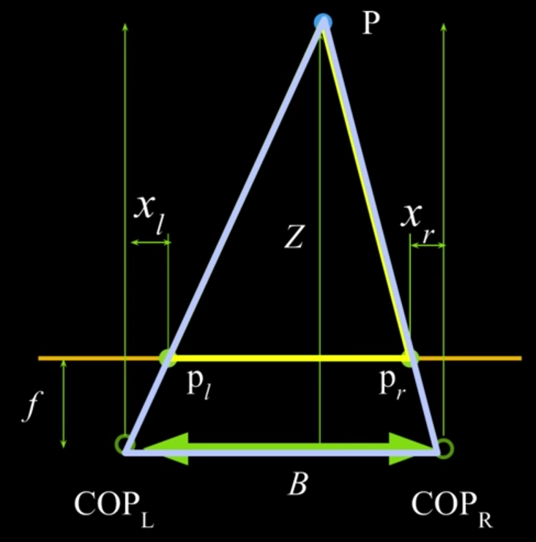
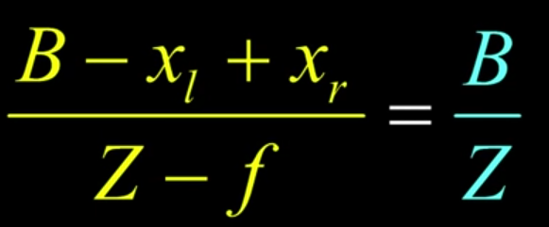
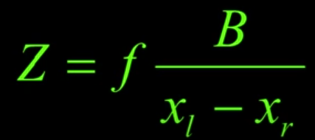
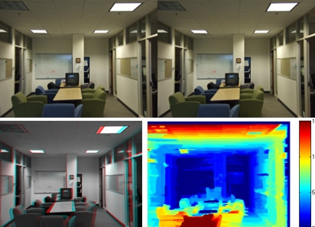
Stereo Vision |
X_{l} - X_{r} = disparity
Source: Aaron Bobik
Jason Rebello | Waterloo Autonomous Vehicles Lab

Slide 27
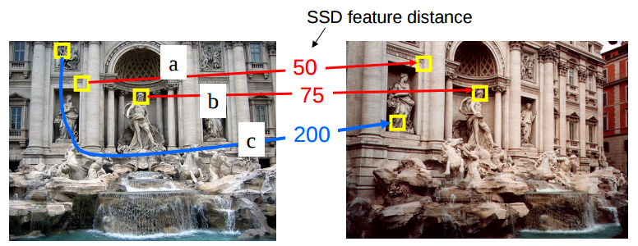
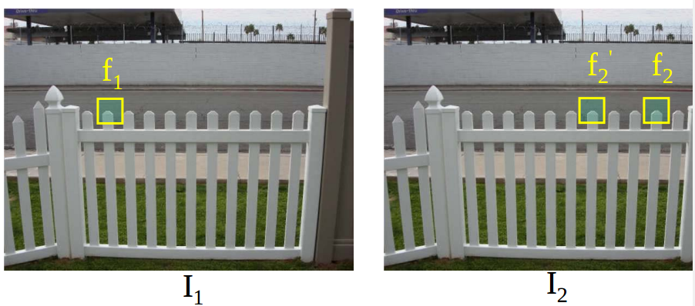
Feature Matching | SSD
Sum of Square differences between two descriptors f₁ and f₂
What value of threshold to use ?
How to resolve ambiguous matches ? Ratio distance = SSD(f₁,f₂) / SSD(f₁,f’₂)
Ambiguous matches will have ratio close to 1
Jason Rebello | Waterloo Autonomous Vehicles Lab

Slide 28




Feature Tracking | Optical Flow
Determine apparent motion of object in consecutive frames
Given pixel in I(x,y,t), find nearby pixels of same intensity in I(x,y,t+1)
Brightness Constancy Constraint:
Small Motion Constraint:
Source: Aaron Bobik
Jason Rebello | Waterloo Autonomous Vehicles Lab

Slide 29



Feature Tracking | KLT
I_{x} I_{y} are space image derivatives
I_{t} is time image derivative
u v are unknowns
Optical Flow Equation
5x5 window gives 25 equations per pixel.
Solution: d = (A^{T}A)⁻¹A^{T}b
Source: Aaron Bobik
Jason Rebello | Waterloo Autonomous Vehicles Lab

Slide 30

Feature Prediction | Parallel image planes
Sum of Squared Differences :
What if the image planes weren’t parallel ?
Jason Rebello | Waterloo Autonomous Vehicles Lab

Slide 31


Feature Prediction | Epipolar Geometry
Lines project to lines in the image
All epipolar lines intersect at epipole
One dimensional search for correspondence
Parallel image planes have epipole at infinity
Jason Rebello | Waterloo Autonomous Vehicles Lab

Slide 32


Epipolar Geometry | Essential Matrix
Source: Aaron Bobik
Jason Rebello | Waterloo Autonomous Vehicles Lab

Slide 33



Epipolar Geometry | Fundamental matrix
Calculate F from minimum
8 correspondences
Source: Aaron Bobik
Jason Rebello | Waterloo Autonomous Vehicles Lab

Slide 34





Epipolar Geometry | Fundamental Matrix
Source: Aaron Bobik
Jason Rebello | Waterloo Autonomous Vehicles Lab

Slide 35



Correspondence Problem | Why is it hard
Window Size
Occlusion
Narrow occluding surface ( Ordering problems)
Source: Aaron Bobik
Jason Rebello | Waterloo Autonomous Vehicles Lab

Slide 36

Questions |
Jason Rebello | Waterloo Autonomous Vehicles Lab

Slide 37
Part IV |
Bag of Words
Jason Rebello | Waterloo Autonomous Vehicles Lab

Slide 38




Place Recognition | Overview
Source: Margarita Chli
Jason Rebello | Waterloo Autonomous Vehicles Lab

Slide 39


Place Recognition | Creating feature space
Extract Features using SIFT descriptor
Hierarchical Clustering to get Visual Words
Source: Margarita Chli
Jason Rebello | Waterloo Autonomous Vehicles Lab

Slide 40

Place Recognition | Training Images
Pass each image through Vocabulary Tree
Get Visual words based on features of image
Use inverted file index (Visual word to image mapping) for quick test time
Source: Margarita Chli
Jason Rebello | Waterloo Autonomous Vehicles Lab

Slide 41


Place Recognition | Test Image
Extract Features from Test Image
Find corresponding Visual Words
Determine closest match
Source: Margarita Chli
Jason Rebello | Waterloo Autonomous Vehicles Lab

Slide 42

Questions |
Jason Rebello | Waterloo Autonomous Vehicles Lab

Slide 43
Homework |
Read and Summarize:
SURF Detector and Descriptor
ORB Detector and Descriptor
Jason Rebello | Waterloo Autonomous Vehicles Lab

Slide 44


SURF Detector | Integral Image
Create: 16 + 12 - 7 + 3 = 24
Create: 16 + 23 - 13 + 6 = 32
Query: 64 + 16 - 32 - 32 = 16
same as 6+5+3+2 = 16
Jason Rebello | Waterloo Autonomous Vehicles Lab

Slide 45





SURF Detector | Speeded Up Robust Features
Gaussian Partial Derivatives
Scale space analysis
L_{yy}
L_{xy}
D_{yy}
D_{xy}
Box Filter Approximations
Hessian Matrix and Determinant
Jason Rebello | Waterloo Autonomous Vehicles Lab

Slide 46




SURF Descriptor |
Each patch is 4 dimensional vector
16 Patches give 64 Dimensional Vector
Sign of Hessian Matrix for black vs white blobs
Haar Wavelets
SURF Descriptor
Dominant Orientation
Black vs White blobs
Jason Rebello | Waterloo Autonomous Vehicles Lab

Slide 47

ORB Detector | Oriented fast and Robust Brief
FAST corner Detector
Harris Corner Measure
FAST detected at multiple levels in the Pyramid for Scale Invariance
BRIEF: Binary Robust Independent Elementary Features
Random Selection of pairs of Intensity Values
Fixed sampling Pattern of 128, 256 or 512 pairs
Hamming Distance to compare descriptors (XOR)
Jason Rebello | Waterloo Autonomous Vehicles Lab

Slide 48





ORB Descriptor |
Learning the paris
Patch moments
Center of Mass
300K Keypoints
205590 Possible Tests
256 dimensional descriptor
Orientation
Angle Calculation
Jason Rebello | Waterloo Autonomous Vehicles Lab

