Slide 1

Differential Calculus of 3D Orientations
Arun Das
05/15/2017
Arun Das | Waterloo Autonomous Vehicles Lab

Slide 2
Outline | Papers and Books
Quick Review of Lie Groups
Box-plus and Box-minus
Derivatives of Rotations (A Primer on the Differential Calculus of 3D
Orientations, Bloesch et al.)
  Derivations on the board
Uncertainty of rotations and rotated vectors (State Estimation for Robotics, Barfoot)
Arun Das | Waterloo Autonomous Vehicles Lab

Slide 3
Motivation | Nonlinear Least Squares
Where J is the Jacobian of the residual term
Important to be able to get analytical Jacobians for our residual terms!
Arun Das | Waterloo Autonomous Vehicles Lab

Slide 4


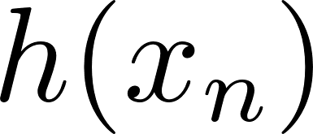



Motivation | Re-projection Error Example
re-projection error
predicted meas.
actual meas.
How do we do re-projection?
Arun Das | Waterloo Autonomous Vehicles Lab

Slide 5
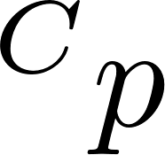
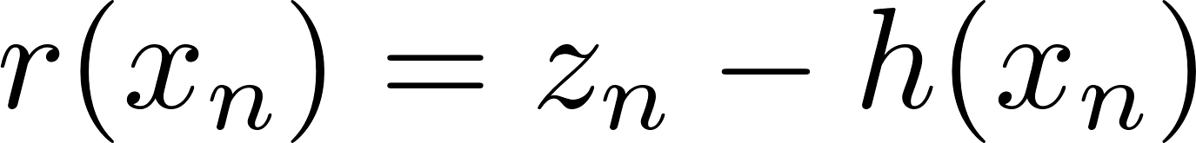
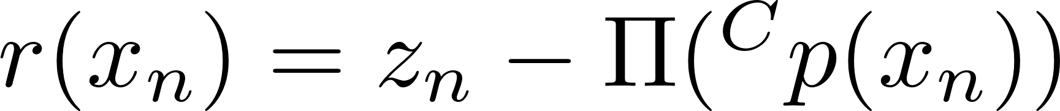
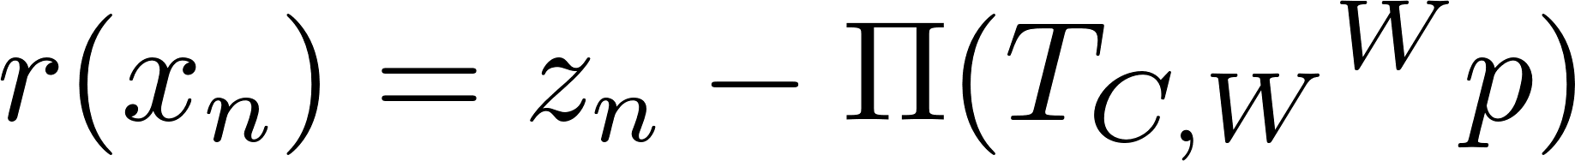
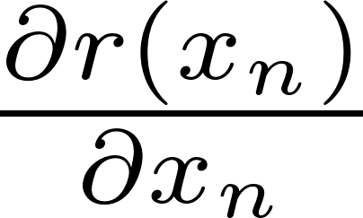
Motivation | Re-projection Error Example
re-projection error
predicted meas.
actual meas.
What is ?
Remember that is a pose!
Need to use chain rule!
Arun Das | Waterloo Autonomous Vehicles Lab

Slide 6
Review | Group Properties
Composition:
Identity:
Inverse:
Arun Das | Waterloo Autonomous Vehicles Lab

Slide 7
Review| Rotations – Exponential Map
Lie Group SO(3)
Lie Algebra so(3)
State Vector
Parameter Estimate
Exp. Map
Log Map
Arun Das| Waterloo Autonomous Vehicles Lab

Slide 8
Notation |
- A vector from B to C, expressed in frame A
- A rotation that maps points from frame A to frame B
- Co-ordinate mapping
- Dropping Subscripts
- Extraction of the Rotation matrix
Arun Das | Waterloo Autonomous Vehicles Lab

Slide 9
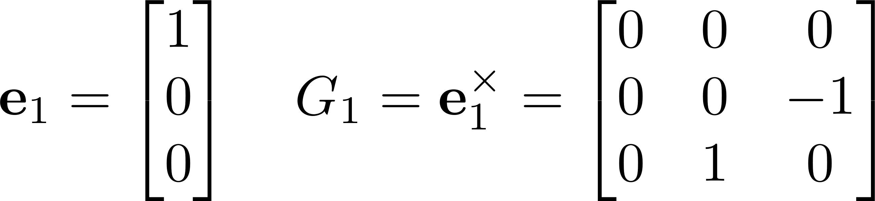
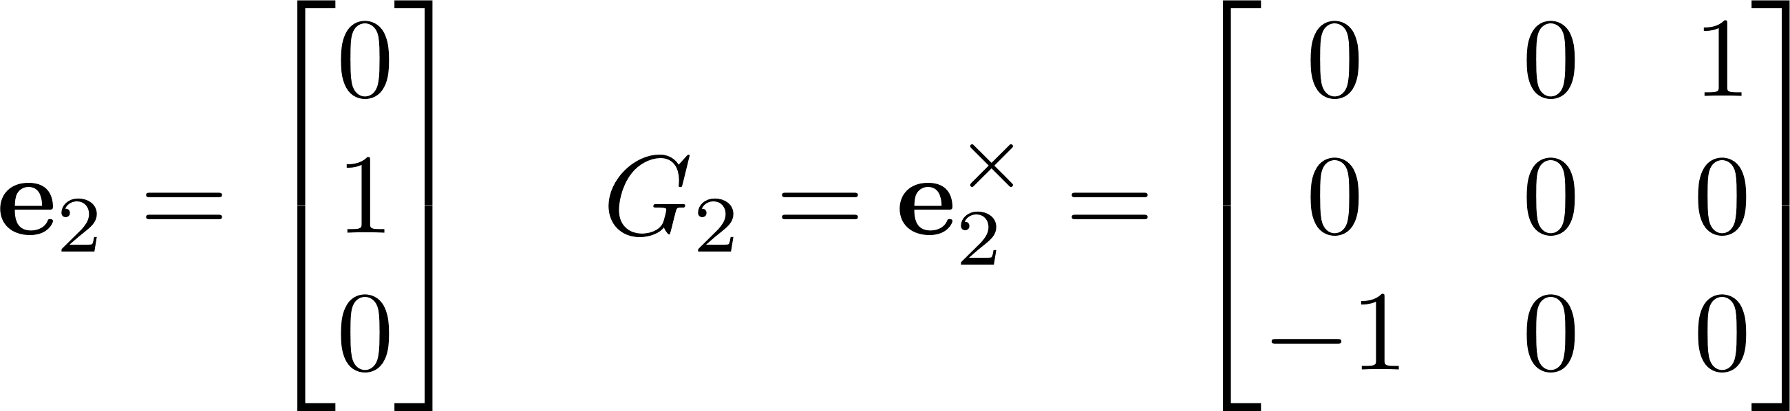
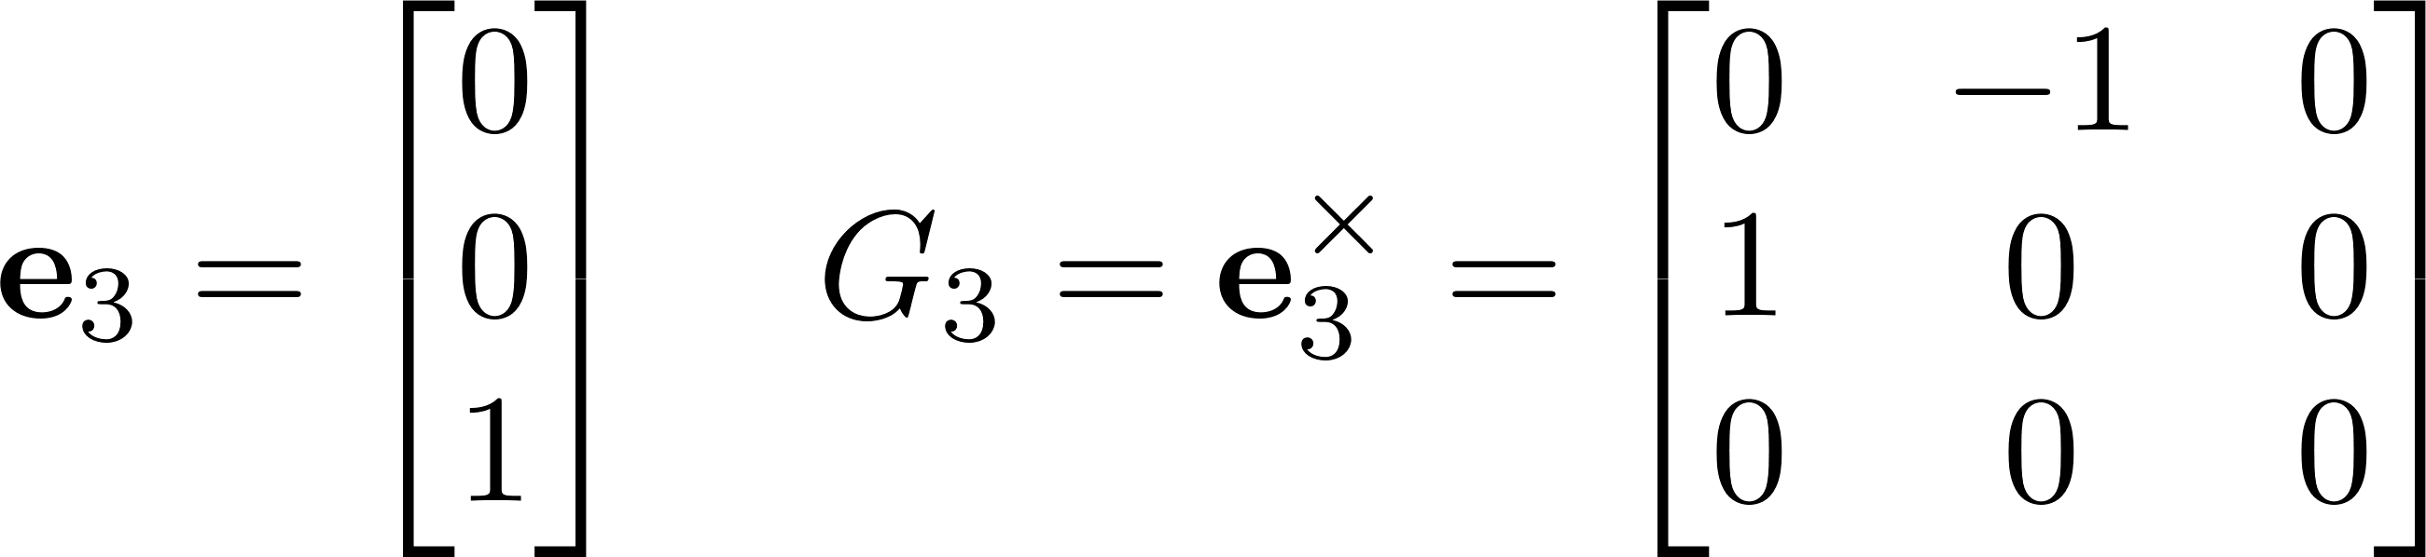
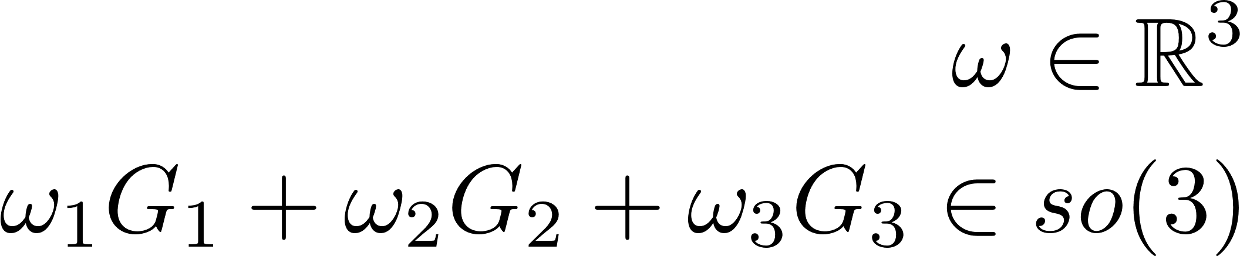

Lie Algebra| Generators
Recall we have basis vectors $e_{i}$ which in skew symmetric form are Generators for SO(3)
Arun Das | Waterloo Autonomous Vehicles Lab

Slide 10
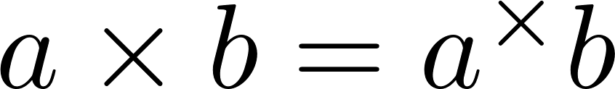
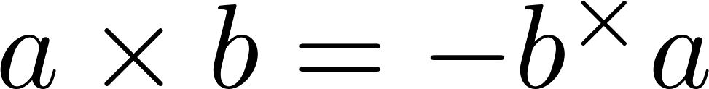
Skew Symmetric Matrices| Properties
Skew symmetric matrices have certain properties:
The vector cross product can be written using skew symmetric matrices. Note that the cross product is anticommutative :
Arun Das | Waterloo Autonomous Vehicles Lab

Slide 11
Manifold Addition | Box Plus/Minus
Specific implementation for SO(3), let’s go through it on the board
Arun Das | Waterloo Autonomous Vehicles Lab

Slide 12
Manifold Addition | Box Plus/Minus
Specific implementation for SO(3), let’s go through it on the board
Arun Das | Waterloo Autonomous Vehicles Lab

Slide 13
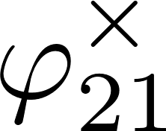

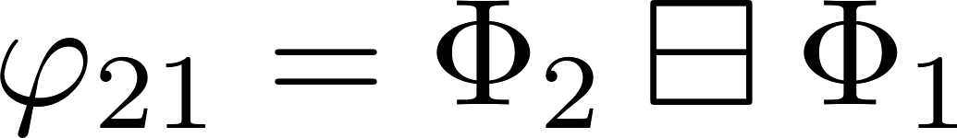

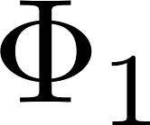
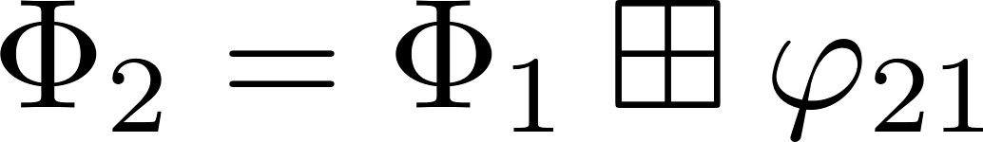

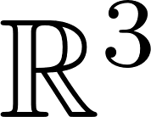
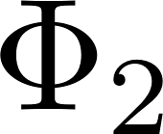
Manifold Addition | Box Plus/Minus - Picture
Box-plus
Box-Minus
Physical World
Arun Das | Waterloo Autonomous Vehicles Lab

Slide 14

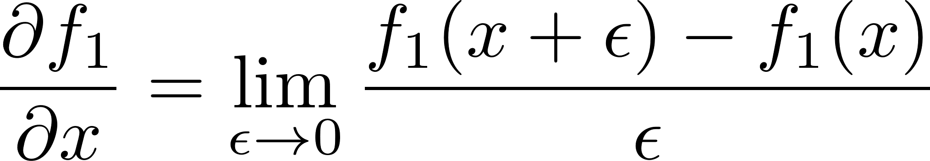
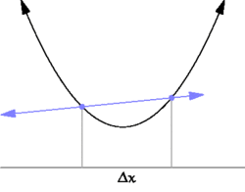
Differential Calculus| Easy Case
Fairly simple to take the derivative of a function using the first principles definition:
Arun Das | Waterloo Autonomous Vehicles Lab

Slide 15
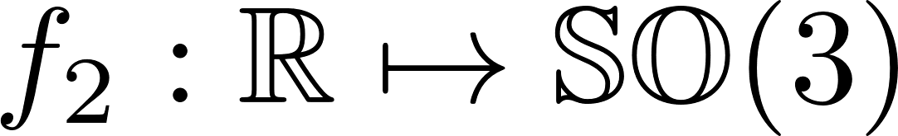
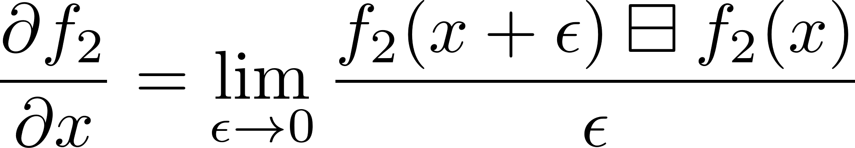
Differential Calculus| Function Image on Manifold
When the function image is a manifold quantity, perform something similar to the easy case, except use box-minus to subtract group elements:
Arun Das | Waterloo Autonomous Vehicles Lab

Slide 16
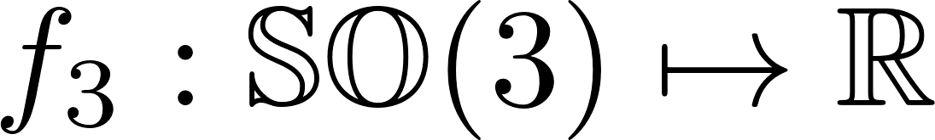
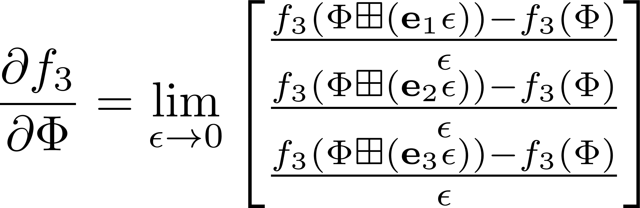
Differential Calculus| Function Domain on Manifold
When the function domain is a manifold quantity, perform something similar to the previous case, except use box-plus for the function arguments:
Arun Das | Waterloo Autonomous Vehicles Lab

Slide 17
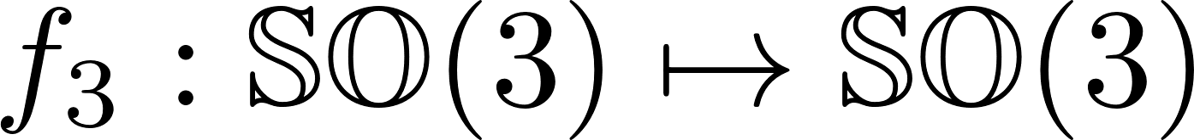
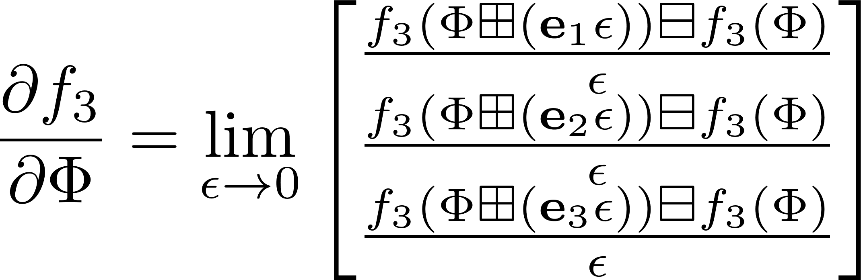
Differential Calculus| Function Domain and Image on Manifold
When the function domain and image is a manifold quantity, perform something similar to the previous case, except use box-minus and box-plus:
Arun Das | Waterloo Autonomous Vehicles Lab

Slide 18
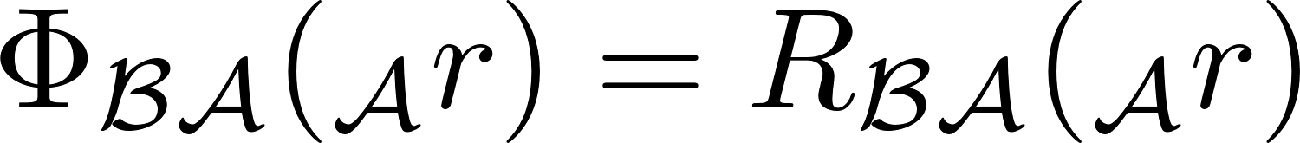
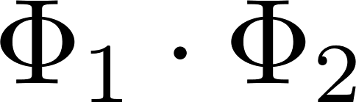
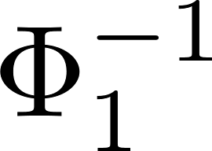
Differential Calculus| Elemental Operations
Co-ordinate Mapping:
Composition:
Inverse:
We can build many residual functions just using these operations!
Arun Das | Waterloo Autonomous Vehicles Lab

Slide 19

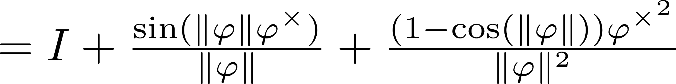
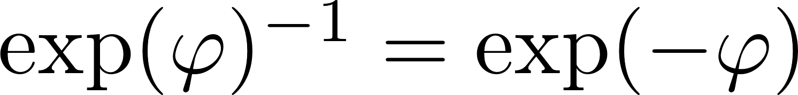
Differential Calculus| Important Expressions
(1) Box-plus and box-minus
(2) Rodriguez Formula
(3) Inverse Identity
(4) Adjoint Related Identity
(5) anticommutative
Arun Das | Waterloo Autonomous Vehicles Lab

Slide 20
Differential Calculus| Derivative of Co-ordinate Map
Arun Das | Waterloo Autonomous Vehicles Lab

Slide 21
Differential Calculus| Derivative of Co-ordinate Map
Arun Das | Waterloo Autonomous Vehicles Lab

Slide 22
Differential Calculus| Derivative of Composition (w.r.t Left Element)
Arun Das | Waterloo Autonomous Vehicles Lab

Slide 23
Differential Calculus| Derivative of Composition (w.r.t Left Element)
Arun Das | Waterloo Autonomous Vehicles Lab

Slide 24
Differential Calculus| Derivative of Composition (w.r.t Right Element)
Arun Das | Waterloo Autonomous Vehicles Lab

Slide 25
Differential Calculus| Derivative of Composition (w.r.t Right Element)
Arun Das | Waterloo Autonomous Vehicles Lab

Slide 26
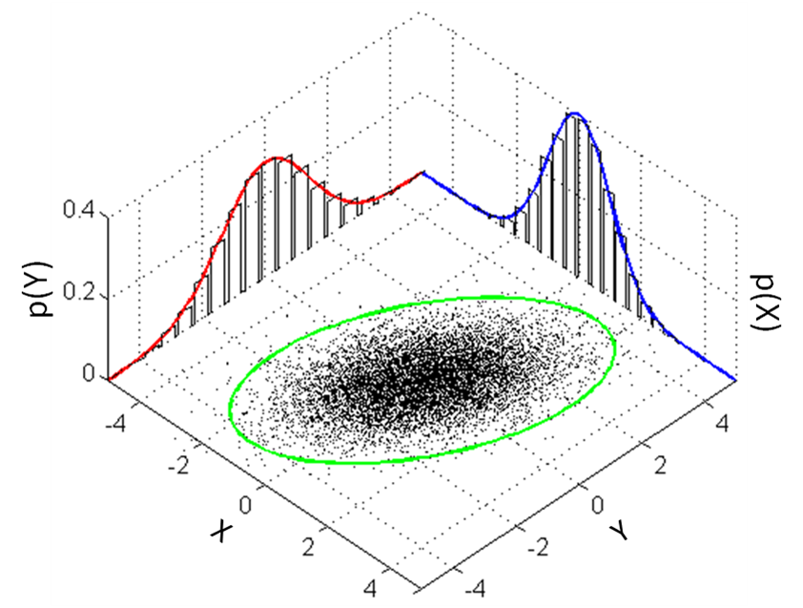
Uncertainty| Vector Space Case
Gaussian random variables take the form:
Often, we write them as some nominal value with zero mean noise:
This works because x lives in a vector space (closed under + ). What should we do for SO(3)?
Arun Das | Waterloo Autonomous Vehicles Lab

Slide 27
Uncertainty| Options for SO(3) and SE(3)
There are a few options for SO(3), either performing perturbations on the Lie Group, or the Lie Algebra:
Pros and cons?
Arun Das | Waterloo Autonomous Vehicles Lab

Slide 28
Uncertainty| Options for SO(3) and SE(3)
There are a few options for SO(3), either performing perturbations on the Lie Group, or the Lie Algebra:
Generally prefer perturbations in Lie Group to avoid singularities
Arun Das | Waterloo Autonomous Vehicles Lab

Slide 29
Uncertainty| Uncertainty of a Rotated Vector
Consider:
What does the distribution over y look like?
Arun Das | Waterloo Autonomous Vehicles Lab

Slide 30
Uncertainty| Uncertainty of a Rotated Vector - Diagram
Arun Das | Waterloo Autonomous Vehicles Lab

Slide 31
Uncertainty| Uncertainty of a Rotated Vector – Analytical Approximation
What about E[y]? We can perform an expansion of the exponential map term:
(Fourth order expansion)
Arun Das | Waterloo Autonomous Vehicles Lab

Slide 32
Homework|
Homework: Derive the following expression for the derivative of the inverse mapping
Arun Das | Waterloo Autonomous Vehicles Lab

