Slide 1

Rotations and Transformations
Arun Das and Steven Waslander
08/05/2017

Slide 2
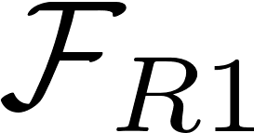
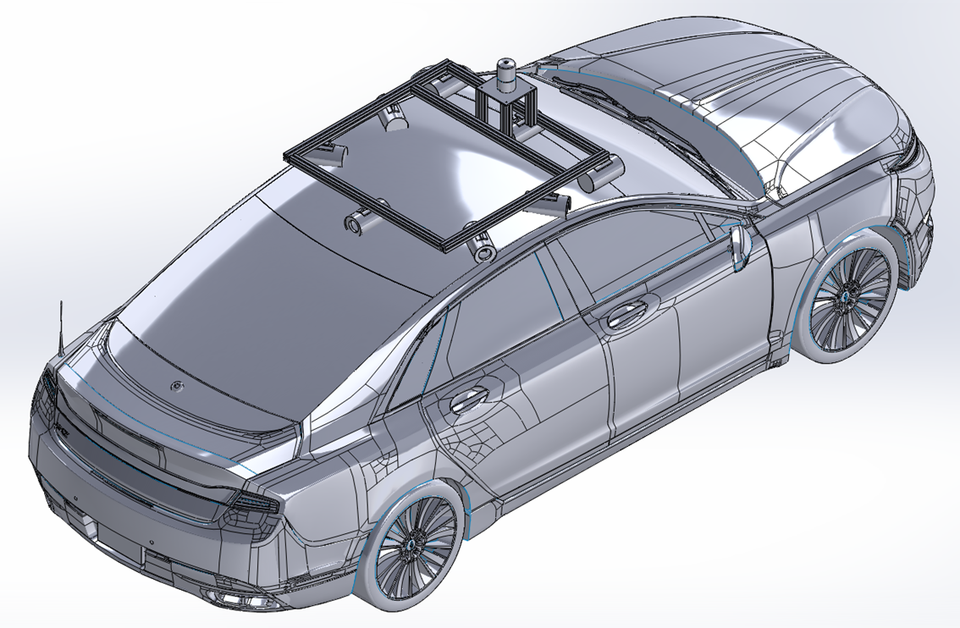



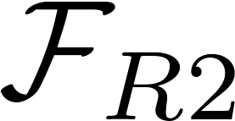

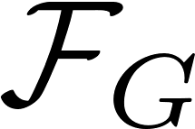



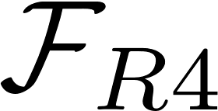
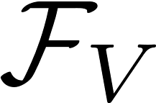
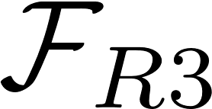

Transformations| Motivation
How do we map and analyze quantities between co-ordinate frames?
6 DOF, translation in space and rotation of coordinate axes

Slide 3
Kinematics Overview | Outline: Part 1
Mathematical Preliminaries
  Algebraic Structures
  Topological Spaces and Manifolds
  Matrix Lie Groups, SO(3) and SE(3)
Rotation Representations
    Euler Angles
    Quaternions
  Rotation Matrices
Transformations

Slide 4
Transformations| Mathematical Preliminaries
Transformations from one coordinate frame to another can be described using standard geometric structures
A brief intro to the definitions we will rely on, and what all the terms mean follows
This field works from first principles to define the minimum properties needed to create well known types of structures
  What are the minimum properties (axioms) to define integers, real numbers, etc.?
    Groups, Rings, Fields
    Vectors spaces
Warning! Needs further expansion and clarification

Slide 5
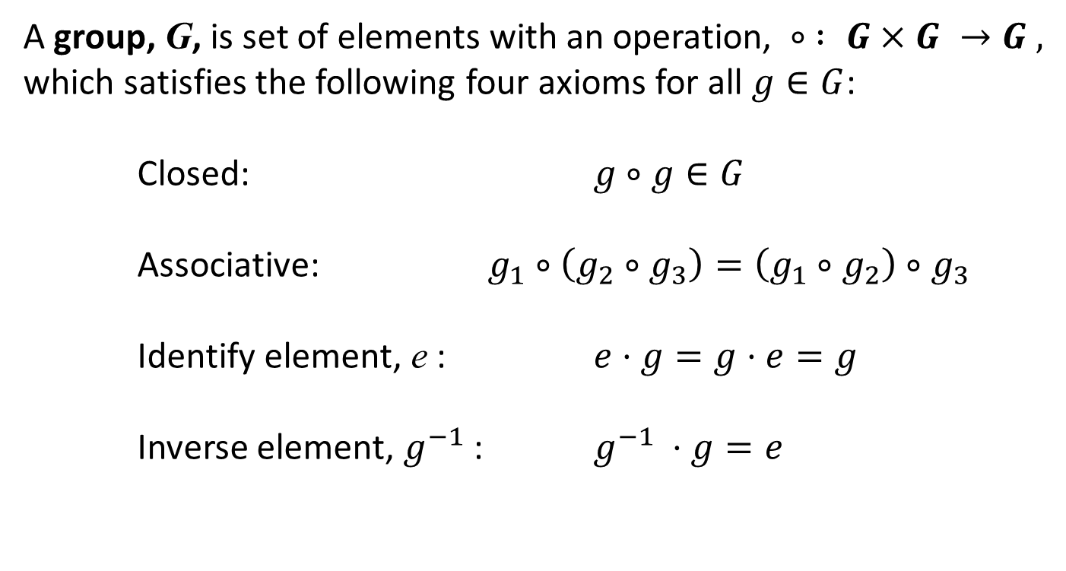
Transformations| Groups and Linear groups
A group, G, is set of elements with an operation, $∘ : G×G →G ,$
which satisfies the following four axioms for all $g∈G$:
Closed: $g∘g∈G$
Associative: $g_{1}∘\left(g_{2}∘g_{3}\right)=\left(g_{1}∘g_{2}\right)∘g_{3}$
Identify element, e : $e⋅g=g⋅e=g$
Inverse element, $g^{−1}$ : $g^{−1} ⋅g=e$

Slide 6
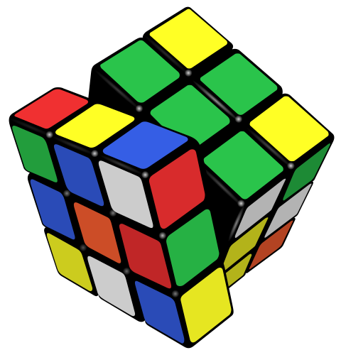
Transformations| Groups
Examples:
Integers under addition (not multiplication, no inverse)
a + b = c, e = 0, a⁻¹ = -a
Fractions under multiplication
Rubic’s cube patterns under rotations

Slide 7
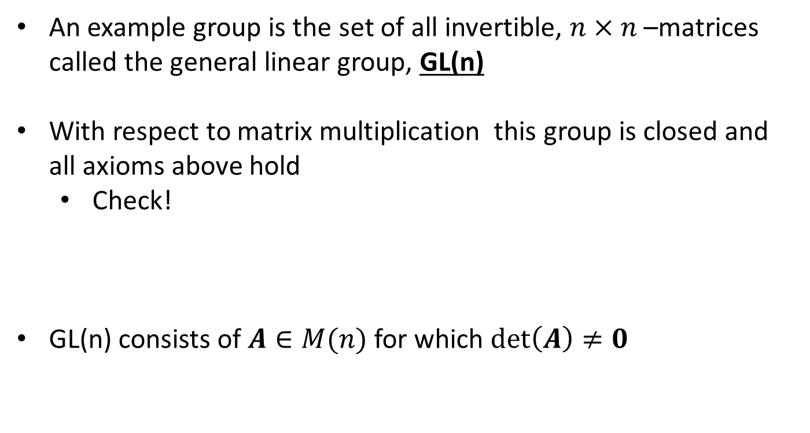
Transformations| General Linear Group
An example group is the set of all invertible, $n×n$–matrices called the general linear group, GL(n)
With respect to matrix multiplication this group is closed and all axioms above hold
  Check!
GL(n) consists of $A∈M(n)$ for which $\det\left(A\right)≠0$

Slide 8
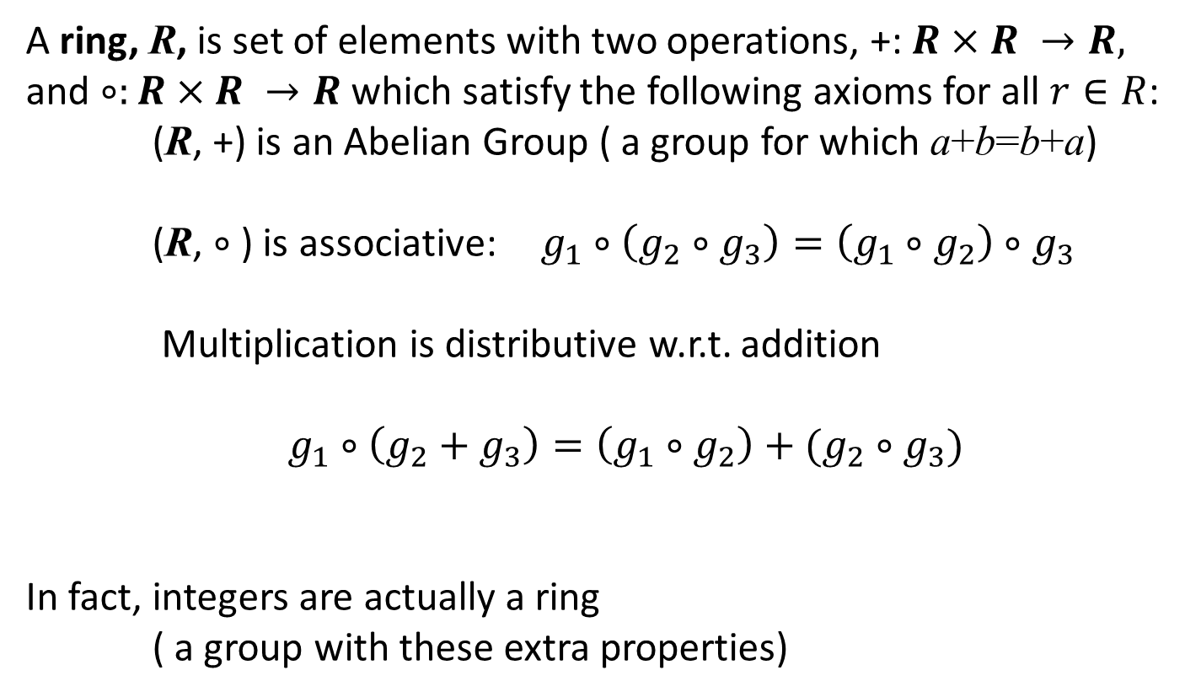
Transformations| Rings
A ring, R, is set of elements with two operations, +: $R×R →R,$ and $∘:R×R →R$which satisfy the following axioms for all $r∈R$:
(R, +) is an Abelian Group ( a group for which a+b=b+a)
(R, $∘$) is associative: $g_{1}∘\left(g_{2}∘g_{3}\right)=\left(g_{1}∘g_{2}\right)∘g_{3}$
Multiplication is distributive w.r.t. addition
$g_{1}∘\left(g_{2}+g_{3}\right)=\left(g_{1}∘g_{2}\right)+(g_{2}∘g_{3})$
In fact, integers are actually a ring
( a group with these extra properties)

Slide 9
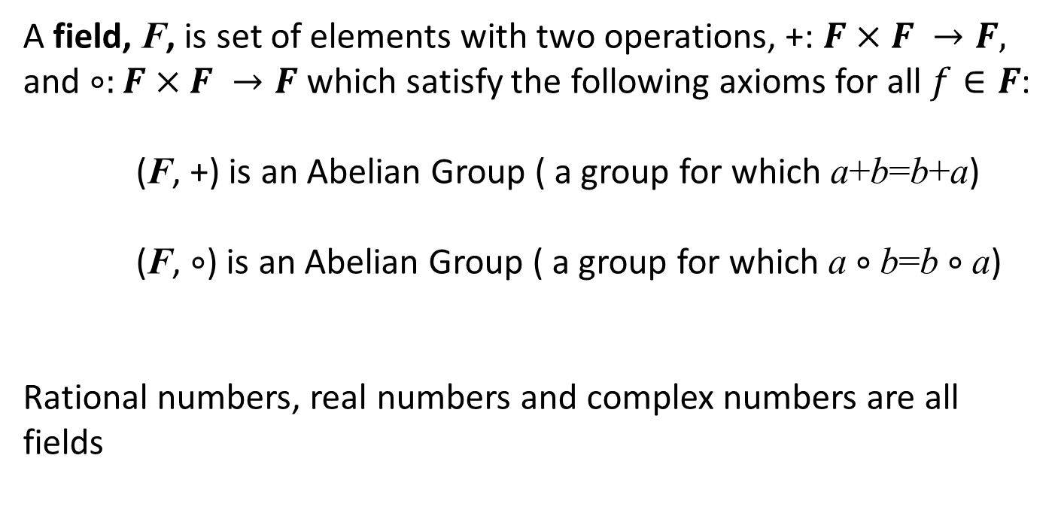
Transformations| Fields
A field, F, is set of elements with two operations, +: $F×F →F,$ and $∘:F×F →F$which satisfy the following axioms for all $f∈F$:
(F, +) is an Abelian Group ( a group for which a+b=b+a)
(F, $∘$) is an Abelian Group ( a group for which a $∘$b=b $∘$a)
Rational numbers, real numbers and complex numbers are all fields

Slide 10
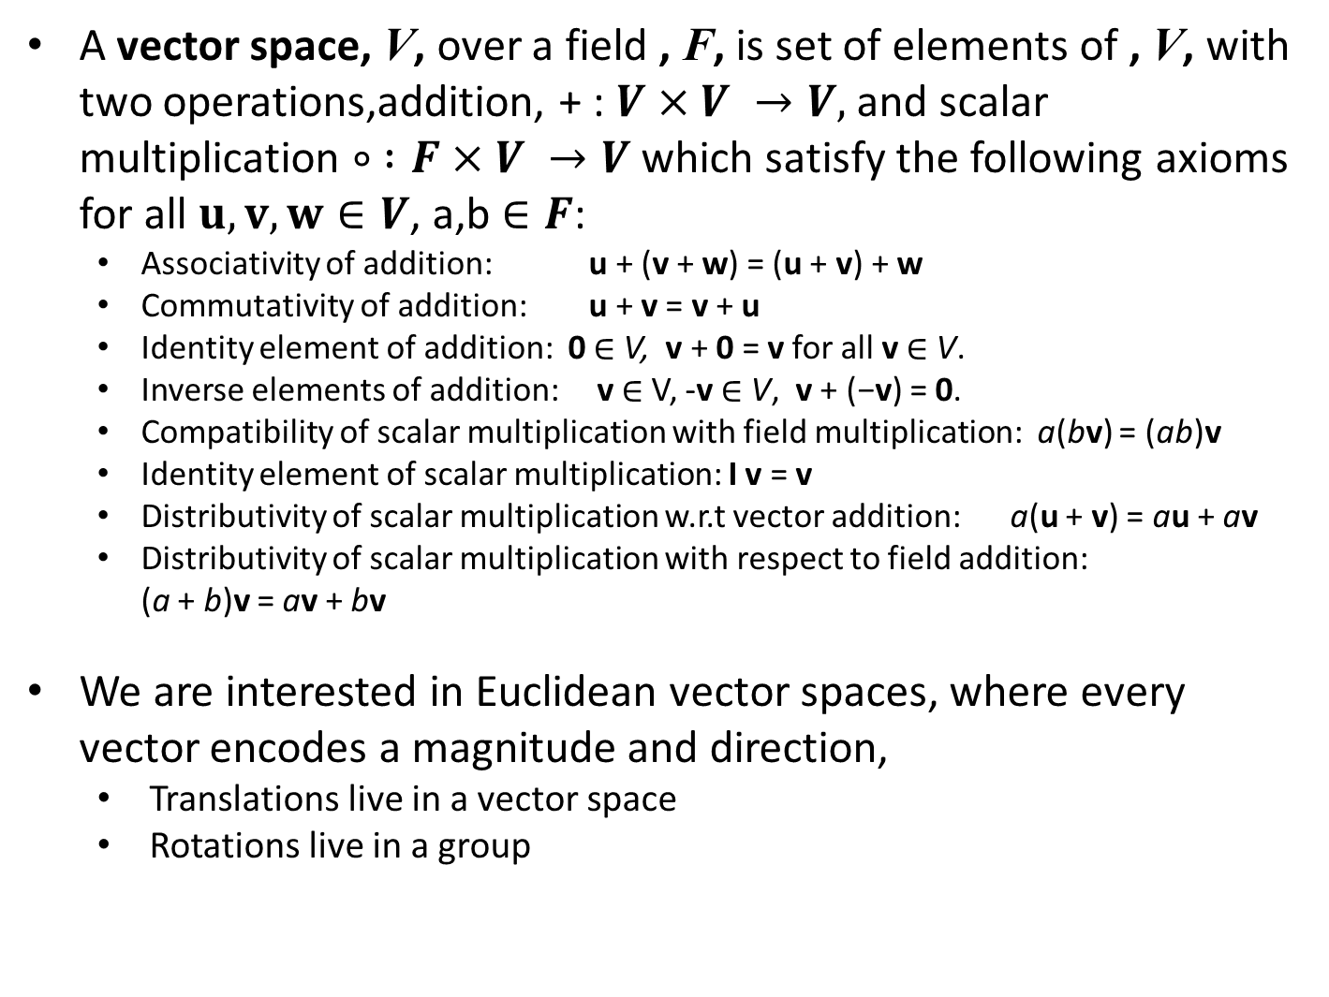
Transformations| Vector Space
A vector space, V, over a field , F, is set of elements of , V, with two operations,addition, + : $V×V →V,$ and scalar multiplication $∘ :F×V →V$which satisfy the following axioms for all $u,v,w∈V$, a,b $∈F$:
  Associativity of addition: u + (v + w) = (u + v) + w
  Commutativity of addition: u + v = v + u
  Identity element of addition: 0 ∈ V, v + 0 = v for all v ∈ V.
  Inverse elements of addition: v ∈ V, -v ∈ V, v + (−v) = 0.
  Compatibility of scalar multiplication with field multiplication: a(bv) = (ab)v
  Identity element of scalar multiplication: I v = v
  Distributivity of scalar multiplication w.r.t vector addition: a(u + v) = au + av
  Distributivity of scalar multiplication with respect to field addition: (a + b)v = av + bv
We are interested in Euclidean vector spaces, where every vector encodes a magnitude and direction,
  Translations live in a vector space
  Rotations live in a group

Slide 11
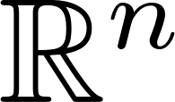
Kinematics Overview | Definitions: Manifold
A manifold is a topological space that locally looks like an open subset of
Each point of an n-dimensional manifold has a neighbourhood that is homeomorphic to Euclidean space of dimension n.

Slide 12
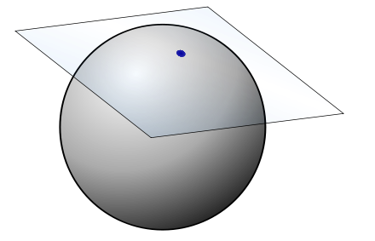
Kinematics Overview | Definitions: Tangent Space
Tangent Space: A vector space that best approximates the manifold about a point, tangent to the manifold at the point.

Slide 13
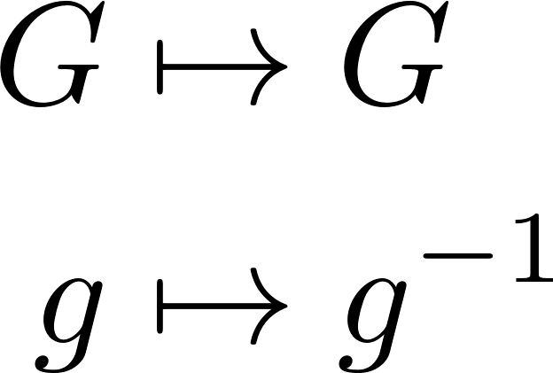
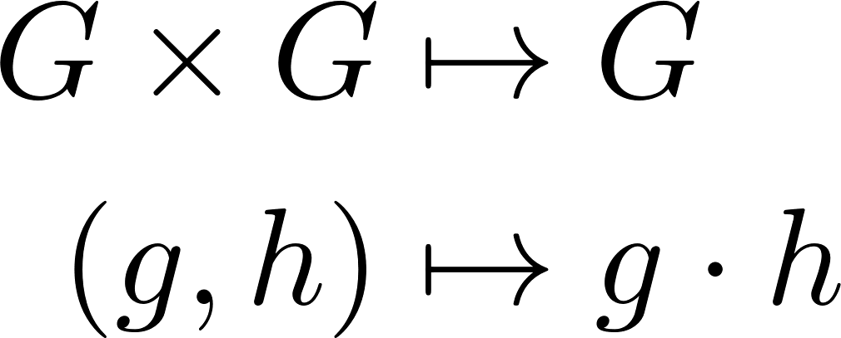

Kinematics Overview | Definitions: Lie Group
A Lie Group is a both a group and a smooth manifold such that the maps
are smooth, , meaning the maps are differentiable so small deviations are continuous
Rotations SO(3) and Transformations SE(3) are examples of Lie Groups

Slide 14
Transformations| Rotations – SO(3)
Rotations are part of a special Lie group
  Special: det(R) =1
  Orthogonal: matrix rows/columns are orthogonal
SO(3) or Special Orthogonal Group

Slide 15
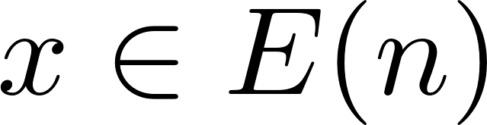

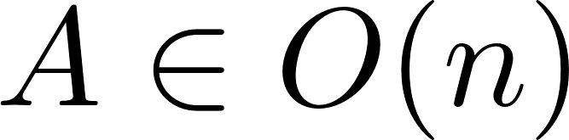
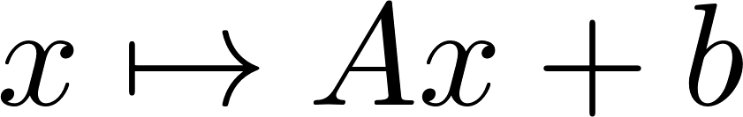
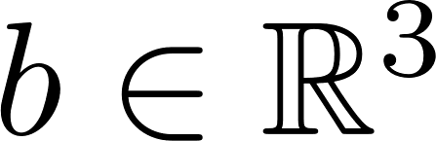
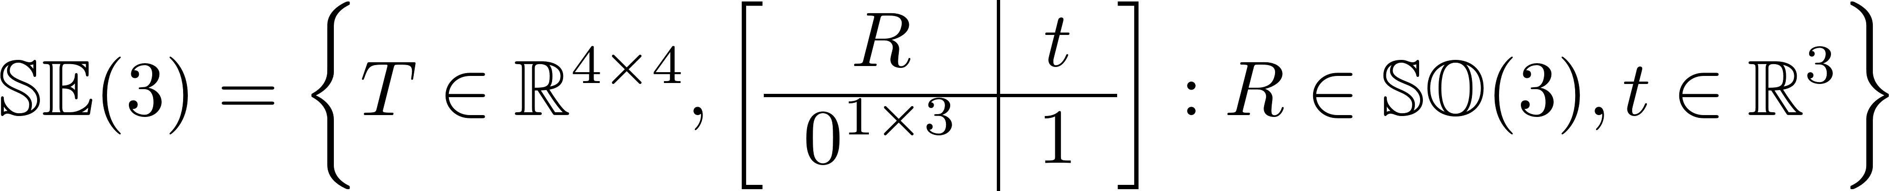

Transformations| Transformation – SE(3)
An element of a Euclidean Group, E(n) is combines a translation and an orthogonal rotation A,
When A is from SO(3), we get the Special Euclidean Group
Homeomorphic to

Slide 16
Kinematics Overview | Outline: Part 1
Mathematical Preliminaries
  Algebraic Structures
  Topological Spaces and Manifolds
  Matrix Lie Groups, SO(3) and SE(3)
Rotation Representations
    Euler Angles
    Quaternions
  Rotation Matrices
Transformations

Slide 17
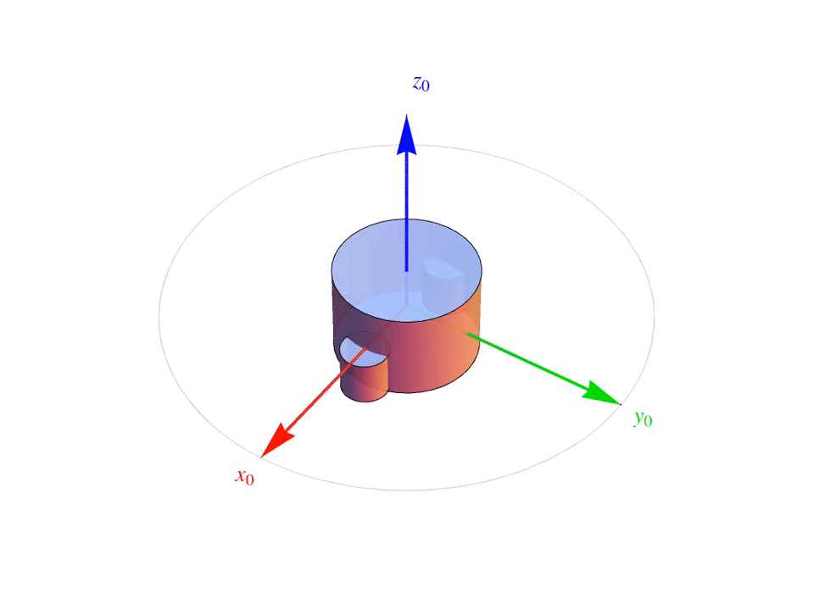
Transformations| Rotations – Euler Angles

Slide 18
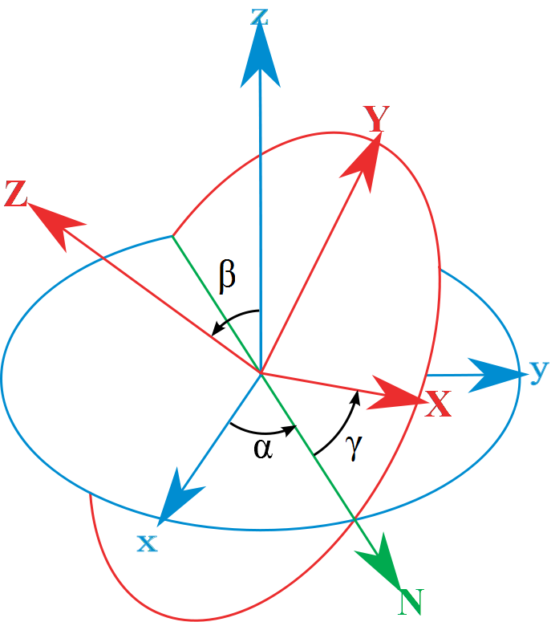
Transformations| Rotations – Euler Angles
Euler’s Theorem: Any two independent orthonormal coordinate frames can be related by a sequence of at most three rotations about coordinate axes, where no two successive rotations may be about the same axis
Given First Axes (xyz), rotate to
Second Axes (XYZ) through 3
successive rotations
  Rotation 1: About z by α
  Rotation 2: About N by β
  Rotation 3: About Z by γ
Known as 3-1-3 Euler Angles

Slide 19
Transformations| Rotations – Euler Angles
Aero convention: 3-2-1 Euler Angles
  Roll, Pitch, Yaw (when decoupled):
  Rotation Matrices
    3 - Yaw
    2- Roll
    1- Pitch

Slide 20
Transformations| Rotations – Euler Angles
Direction Cosine Matrix (DCM)
  All three rotations combined (from inertial to body)

Slide 21
Transformations| Rotations – Euler Angles
Euler angles are measured relative to intermediate coordinate frames (3-2-1),
  Not a rotation matrix

Slide 22
Transformations| Rotations – Euler Angles
Resulting transformations

Slide 23
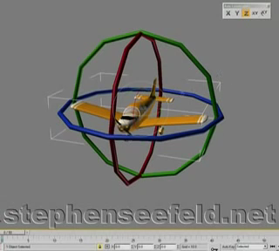
Transformations| Rotations – Gimbal Lock

Slide 24
Transformations| Quaternions
An alternative way of representing rotations is through quaternions
  Hamilton (1843) was looking for a field of dimension 4, to complete the picture (reals are a field of dimension 1, complex are a field of dimension 2)
    Was only able to find a non-commutative division ring
    He called them quaternions
    While walking with his wife in Dublin, scribbled the rule of quaternions on a bridge so he would not forget it.
    Everything but commutative multiplication work for quaternions (almost a field)

Slide 25
Transformations| Quaternions
Quaternions are a 4-tuple, divided into a scalar and a 3-vector
  Let
  Then a quaternion can be written as
  Addition simply adds the elements

Slide 26
Transformations| Quaternions
Quaternions are a 4-tuple, divided into a scalar and a 3-vector
  Multiplication by a constant
  The product of two quaternions is defined by Hamilton’s rule

Slide 27
Transformations| Quaternions
To get the rule for multiplication, do it out longhand and simplify
  Let , then
  In matrix form,
Scalar part, r₀
Vector part, r

Slide 28
Transformations| Quaternions
The complex conjugate of a quaternion is similar to complex numbers
  Which leads to
  And
The 2-norm of a quaternion is

Slide 29
Transformations| Quaternions
The inverse of a quaternion
And if the quaternion is a unit quaternion
  Which is similar to a rotation matrix

Slide 30
Transformations| Quaternions
Unit quaternions can be related to an angle (and a vector), similar to the rotation matrix
  Therefore, there must exist an angle for any quaternion q
  Then
  And we can express the unit quaternion and its conjugate as

Slide 31
Transformations| Quaternions
Define the unit quaternion rotation operator as
  Where v is the quaternion version of a vector v with zero scalar part (v=(0,v) and quaternion multiplication is used. Simplifying yields
  The unit quaternion rotation operator is linear
    Satisfies additivity and distributivity
  The norm ||R_{q}(v)|| is still ||v||
  So it appears we might be on to something, here
    If quaternions represent a rotation, then the rotation operation becomes linear in quaternion space

Slide 32
Transformations| Quaternions
Theorem: The quaternion rotation operator R_{q}(v) performs a rotation of v by 2θ about q.
Proof: Define the components of v in the direction of and perpendicular to q (a and n, respectively).
Which implies
By linearity and the definition of the rotation operator

Slide 33
Transformations| Quaternions
So the component of v along q is invariant to rotation, as required.
For the perpendicular component, we must show that a rotation by 2θ occurs
Expanding
Denote

Slide 34
Transformations| Quaternions
Note that
Finally, using angle description of q
  But this is just a rotation of the component of v perpendicular to q in the plane by 2θ.

Slide 35
Quaternions for rotations
Transformations| Quaternions
The picture

Slide 36
Transformations| Quaternions
So now we have a physical interpretation of the quaternion as a combination of the Euler rotation vector v=q and angle γ=2θ
Going back to rotation operator, we can write it in matrix form and extract a conversion to rotation matrix

Slide 37
Transformations| Quaternions
Similar to the rotation matrix and Euler angle update, quaternions can be updated directly from body rotation rates
Body rotation rate quaternion (notation abuse)
Given a vector v with quaternion v= (0,v) and a unit quaternion q defining a rotation about q by 2θ

Slide 38
Transformations| Quaternions
Differentiating yields
Rearranging
From qq⁻¹= 1, we get

Slide 39
Transformations| Quaternions
And combining leads to
Now define
So we get

Slide 40
Transformations| Quaternions
Recall that the scalar and vector parts of a quaternion multiplication are defined by
The scalar part of v’ is 0 and, it turns out, the scalar part of dv’/dt is too
Scalar part, r₀
Vector part, r

Slide 41
Transformations| Quaternions
The vector part of dv’/dt returns
So dv’/dt is a vector defined by a cross product
We also know that dv’/dt is defined by the vector v’ and its rate of rotation

Slide 42
Transformations| Quaternions
Looking at p, we see that
And so we can update our quaternion as follows (with quaternion multiplication)

Slide 43
Kinematics Overview | Outline: Part 1
Mathematical Preliminaries
  Algebraic Structures
  Topological Spaces and Manifolds
  Matrix Lie Groups, SO(3) and SE(3)
Rotation Representations
    Euler Angles
    Quaternions
  Rotation Matrices
Transformations

Slide 44
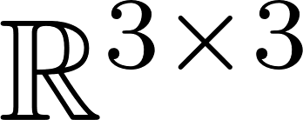
Kinematics Overview | SO(3)
As defined above, the Special Orthogonal group can also represent rotations
Not all 3x3 matrices are members of SO(3)
Recall we have constraints on the rotation matrix.
Locally, the group is 3 dimensional.
3 dimensional manifold embedded in
What matrices in SO(3) differ from the identity by a small amount?

Slide 45
Kinematics Overview | SO(3)
A Rotation matrix near identity:
The rotation times its transpose is identity:

Slide 46
Kinematics Overview | SO(3)
Ignoring second order terms:
Six independent constraints:
Only need three parameters (b,c,f)

Slide 47
Kinematics Overview | SO(3)
Any rotation near the identity looks like
G1,G2,G3 are called Generators

Slide 48
Kinematics Overview | Tangent Space and the Lie Algebra
All group elements have a tangent space. Together, known as a Tangent Bundle

Slide 49
Kinematics Overview | Tangent Space and the Lie Algebra
All group elements have a tangent space. Together, known as a Tangent Bundle

Slide 50
Kinematics Overview | Tangent Space and the Lie Algebra
All group elements have a tangent space. Together, known as a Tangent Bundle

Slide 51
Kinematics Overview | Tangent Space and the Lie Algebra
All group elements have a tangent space. Together, known as a Tangent Bundle

Slide 52
Kinematics Overview | Tangent Space and the Lie Algebra
Let’s re-visit our SO(3) example
If we let the generator coefficients become non infinitesimal, we get a 3-dimensional space that is tangent to the Identity element. Note that the generators form a basis for this space.

Slide 53

Kinematics Overview | Tangent Space and the Lie Algebra
2D visualization
The tangent space at the identity element is given a special designation: the Lie Algebra of the group,
and is denoted by

Slide 54
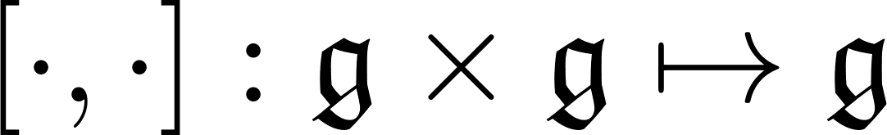
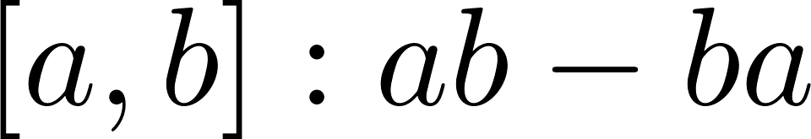
Kinematics Overview | Lie Algebra: Properties
The Lie Algebra is a vector space, along with a binary operation called the Lie Bracket
Must satisfy full list of axioms associated with Lie Bracket (https://en.wikipedia.org/wiki/Lie_algebra)

Slide 55

Kinematics Overview | Tangent Space and the Lie Algebra
The tangent space at the identity element (Lie Algebra) is isomorphic to the tangent space of the other group elements.

Slide 56

Kinematics Overview | Relationship of Lie Algebra to Lie Group
Define a tangent space element at the identity:

Slide 57
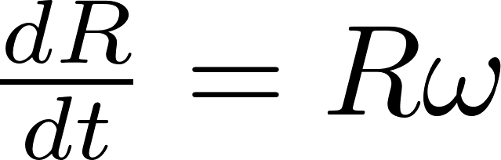
Kinematics Overview | Relationship of Lie Algebra to Lie Group
The differential equation that relates the tangent spaces:

Slide 58
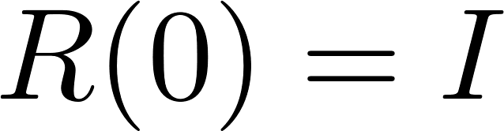
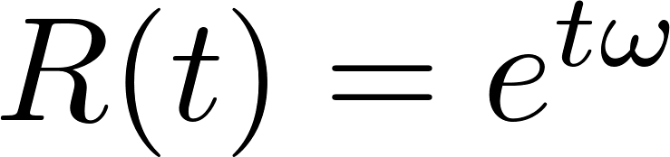
Kinematics Overview | Relationship of Lie Algebra to Lie Group
Solve the differential eqn with initial condition

Slide 59


Kinematics Overview | Relationship of Lie Algebra to Lie Group
We call this relationship between the Lie Algebra and Lie group the exponential map. For SO(3), when t=1

Slide 60
Kinematics Overview | Exponential Map
Visual example of exponential map
As n grows, quantity inside brackets becomes member of SO(3). Multiplication n times also gives member of SO(3). Successive approximations:

Slide 61
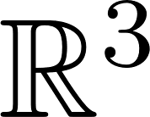
Kinematics Overview | Parameterization
For SO(3), the Lie Algebra is the set of all skew-symmetric matrices
This gives us a very nice parameterization for SO(3), using an element in to represent an element in SO(3).

Slide 62
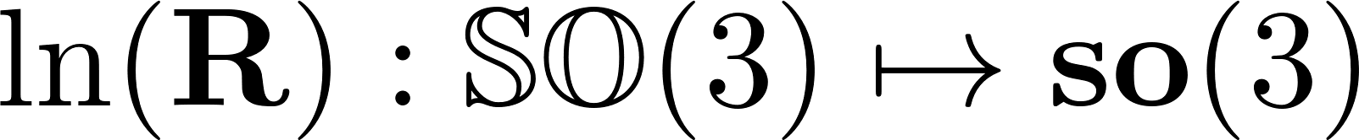
Kinematics Overview | Parameterization
Exponential Map for SO(3) has a closed form solution, called the Rodrigues formula.
We can also invert the exponential map using the logarithmic map.

Slide 63
Kinematics Overview | Transformations: SE(3)
We can use a similar derivation to get the generators of SE(3)
G1,G2,G3 are generators for the translations, G4,G5,G6 are the generators for the rotation.

Slide 64
Kinematics Overview | Transformations: SE(3)
The exponential map for SE(3) also has a closed form:

Slide 65


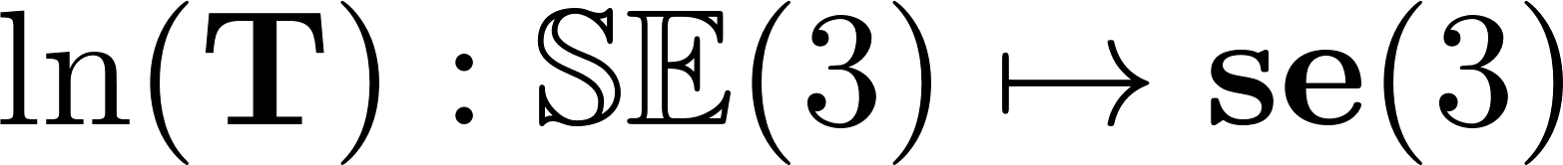

Kinematics Overview | Transformations: SE(3)
The logarithmic map for SE(3) also has a closed form:

Slide 66


Kinematics Overview | SO(3) and SE(3) Summary
 | Rotation | Transformation
Matrix | 3x3 matrix | 4x4 matrix
Lie Group | SO(3) | SE(3)
Lie Algebra | so(3) | se(3)
Tangent vectors | “angular velocities” | “twist”

Slide 67
DONE!

Slide 68

Kinematics Overview| Axis Angle: Any better?
Still investigating in more detail
exp map is not one-to-one, will map rotations in multiples of 2$π$ to same group element
  Also need to be careful when rotation magnitude is close to zero

Slide 69


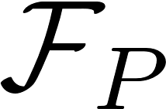

Kinematics Overview| Kinematics Standards: Frame Diagram

Slide 70
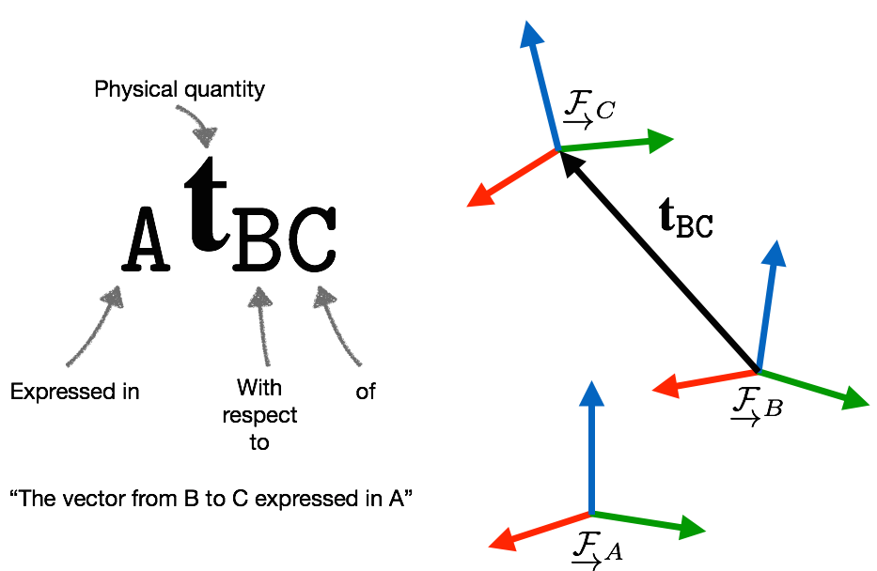
Kinematics Overview| Kinematics Standards: Vector Decoration
Arun Das| Waterloo Autonomous Vehicles Lab

Slide 71
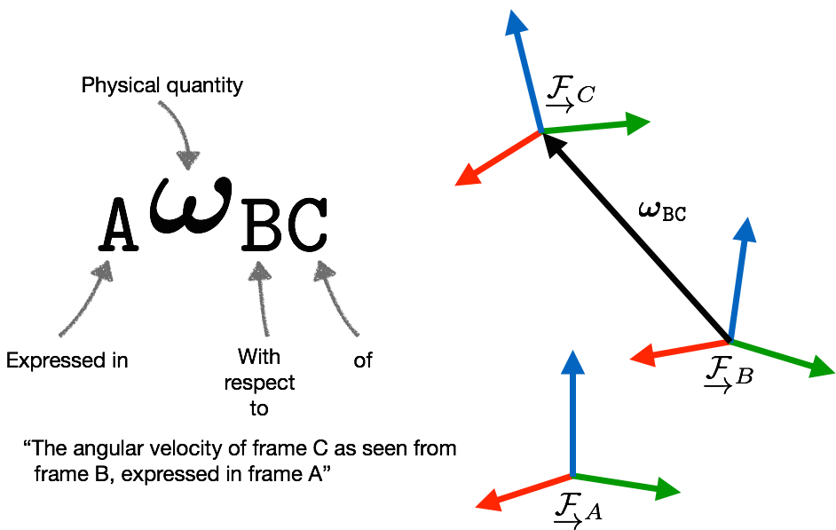
Kinematics Overview| Kinematics Standards: Vector Decoration
Arun Das| Waterloo Autonomous Vehicles Lab

Slide 72
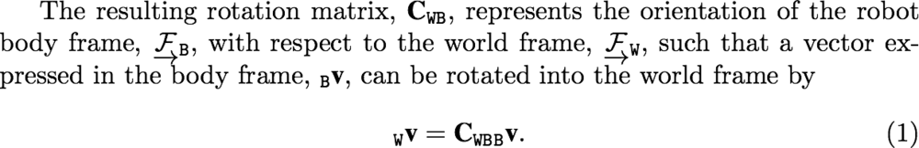
Kinematics Overview| Kinematics Standards: Vector Rotation
Be very clear in terms of rotation direction
Arun Das| Waterloo Autonomous Vehicles Lab

Slide 73
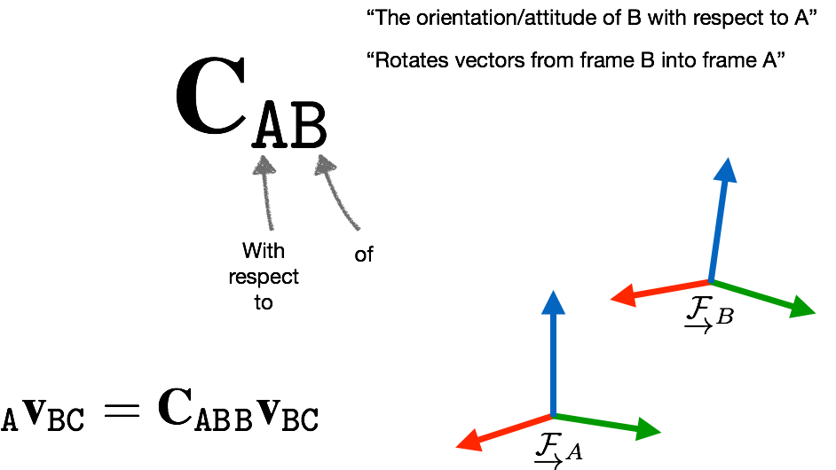
Kinematics Overview| Kinematics Standards: Vector Rotation
Arun Das| Waterloo Autonomous Vehicles Lab

Slide 74
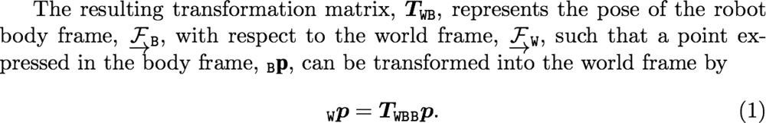
Kinematics Overview| Kinematics Standards: Pose Transformations
Be very clear about the pose transformation direction
Arun Das| Waterloo Autonomous Vehicles Lab

Slide 75
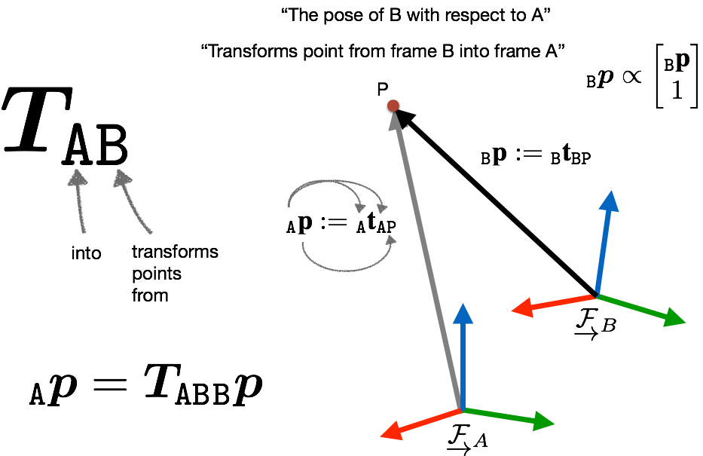
Kinematics Overview| Kinematics Standards: Pose Transformations
Arun Das| Waterloo Autonomous Vehicles Lab

Slide 76
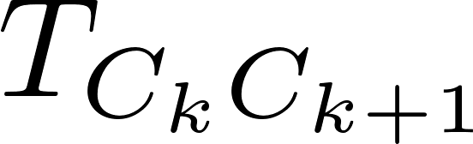
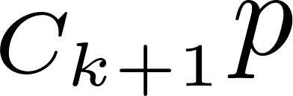
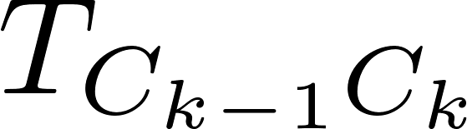
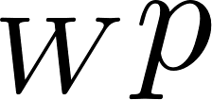

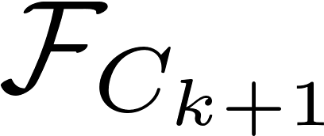
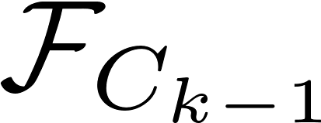
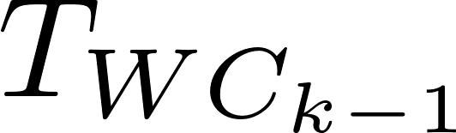

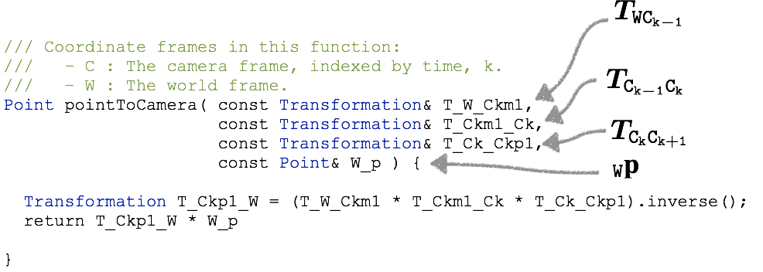
Kinematics Overview| Kinematics Standards: Code implementation
Arun Das| Waterloo Autonomous Vehicles Lab

Slide 77
Kinematics Overview| Moose Standards
Frame | Description | Kinematics Tag
Camera | Camera Lens Optical Center | C
Point | Landmark (Point) Frame | P
Vehicle | Centre of Back Axle | V
IMU | IMU Origin | I
GPS | Antenna Phase Center | G
Lidar | Local Lidar Point Frame | L
Encoder | About axis of rotation | E
Radar | Radar Center | R
ECEF | Earth Centered Earth Fixed | F
Map | Localization Map Frame | M
Arun Das| Waterloo Autonomous Vehicles Lab

Slide 78
Kinematics Overview | Preview for Part 2
In depth derivations of the closed forms for exp and log maps on SO(3) and SE(3)
Adjoint mapping and representations
Defining “distance” between group elements
Differential Calculus on SO(3) and SE(3)
Implementation using wave::kinematics
Building residual terms using wave::kinematics
Arun Das | Waterloo Autonomous Vehicles Lab

