Slide 1

Kinematics: Part 1
Arun Das
29/03/2017
Arun Das | Waterloo Autonomous Vehicles Lab

Slide 2
Kinematics Overview | Outline: Part 1
Kinematics: Motivation
Rotation Representation
Pose Representation
Parameterizations
Matrix Lie Groups, SO(3) and SE(3)
Kinematics Lab Standards
  Documentation
  Code
Arun Das | Waterloo Autonomous Vehicles Lab

Slide 3

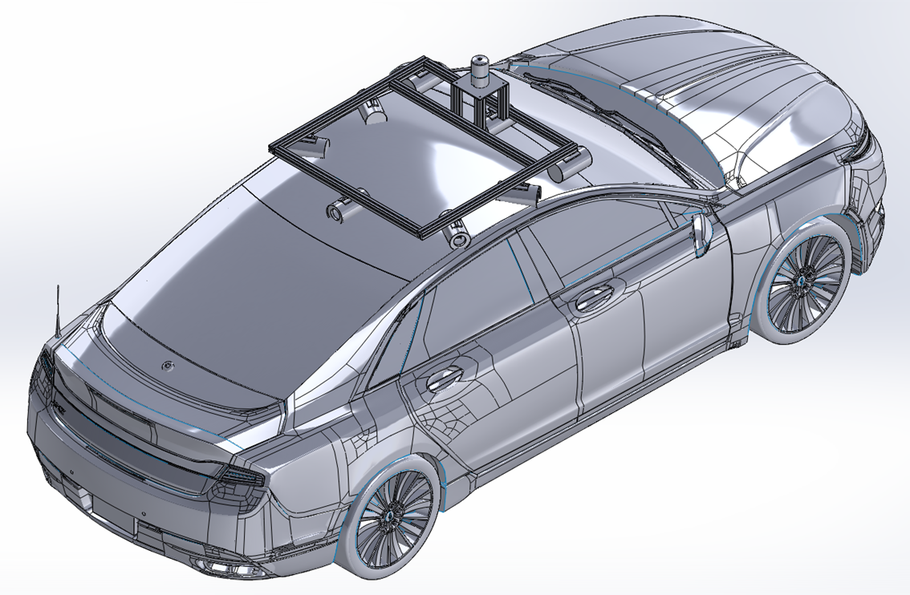



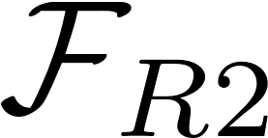






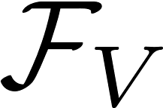


Kinematics Overview| Motivation
How do we map and analyze quantities between co-ordinate frames?
Arun Das| Waterloo Autonomous Vehicles Lab

Slide 4
Kinematics Overview | Rotations – SO(3)
Rotations are part of a special group
  det =1
  Orthogonal matrix
SO(3) or Special Orthogonal Group
Manifold, not a vector space!
Arun Das| Waterloo Autonomous Vehicles Lab

Slide 5
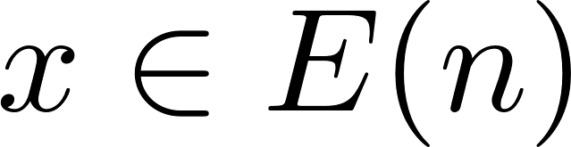

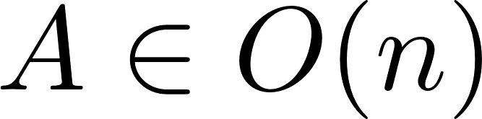
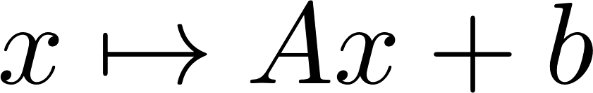
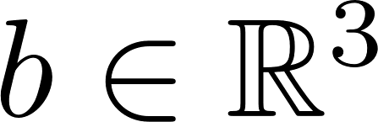
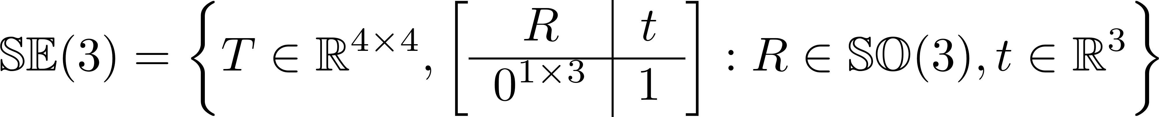

Kinematics Overview | Transformation – SE(3)
An element of a Euclidean Group, E(n) is a translation and an orthogonal transformation A,
When A is from SO(3), we get the Special Euclidean Group
Homeomorphic to
Arun Das| Waterloo Autonomous Vehicles Lab

Slide 6
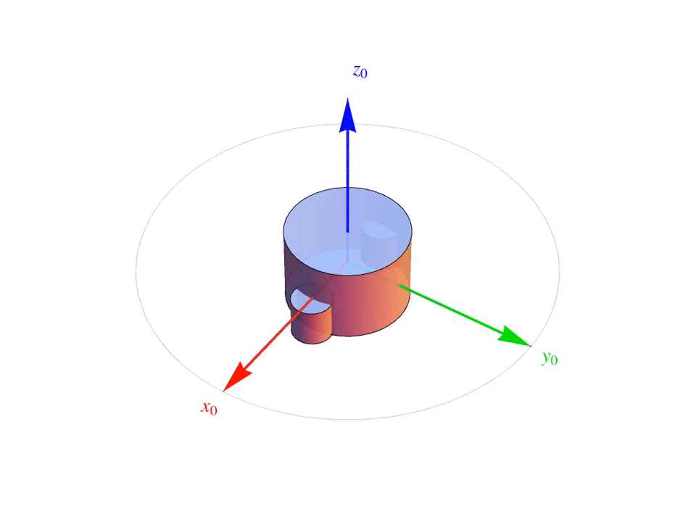
Kinematics Overview | Rotations – Euler Angles
Arun Das| Waterloo Autonomous Vehicles Lab

Slide 7
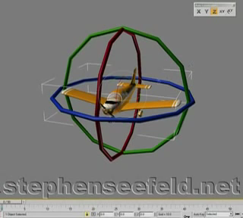
Kinematics Overview | Rotations – Gimbal Lock
Arun Das| Waterloo Autonomous Vehicles Lab

Slide 8
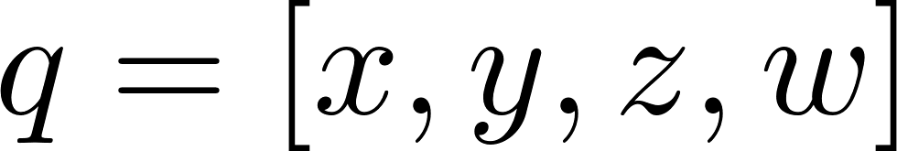
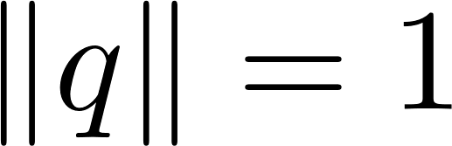
Kinematics Overview | Rotations – Quaternions
Alternate rotation parameterization
Over parameterized
Solved by adding norm constraint
Arun Das| Waterloo Autonomous Vehicles Lab

Slide 9

Kinematics Overview | Definitions: Manifold
A manifold locally looks like an open subset of
Arun Das| Waterloo Autonomous Vehicles Lab

Slide 10
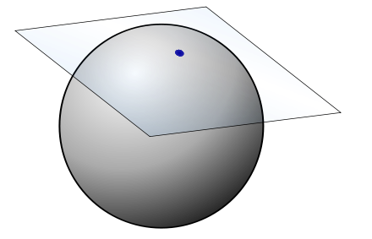
Kinematics Overview | Definitions: Tangent Space
A vector space that best approximates the manifold about a point, tangent to the Manifold at the point.
Arun Das| Waterloo Autonomous Vehicles Lab

Slide 11
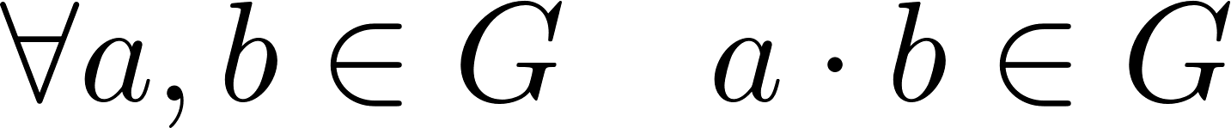
Kinematics Overview | Definitions: Group
A Group is a set, G, together with an operator, known as the group law, that can combine two elements in the group to form a third.
Must satisfy four axioms
  Closure:
  Associativity:
  Identity Element:
  Inverse Element:
Arun Das| Waterloo Autonomous Vehicles Lab

Slide 12
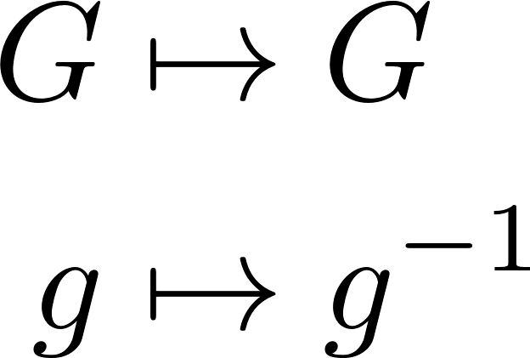
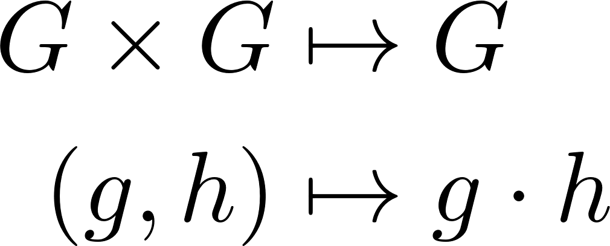

Kinematics Overview | Definitions: Lie Group
A Lie Group is a group if it is a smooth manifold such that the maps
are smooth
Rotations SO(3) and Transformations SE(3) are examples of Lie Groups
Arun Das| Waterloo Autonomous Vehicles Lab

Slide 13

Kinematics Overview | SO(3)
Not all 3x3 matrices are members of SO(3)
Recall we have constraints on the rotation matrix.
Locally, the group is 3 dimensional.
3 dimensional manifold embedded in
What matrices in SO(3) differ from the identity by a small amount?
Arun Das| Waterloo Autonomous Vehicles Lab

Slide 14
Kinematics Overview | SO(3)
A Rotation matrix near identity:
The rotation times its transpose is identity:
Arun Das| Waterloo Autonomous Vehicles Lab

Slide 15
Kinematics Overview | SO(3)
Ignoring second order terms:
Six independent constraints:
Only need three parameters (b,c,f)
Arun Das| Waterloo Autonomous Vehicles Lab

Slide 16
Kinematics Overview | SO(3)
Any rotation near the identity looks like
G1,G2,G3 are called Generators
Arun Das| Waterloo Autonomous Vehicles Lab

Slide 17
Kinematics Overview | Tangent Space and the Lie Algebra
All group elements have a tangent space. Together, known as a Tangent Bundle
Arun Das| Waterloo Autonomous Vehicles Lab

Slide 18
Kinematics Overview | Tangent Space and the Lie Algebra
All group elements have a tangent space. Together, known as a Tangent Bundle
Arun Das| Waterloo Autonomous Vehicles Lab

Slide 19
Kinematics Overview | Tangent Space and the Lie Algebra
All group elements have a tangent space. Together, known as a Tangent Bundle
Arun Das| Waterloo Autonomous Vehicles Lab

Slide 20
Kinematics Overview | Tangent Space and the Lie Algebra
All group elements have a tangent space. Together, known as a Tangent Bundle
Arun Das| Waterloo Autonomous Vehicles Lab

Slide 21
Kinematics Overview | Tangent Space and the Lie Algebra
Let’s re-visit our SO(3) example
If we let the generator coefficients to become, non infinitesimal, we get a 3-dimensional space that is tangent to the Identity element. Note that the generators form a basis for this space.
Arun Das| Waterloo Autonomous Vehicles Lab

Slide 22

Kinematics Overview | Tangent Space and the Lie Algebra
2D visualization
The tangent space at the identity element is given a special designation: the Lie Algebra of the group,
and is denoted by
Arun Das| Waterloo Autonomous Vehicles Lab

Slide 23

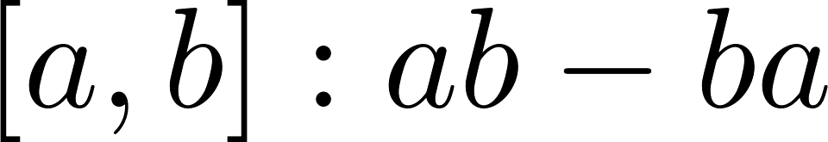
Kinematics Overview | Lie Algebra: Properties
The Lie Algebra is a vector space, along with a binary operation called the Lie Bracket
Must satisfy full list of axioms associated with Lie Bracket (https://en.wikipedia.org/wiki/Lie_algebra)
Arun Das| Waterloo Autonomous Vehicles Lab

Slide 24

Kinematics Overview | Tangent Space and the Lie Algebra
The tangent space at the identity element (Lie Algebra) is isomorphic to the tangent space of the other group elements.
Arun Das| Waterloo Autonomous Vehicles Lab

Slide 25

Kinematics Overview | Relationship of Lie Algebra to Lie Group
Define a tangent space element at the identity:
Arun Das| Waterloo Autonomous Vehicles Lab

Slide 26
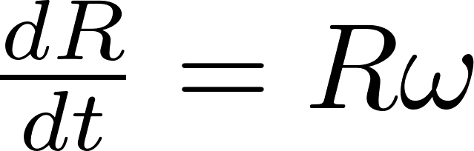
Kinematics Overview | Relationship of Lie Algebra to Lie Group
The differential equation that relates the tangent spaces:
Arun Das| Waterloo Autonomous Vehicles Lab

Slide 27
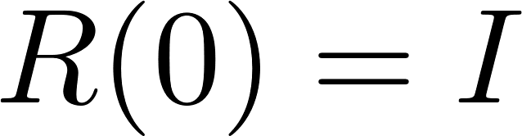

Kinematics Overview | Relationship of Lie Algebra to Lie Group
Solve the differential eqn with initial condition
Arun Das| Waterloo Autonomous Vehicles Lab

Slide 28


Kinematics Overview | Relationship of Lie Algebra to Lie Group
We call this relationship between the Lie Algebra and Lie group the exponential map. For SO(3), when t=1
Arun Das| Waterloo Autonomous Vehicles Lab

Slide 29
Kinematics Overview | Exponential Map
Visual example of exponential map
As n grows, quantity inside brackets becomes member of SO(3). Multiplication n times also gives member of SO(3). Successive approximations:
Arun Das| Waterloo Autonomous Vehicles Lab

Slide 30

Kinematics Overview | Parameterization
For SO(3), the Lie Algebra is the set of all skew-symmetric matrices
This gives us a very nice parameterization for SO(3), using an element in to represent an element in SO(3).
Arun Das| Waterloo Autonomous Vehicles Lab

Slide 31
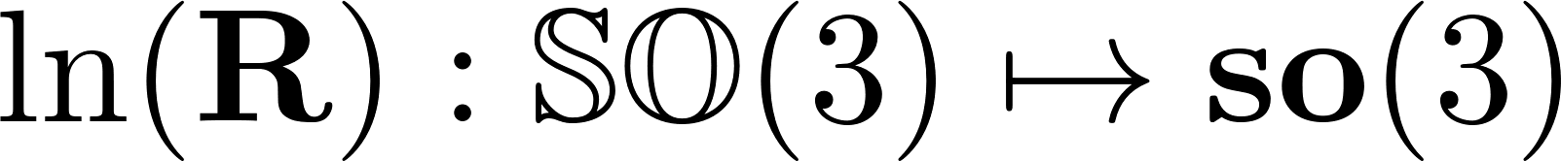
Kinematics Overview | Parameterization
Exponential Map for SO(3) has a closed form solution, called the Rodrigues formula.
We can also invert the exponential map using the logarithmic map.
Arun Das| Waterloo Autonomous Vehicles Lab

Slide 32
Kinematics Overview | Transformations: SE(3)
We can use a similar derivation to get the generators of SE(3)
G1,G2,G3 are generators for the translations, G4,G5,G6 are the generators for the rotation.
Arun Das| Waterloo Autonomous Vehicles Lab

Slide 33
Kinematics Overview | Transformations: SE(3)
The exponential map for SE(3) also has a closed form:
Arun Das| Waterloo Autonomous Vehicles Lab

Slide 34


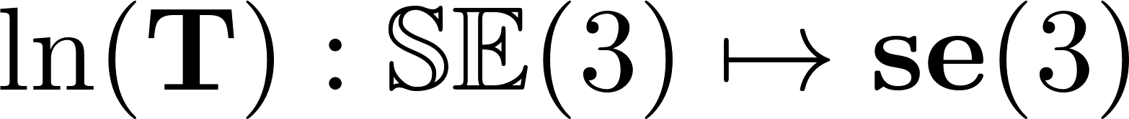

Kinematics Overview | Transformations: SE(3)
The logarithmic map for SE(3) also has a closed form:
Arun Das| Waterloo Autonomous Vehicles Lab

Slide 35


Kinematics Overview | SO(3) and SE(3) Summary
 | Rotation | Transformation
Matrix | 3x3 matrix | 4x4 matrix
Lie Group | SO(3) | SE(3)
Lie Algebra | so(3) | se(3)
Tangent vectors | “angular velocities” | “twist”
Arun Das| Waterloo Autonomous Vehicles Lab

Slide 36
Kinematics Overview| Kinematics Standards
A summary of 2014 ICRA workshop presentation by Paul Furgale, “Representing Robot Pose: The good, the bad, and the ugly”.
Notation traced back to this book: Elastic Multibody Dynamics -- A Direct Ritz Approach
Full slides: http://paulfurgale.info/news/2014/6/9/representing-robot-pose-the-good-the-bad-and-the-ugly
Arun Das| Waterloo Autonomous Vehicles Lab

Slide 37



Kinematics Overview| Pain Points: three value problem
Given a 3 value parameterization, how much do we really know?
Arun Das| Waterloo Autonomous Vehicles Lab

Slide 38
Kinematics Overview| Pain Points: three value problem
There are 12 valid combinations of rotations
  z-x-z, x-y-x,y-z-y,z-y-z…
  x-y-z, y-z-x, z-y-x, x-z-y…
Each can be either active or passive
Arun Das| Waterloo Autonomous Vehicles Lab

Slide 39
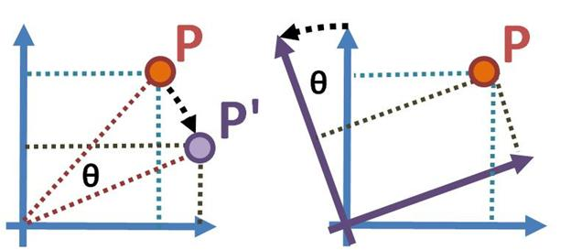
Kinematics Overview| Pain Points: Active vs Passive Rotations
Active Rotation (left): Point changes location
Passive Rotation (right): Change of co-ordinate frame
Arun Das| Waterloo Autonomous Vehicles Lab

Slide 40
Kinematics Overview| Pain Points: Rotation Direction
From Map to Vehicle frame? Or from Vehicle to Map frame?
Arun Das| Waterloo Autonomous Vehicles Lab

Slide 41
Kinematics Overview| Pain Points: Parameter Ordering
What is the ordering of the parameters?
x y z
z y x
y x z
y z x
z x y
z y x
Arun Das| Waterloo Autonomous Vehicles Lab

Slide 42
Kinematics Overview| Pain Points: Units
Degrees or Rads?
Deg
Rad
Arun Das| Waterloo Autonomous Vehicles Lab

Slide 43
Kinematics Overview| Pain Points: Units
(12) valid rotation combinations?
(2) active or passive?
(2) rotation direction
(6) parameter ordering
(2) units
Arun Das| Waterloo Autonomous Vehicles Lab

Slide 44
Kinematics Overview| Pain Points: three value problem
Given a 3 value parameterization, how much do we really know?
Arun Das| Waterloo Autonomous Vehicles Lab

Slide 45
Kinematics Overview| Pain Points: three value problem
Given a 3 value parameterization, how much do we really know?
VERY LITTLE:
576 different combinations
Arun Das| Waterloo Autonomous Vehicles Lab

Slide 46
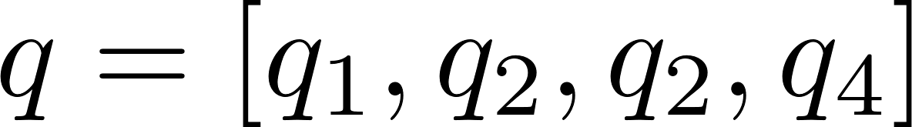
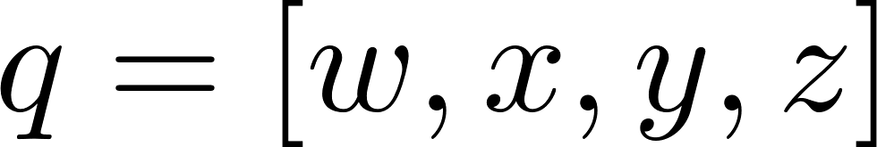

Kinematics Overview| Pain Points: Quaternion Ordering
Scalar first or scalar last?
Scalar first
Scalar Last
Arun Das| Waterloo Autonomous Vehicles Lab

Slide 47
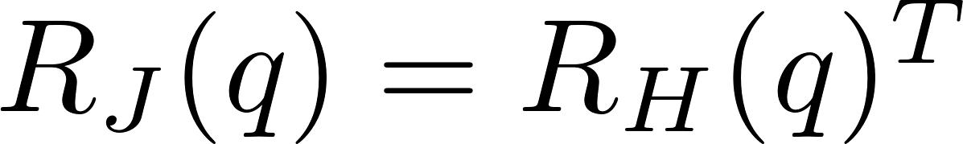
Kinematics Overview| Pain Points: Quaternion handedness
JPL vs Hamilton?
  Hamilton: Right handed rotations
  JPL: Left handed rotations
Arun Das| Waterloo Autonomous Vehicles Lab

Slide 48
Kinematics Overview| Axis Angle: Any better?
Still investigating in more detail
exp map is not one-to-one, will map rotations in multiples of 2pi to same group element
  Also need to be careful when rotation magnitude is close to zero
Arun Das| Waterloo Autonomous Vehicles Lab

Slide 49
Kinematics Overview| Moose Standards
Frame | Description | Kinematics Tag
Camera | Camera Lens Optical Center | C
Point | Landmark (Point) Frame | P
Vehicle | Centre of Back Axle | V
IMU | IMU Origin | I
GPS | Antenna Phase Center | G
Lidar | Local Lidar Point Frame | L
Encoder | About axis of rotation | E
Radar | Radar Center | R
ECEF | Earth Centered Earth Fixed | F
Map | Localization Map Frame | M
Arun Das| Waterloo Autonomous Vehicles Lab

Slide 50



Kinematics Overview| Kinematics Standards: Frame Diagram
Arun Das| Waterloo Autonomous Vehicles Lab

Slide 51
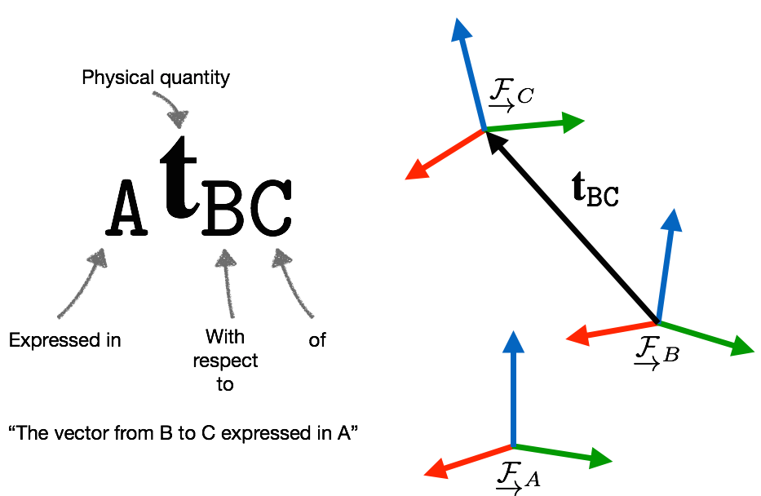
Kinematics Overview| Kinematics Standards: Vector Decoration
Arun Das| Waterloo Autonomous Vehicles Lab

Slide 52
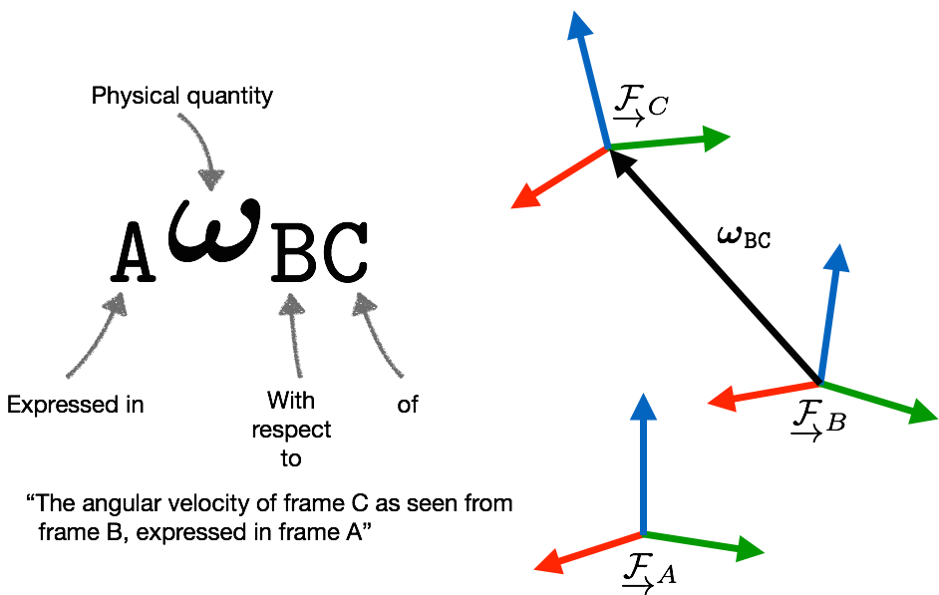
Kinematics Overview| Kinematics Standards: Vector Decoration
Arun Das| Waterloo Autonomous Vehicles Lab

Slide 53
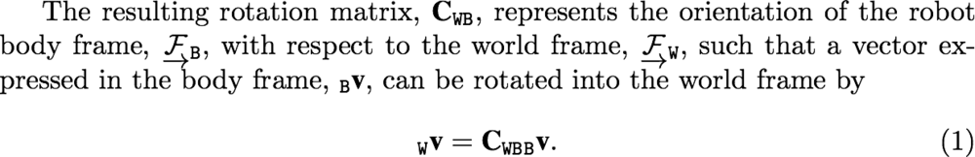
Kinematics Overview| Kinematics Standards: Vector Rotation
Be very clear in terms of rotation direction
Arun Das| Waterloo Autonomous Vehicles Lab

Slide 54
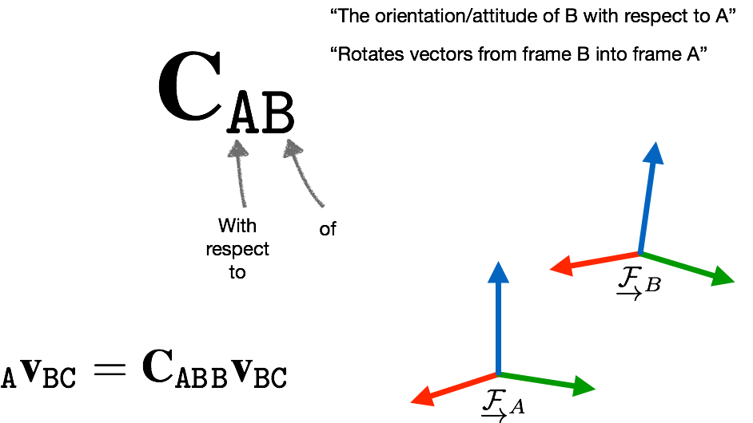
Kinematics Overview| Kinematics Standards: Vector Rotation
Arun Das| Waterloo Autonomous Vehicles Lab

Slide 55
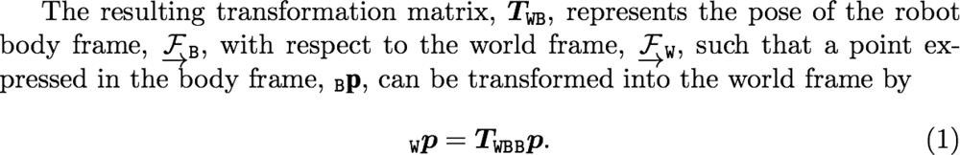
Kinematics Overview| Kinematics Standards: Pose Transformations
Be very clear about the pose transformation direction
Arun Das| Waterloo Autonomous Vehicles Lab

Slide 56
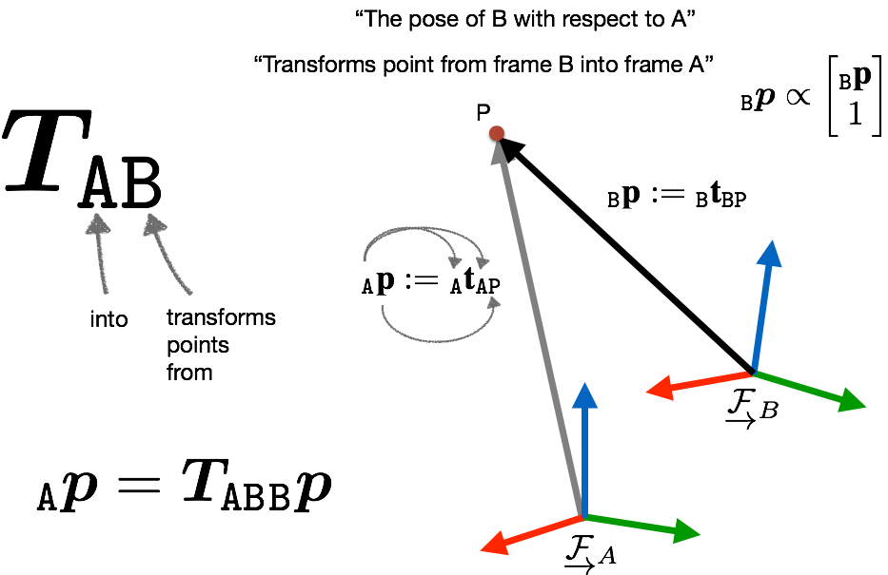
Kinematics Overview| Kinematics Standards: Pose Transformations
Arun Das| Waterloo Autonomous Vehicles Lab

Slide 57
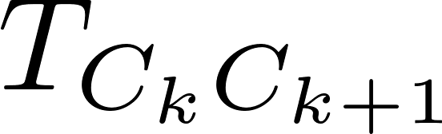


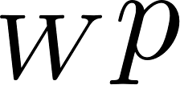

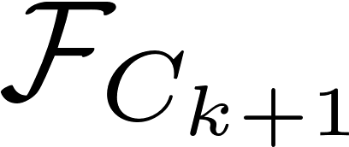
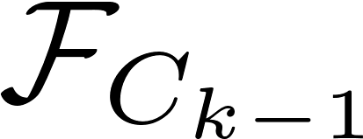
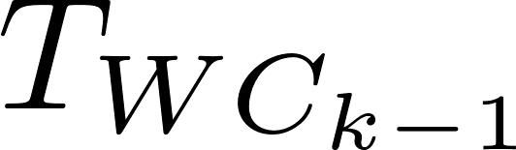

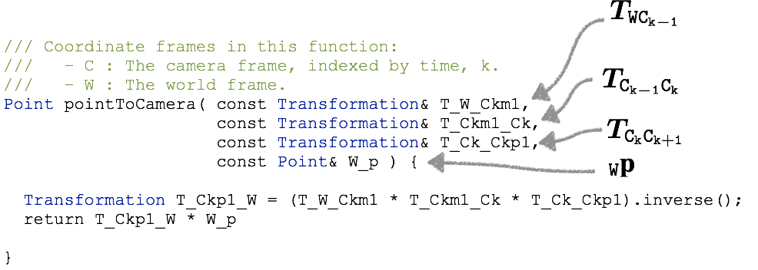
Kinematics Overview| Kinematics Standards: Code implementation
Arun Das| Waterloo Autonomous Vehicles Lab

Slide 58
Kinematics Overview | Preview for Part 2
In depth derivations of the closed forms for exp and log maps on SO(3) and SE(3)
Adjoint mapping and representations
Defining “distance” between group elements
Differential Calculus on SO(3) and SE(3)
Implementation using wave::kinematics
Building residual terms using wave::kinematics
Arun Das | Waterloo Autonomous Vehicles Lab

