Slide 1
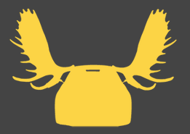
Calibration Overview
Jason Rebello
10/07/2017
No moose was hurt in the making of this presentation
Jason Rebello | Waterloo Autonomous Vehicles Lab

Slide 2
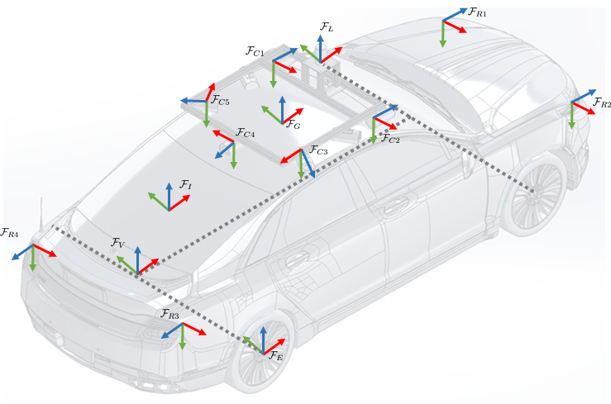
Calibration | Why do we need calibration ?
Data from multiple complementary sensors leads to increased accuracy and robustness
Sensors need to be spatially and temporally calibrated
Calibration helps transform measurements from different sensors into a common reference frame
Source: Arun Das
Jason Rebello | Waterloo Autonomous Vehicles Lab
Notes:
Dynamics is often stochastic, hence can’t optimize for a particular outcome, but only optimize to obtain a good distribution over outcomes ! Probability provides a framework to reason in this setting " Result: ability to find good control policies for stochastic dynamics and environments

Slide 3
Required Calibrations
Calibration |
Camera intrinsic and extrinsic
IMU to Camera
Lidar to GPS
Lidar to Camera
Source: Arun Das
Jason Rebello | Waterloo Autonomous Vehicles Lab
Notes:
Dynamics is often stochastic, hence can’t optimize for a particular outcome, but only optimize to obtain a good distribution over outcomes ! Probability provides a framework to reason in this setting " Result: ability to find good control policies for stochastic dynamics and environments

Slide 4
Required Calibrations
Calibration |
Camera intrinsic and extrinsic
IMU to Camera
Lidar to GPS
Lidar to Camera
Source: Arun Das
Jason Rebello | Waterloo Autonomous Vehicles Lab
Notes:
Dynamics is often stochastic, hence can’t optimize for a particular outcome, but only optimize to obtain a good distribution over outcomes ! Probability provides a framework to reason in this setting " Result: ability to find good control policies for stochastic dynamics and environments

Slide 5
Required Calibrations
Calibration |
Camera intrinsic and extrinsic
IMU to Camera
Lidar to GPS
Lidar to Camera
Source: Arun Das
Jason Rebello | Waterloo Autonomous Vehicles Lab
Notes:
Dynamics is often stochastic, hence can’t optimize for a particular outcome, but only optimize to obtain a good distribution over outcomes ! Probability provides a framework to reason in this setting " Result: ability to find good control policies for stochastic dynamics and environments

Slide 6
Required Calibrations
Calibration |
Camera intrinsic and extrinsic
IMU to Camera
Lidar to GPS
Lidar to Camera
Source: Arun Das
Jason Rebello | Waterloo Autonomous Vehicles Lab
Notes:
Dynamics is often stochastic, hence can’t optimize for a particular outcome, but only optimize to obtain a good distribution over outcomes ! Probability provides a framework to reason in this setting " Result: ability to find good control policies for stochastic dynamics and environments

Slide 7
Calibration Camera Intrinsics |
Camera Intrinsics
Jason Rebello | Waterloo Autonomous Vehicles Lab
Notes:
Dynamics is often stochastic, hence can’t optimize for a particular outcome, but only optimize to obtain a good distribution over outcomes ! Probability provides a framework to reason in this setting " Result: ability to find good control policies for stochastic dynamics and environments

Slide 8
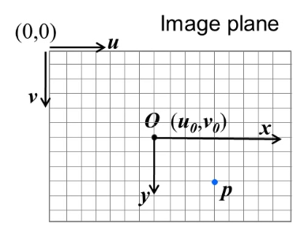
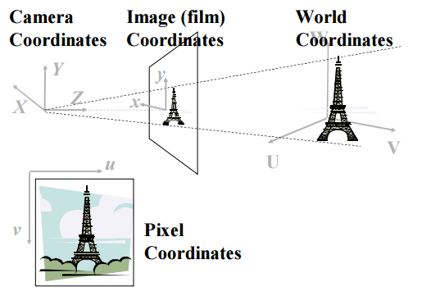
Image Formation | Projection pipeline
Forward Projection
Image to Pixel Coordinates
Extrinsics R,t
Intrinsics focal length, ox, oy
(a)
(b)
(c)
Source: Robert Collins, CSE486
Jason Rebello | Waterloo Autonomous Vehicles Lab

Slide 9
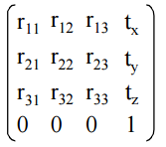
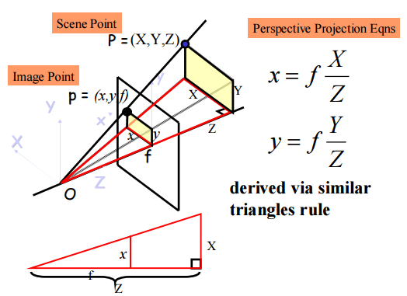
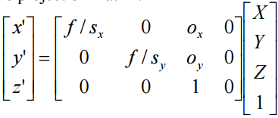
Image Formation | Camera Parameters
Extrinsic Transformation (Rotation + Translation)
Transforms points from
World to Camera coordinate
Frame
Homogeneous coordinates
allow for easy matrix multiplication
(b),(c) Perspective Projection
Camera Coordinates
Pixel Coordinates
Source: Robert Collins, CSE486
Jason Rebello | Waterloo Autonomous Vehicles Lab

Slide 10
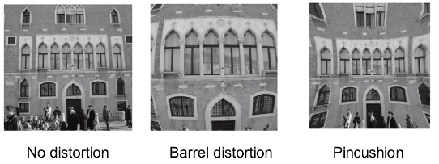
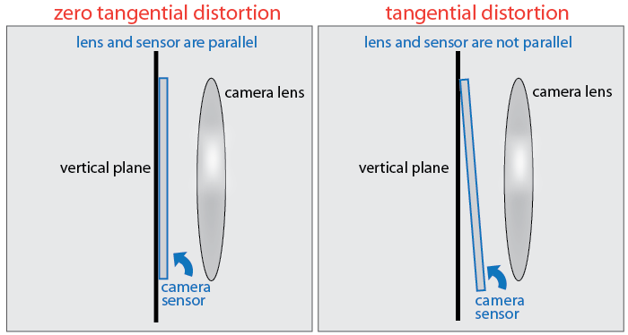
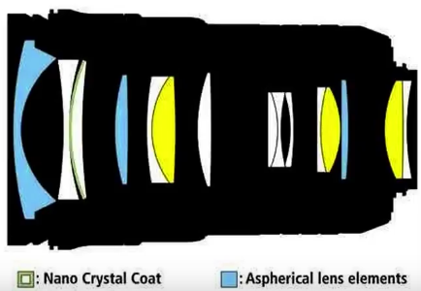
Image Formation | Distortions
Radial Distortion
Source: Scaramuzza
Tangential Distortion
Source: MathWorks
Nikon Lens System
Source: Aaron Bobik
Jason Rebello | Waterloo Autonomous Vehicles Lab

Slide 11
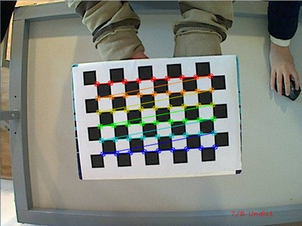
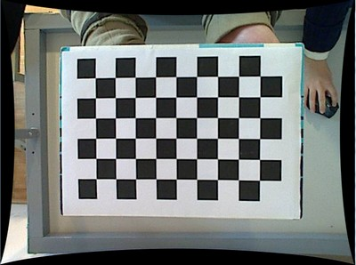
Intrinsic Parameter Calibration |
Camera Calibration using a 2D Checkerboard
Known size (30 mm) and structure (6 x 9 )
Identify corners easily.
Distorted Corrected
Where do I set my world coordinate
frame ?
Jason Rebello | Waterloo Autonomous Vehicles Lab
Notes:
Easily identify corners on checkerboard. Location of pixel coordinates
If I set my world coordinate frame in a smart way I can know the coordinates of all those points

Slide 12
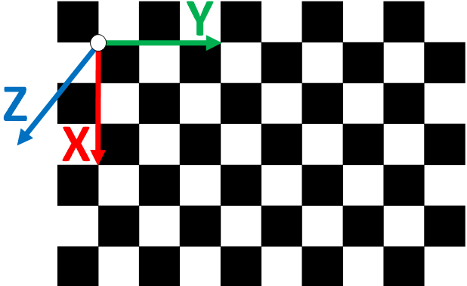
Why use a checkerboard ? |
Can set the world coordinate system to one corner of the checkerboard
All points lie in the X,Y plane with Z=0
Jason Rebello | Waterloo Autonomous Vehicles Lab
Notes:
Projection Equation, Distortions

Slide 13
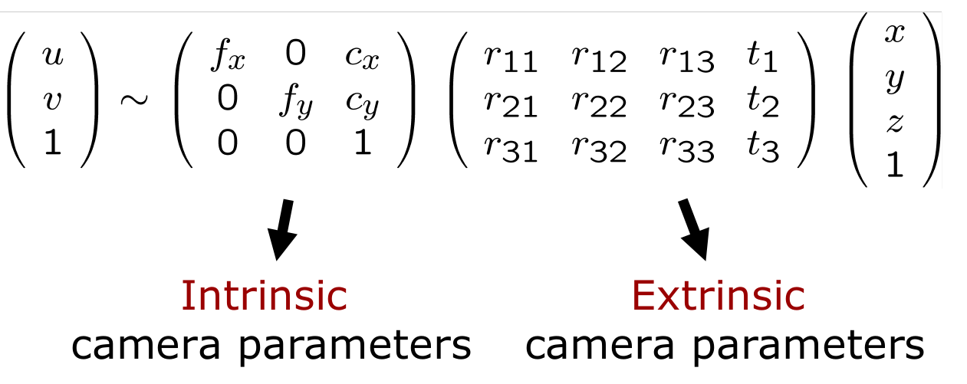
Projection |
Jason Rebello | Waterloo Autonomous Vehicles Lab
Notes:
Projection Equation, Distortions

Slide 14
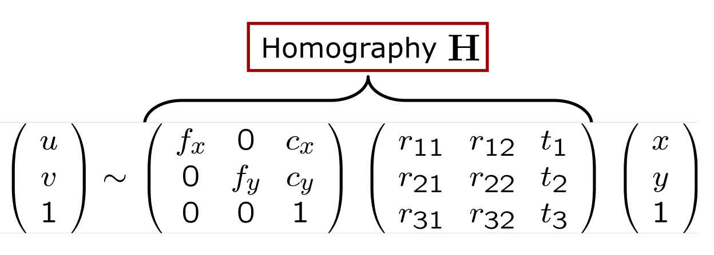
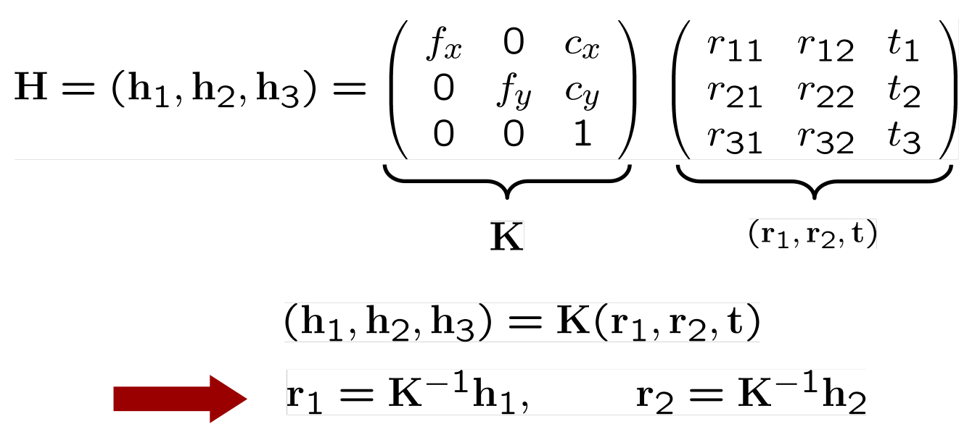
Homography |
Jason Rebello | Waterloo Autonomous Vehicles Lab
Notes:
Projection Equation, Distortions

Slide 15
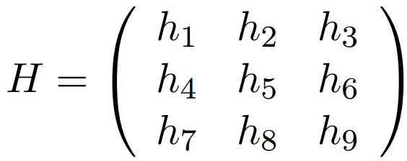
Homography Solution |
Jason Rebello | Waterloo Autonomous Vehicles Lab
Notes:
Projection Equation, Distortions

Slide 16
Homography constraints |
Jason Rebello | Waterloo Autonomous Vehicles Lab
Notes:
Projection Equation, Distortions

Slide 17
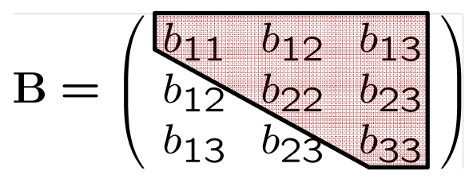
Intrinsic Parameters |
Find B , recover K through the Cholesky decomposition chol (B) = AA^{T}
A = K^{-T}
Jason Rebello | Waterloo Autonomous Vehicles Lab
Notes:
Projection Equation, Distortions

Slide 18
Solve for b |
Construct a system of linear Equations Vb = 0
V = [ v^{T}₁₂ v^{T}₁₁- v^{T}₂₂ ]^{T} … 2x6 matrix for 1 image
Where
v_{ij} = [ h_{1i}h_{1j} , h_{1i}h_{2j}+h_{2i}h_{1j} , h_{3i}h_{1j}+h_{1i}h_{3j} , h_{2i}h_{2j} , h_{3i}h_{2j}+h_{2i}h_{3j} , h_{3i}h_{3j} ]
^{For n images}
V = 2n x 6 matrix
Jason Rebello | Waterloo Autonomous Vehicles Lab
Notes:
Projection Equation, Distortions

Slide 19
Intrinsic Calibration |
Jason Rebello | Waterloo Autonomous Vehicles Lab
Notes:
Projection Equation, Distortions

Slide 20
Intrinsic Parameters |
Jason Rebello | Waterloo Autonomous Vehicles Lab
Notes:
Projection Equation, Distortions

Slide 21
Intrinsic Parameters |
Jason Rebello | Waterloo Autonomous Vehicles Lab
Notes:
Projection Equation, Distortions

Slide 22
Intrinsic Parameters |
Jason Rebello | Waterloo Autonomous Vehicles Lab
Notes:
Projection Equation, Distortions

Slide 23
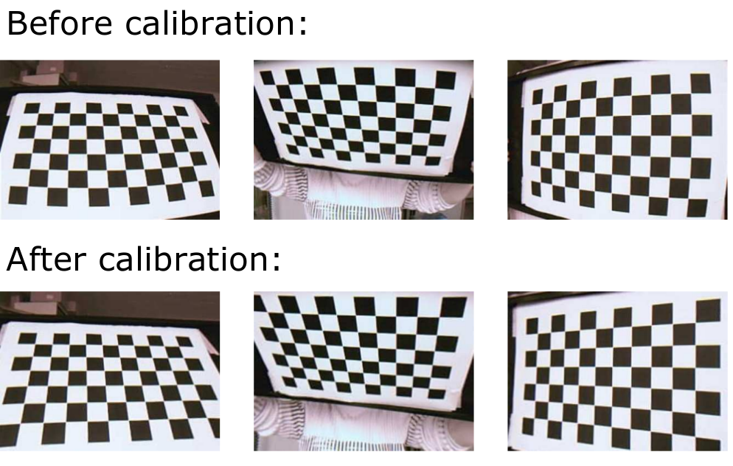
Intrinsic Parameters |
Jason Rebello | Waterloo Autonomous Vehicles Lab
Notes:
Projection Equation, Distortions

Slide 24
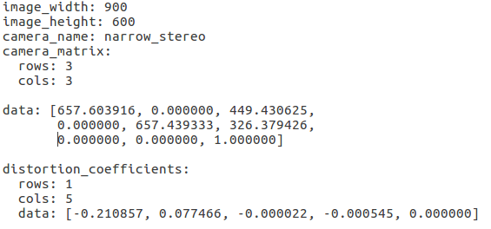
How do I calibrate a camera ? |
Print a target checkerboard (Several available online)
Note dimensions of target, size of square
Take multiple images by moving target to different locations on the image
Calibrate using OpenCV, Matlab
Reprojection error below 0.2 is good
Ximea camera: 5.3 ㎛ / pix
Edmund Optic lens: 3.5 mm
Focal length in pixel = 3.5 / (5.3x10⁻³) = 660.37
Question: What is the problem with this sort of calibration ?
Jason Rebello | Waterloo Autonomous Vehicles Lab
Notes:
Projection Equation, Distortions

Slide 25
Calibration Camera Extrinsics |
Camera Extrinsics
Jason Rebello | Waterloo Autonomous Vehicles Lab
Notes:
Dynamics is often stochastic, hence can’t optimize for a particular outcome, but only optimize to obtain a good distribution over outcomes ! Probability provides a framework to reason in this setting " Result: ability to find good control policies for stochastic dynamics and environments

Slide 26
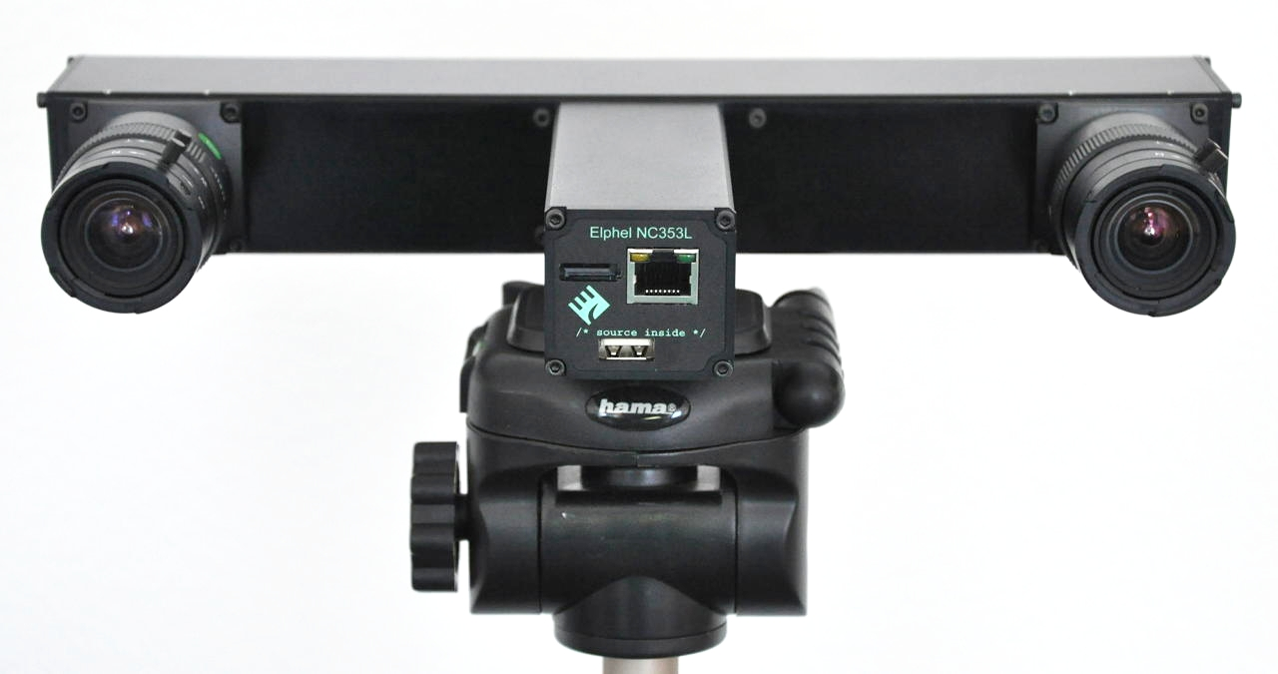
Extrinsic Calibration | Stereo Vision
Rotation and Translation
Jason Rebello | Waterloo Autonomous Vehicles Lab
Notes:
Projection Equation, Distortions

Slide 27
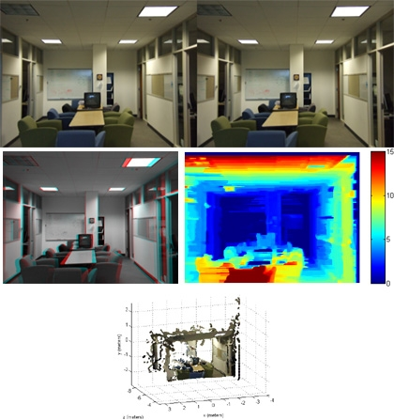
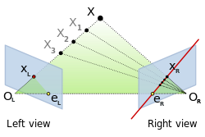
Advantages of Stereo Vision |
Stereo Vision:
Recover Depth
Limit the search space in the second image for point correspondence
Jason Rebello | Waterloo Autonomous Vehicles Lab
Notes:
Projection Equation, Distortions

Slide 28
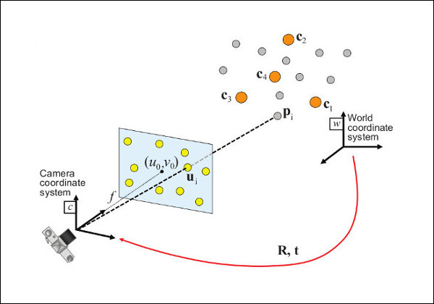
PnP Algorithm |
Given:
Known 3D points in world frame ( Checkerboard Points)
Pixel Locations on image plane
Intrinsic parameters of Camera
Estimate:
Transformation from world to camera
Jason Rebello | Waterloo Autonomous Vehicles Lab
Notes:
Projection Equation, Distortions

Slide 29
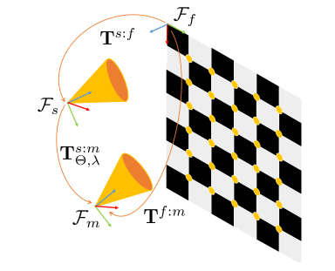
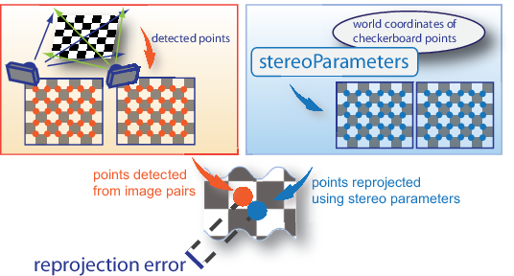
Extrinsic Calibration |
Given 3D points in world frame P^{w} and corresponding 2D pixel locations in both cameras z_{s} and z_{m}
Estimate Transformations from world to both cameras using PnP algorithm T^{s:w} and T^{m:w}
Transform 3D points from world to F_{s} camera.
P^{s} = T^{s:w} P^{w}
Transform 3D points from camera F_{s} to camera F_{m} via Extrinsic transformation.
P^{m} = T^{m:s} P^{s}
Project points onto F_{m.} camera. z’_{m} = ⌅(P^{m})
Reprojection Error:
∑_{images} ∑_{points} d( z’_{m} , z_{m} )² + d( z’_{s} , z_{s} )²
Jason Rebello | Waterloo Autonomous Vehicles Lab
Notes:
Projection Equation, Distortions

Slide 30
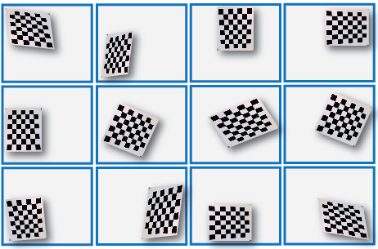
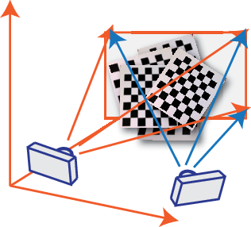
How should I calibrate the extrinsics ? |
Print a target checkerboard (Several available online)
Note dimensions of target, size of square
Take multiple images in both cameras at same time by moving target to different locations on the image
Calibrate using OpenCV, Matlab
Reprojection error below 0.4 is good
Jason Rebello | Waterloo Autonomous Vehicles Lab
Notes:
Projection Equation, Distortions

Slide 31
End of Calibration I |
Jason Rebello | Waterloo Autonomous Vehicles Lab

Slide 32
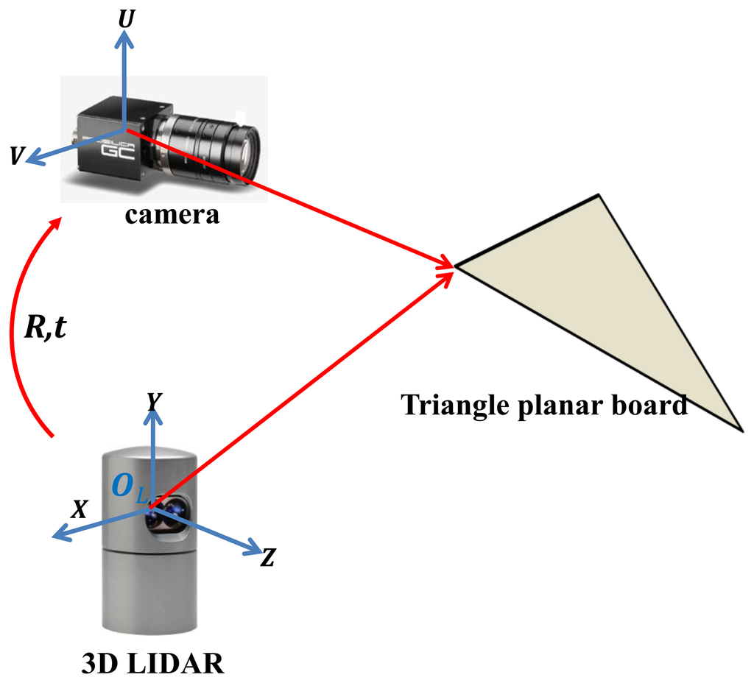
Lidar to Camera Calibration |
Target
Where does this calibration differ from the extrinsic camera calibration ?
What sort of target should be used ?
Jason Rebello | Waterloo Autonomous Vehicles Lab
Notes:
Colour the point cloud, camera gives narrow field of view, lidar is 360. Detection of cars in image and lidar point clouds

Slide 33
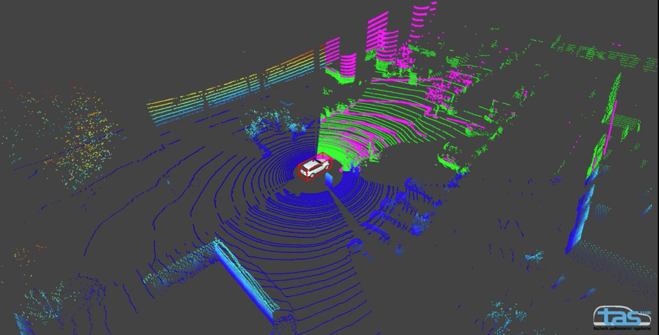
HDL 32 vs HDL 64 |
32 beam
64 beam
32 beam
64 beam
Jason Rebello | Waterloo Autonomous Vehicles Lab
Notes:
Projection Equation, Distortions

Slide 34
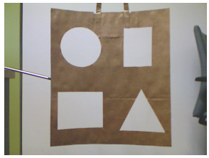
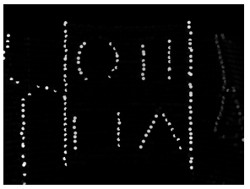
Lidar response problems |
Jason Rebello | Waterloo Autonomous Vehicles Lab
Notes:
Projection Equation, Distortions

Slide 35
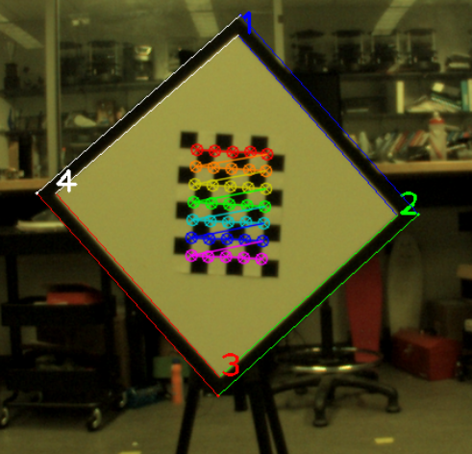
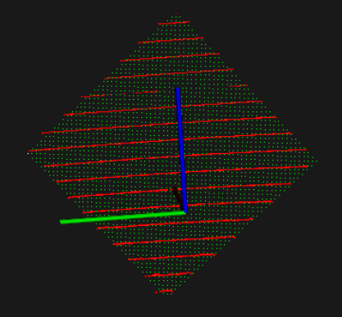
Lidar Camera Calibration |
Given 3D points in world frame P^{w} and corresponding 2D pixel locations z_{c} in the camera
Estimate Transformations from world to the camera using PnP algorithm T^{c:w}.
Input initial transformation from lidar to camera (approximate). T^{c:l}
Transform 3D points from Lidar F_{l} to camera F_{w} via Extrinsic transformation.
P^{w} = inv( T^{c:w} )T^{c:l} P^{l}
Determine which points P^{l} lie on target within some threshold.
Project points on plane
Fit ‘generated’ point cloud to detected point cloud and get end-points.
Determine end points of target on image
Reprojection Error: ∑_{images} ∑_{points} d( ⌅(T^{c:l}(P^{l} )) , z_{c} )²
Jason Rebello | Waterloo Autonomous Vehicles Lab
Notes:
Projection Equation, Distortions

Slide 36
Calibration Results |
Before Calibration
After Calibration
Jason Rebello | Waterloo Autonomous Vehicles Lab
Notes:
Dynamics is often stochastic, hence can’t optimize for a particular outcome, but only optimize to obtain a good distribution over outcomes ! Probability provides a framework to reason in this setting " Result: ability to find good control policies for stochastic dynamics and environments

Slide 37
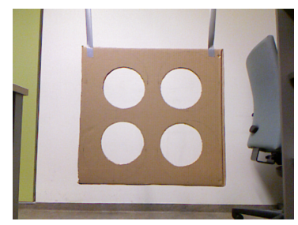
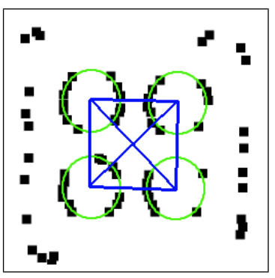
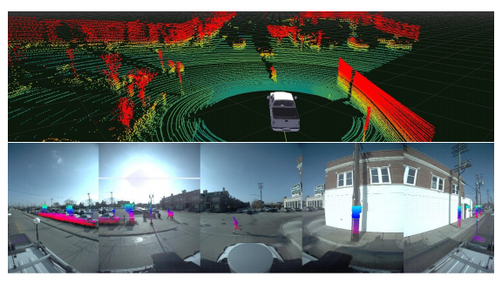
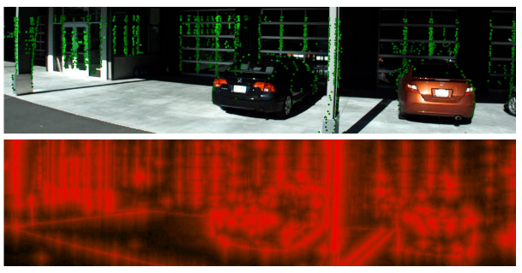
Alternative methods |
Martin Velas et.al Calibration of RGB Camera With Velodyne LiDAR
b) Gaurav Pandey et.al Automatic Extrinsic Calibration of Vision and Lidar by Maximizing Mutual Information
c) Jesse Levinson et.al Automatic Online Calibration of Cameras and Lasers
Jason Rebello | Waterloo Autonomous Vehicles Lab
Notes:
The mutual information (MI) between two random variables X and Y is a measure of the statistical dependence occurring between the two random variables. Here we consider the laser reflectivity value of a 3D point and the corresponding grayscale value of the image pixel to which this 3D point is projected as the random variables X and Y , respectively.The marginal and joint probabilities of the random variables X and Y can be obtained from the kernel density estimate (KDE) of the normalized marginal and joint histograms of Xi and Yi. Once we have an estimate of the probability distribution we can write the MI of the two random variables as a function of the extrinsic calibration parameters (R, t), thereby formulating an objective function:

Slide 38
Questions |
Jason Rebello | Waterloo Autonomous Vehicles Lab
Notes:
Dynamics is often stochastic, hence can’t optimize for a particular outcome, but only optimize to obtain a good distribution over outcomes ! Probability provides a framework to reason in this setting " Result: ability to find good control policies for stochastic dynamics and environments

Slide 39
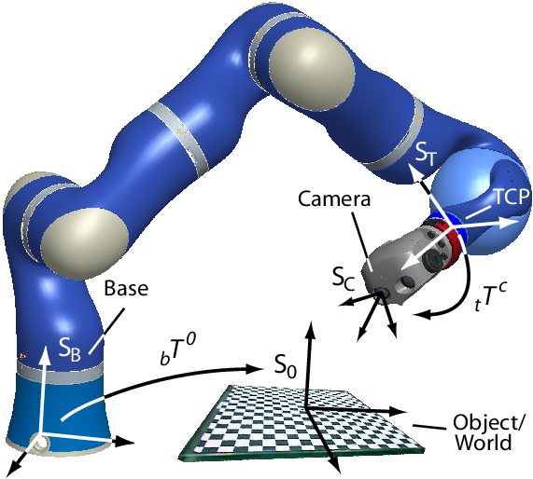
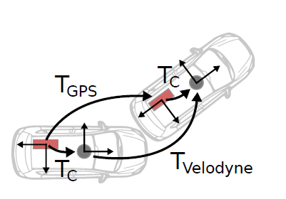
￼
Lidar to GPS |
Jason Rebello | Waterloo Autonomous Vehicles Lab
Notes:
Dynamics is often stochastic, hence can’t optimize for a particular outcome, but only optimize to obtain a good distribution over outcomes ! Probability provides a framework to reason in this setting " Result: ability to find good control policies for stochastic dynamics and environments

Slide 40
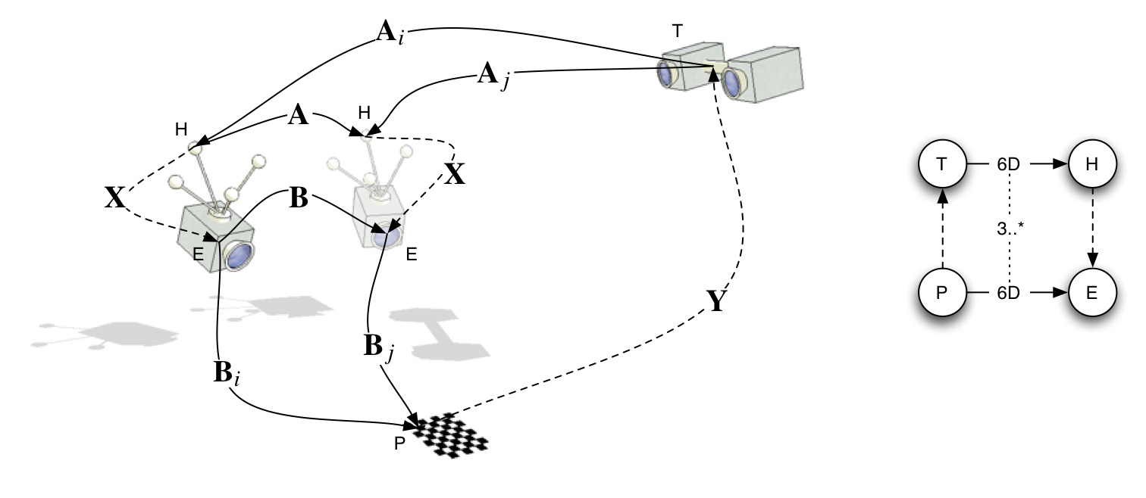
Hand-Eye Calibration |
Motion Capture System
Reflective Marker
Estimate
Static
Static
Camera
Estimate
Fiducial Target
Jason Rebello | Waterloo Autonomous Vehicles Lab
Notes:
Dynamics is often stochastic, hence can’t optimize for a particular outcome, but only optimize to obtain a good distribution over outcomes ! Probability provides a framework to reason in this setting " Result: ability to find good control policies for stochastic dynamics and environments

Slide 41
Hand-Eye Calibration |
T_{VM} : Marker to Vicon Motion Tracking
T_{MC} : Camera to Marker
T_{VF} : Fiducial Target to Vicon
T_{FC} : Camera to Fiducial Target
Jason Rebello | Waterloo Autonomous Vehicles Lab
Notes:
Dynamics is often stochastic, hence can’t optimize for a particular outcome, but only optimize to obtain a good distribution over outcomes ! Probability provides a framework to reason in this setting " Result: ability to find good control policies for stochastic dynamics and environments

Slide 42
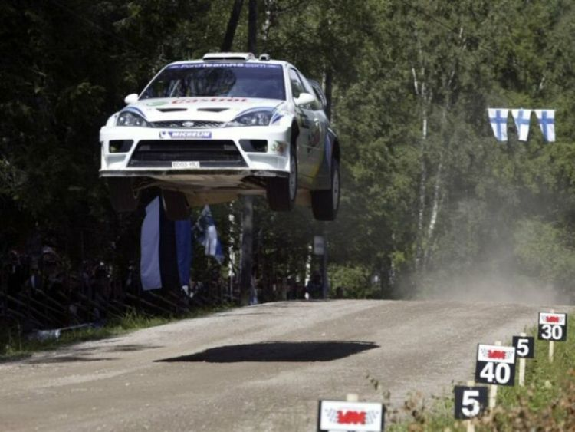
Hand-Eye calibration on Car |
Calibration with motion capture system and fiducial target similar to Lidar (SLAM) and GPS
Planar motion leads to observability issues (Z, roll pitch)
Need to find area that allows for sufficient excitation (car motion).
Jason Rebello | Waterloo Autonomous Vehicles Lab
Notes:
Dynamics is often stochastic, hence can’t optimize for a particular outcome, but only optimize to obtain a good distribution over outcomes ! Probability provides a framework to reason in this setting " Result: ability to find good control policies for stochastic dynamics and environments

Slide 43
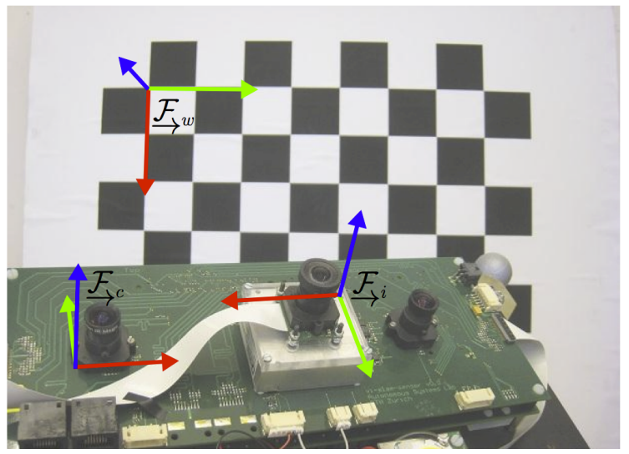
IMU to Camera Calibration |
World
IMU
Camera
Jason Rebello | Waterloo Autonomous Vehicles Lab
Notes:
Dynamics is often stochastic, hence can’t optimize for a particular outcome, but only optimize to obtain a good distribution over outcomes ! Probability provides a framework to reason in this setting " Result: ability to find good control policies for stochastic dynamics and environments

Slide 44
IMU to Camera Calibration |
Quantities Estimated:
Gravity direction expressed in World Frame
Transformation between Camera and IMU
Offset between Camera time and IMU time
Pose of IMU
Accelerometer and gyroscope biases
Assumptions Made:
Camera Intrinsics are known
IMU noise and bias models are known
Have a guess for gravity in world frame
Have a guess for the calibration matrix
Geometry of calibration pattern is known
Data association between image point and world point known
Jason Rebello | Waterloo Autonomous Vehicles Lab
Notes:
Dynamics is often stochastic, hence can’t optimize for a particular outcome, but only optimize to obtain a good distribution over outcomes ! Probability provides a framework to reason in this setting " Result: ability to find good control policies for stochastic dynamics and environments

Slide 45
Questions |
Jason Rebello | Waterloo Autonomous Vehicles Lab
Notes:
Dynamics is often stochastic, hence can’t optimize for a particular outcome, but only optimize to obtain a good distribution over outcomes ! Probability provides a framework to reason in this setting " Result: ability to find good control policies for stochastic dynamics and environments

Slide 46
IMU to Camera Calibration |
Time varying states are represented as weighted sum of a finite number of known basis functions. phi(t) assumed to be known
y_{j} is a measurement that arrived with timestamp t_{j}. h(.) is a measurement model that produces a predicted measurement from x(.) and d is unknown time offset
The analytical Jacobian of the error term, needed for nonlinear least squares is derived by linearizing about a nominal value d, with respect to small changes in d.
Jason Rebello | Waterloo Autonomous Vehicles Lab
Notes:
Dynamics is often stochastic, hence can’t optimize for a particular outcome, but only optimize to obtain a good distribution over outcomes ! Probability provides a framework to reason in this setting " Result: ability to find good control policies for stochastic dynamics and environments

Slide 47
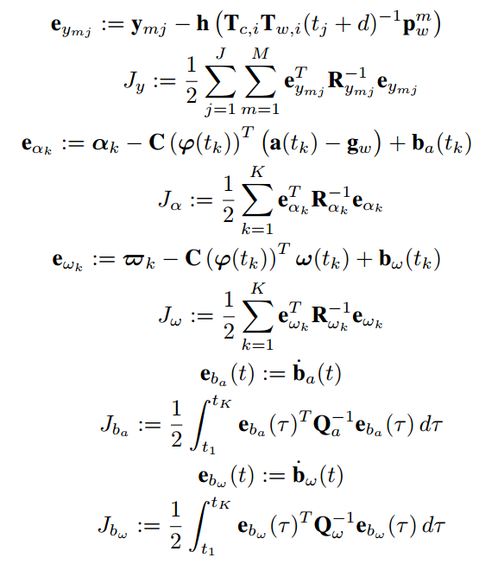
IMU Camera calibration |
Accelerometer measurement, gyroscope measurement (at time k) pixel location (time t+d), h(.) projection model, n is noise. J is number of images
IMU biases
Error terms are associated with the measurements constructed as the difference between the measurement and the predicted measurement for current state estimate
Jason Rebello | Waterloo Autonomous Vehicles Lab
Notes:
Dynamics is often stochastic, hence can’t optimize for a particular outcome, but only optimize to obtain a good distribution over outcomes ! Probability provides a framework to reason in this setting " Result: ability to find good control policies for stochastic dynamics and environments

