Slide 1
Modelling Camera Residual Terms Using Reprojection Error and Photometric Error
June 26 2017
Pranav Ganti

Slide 2
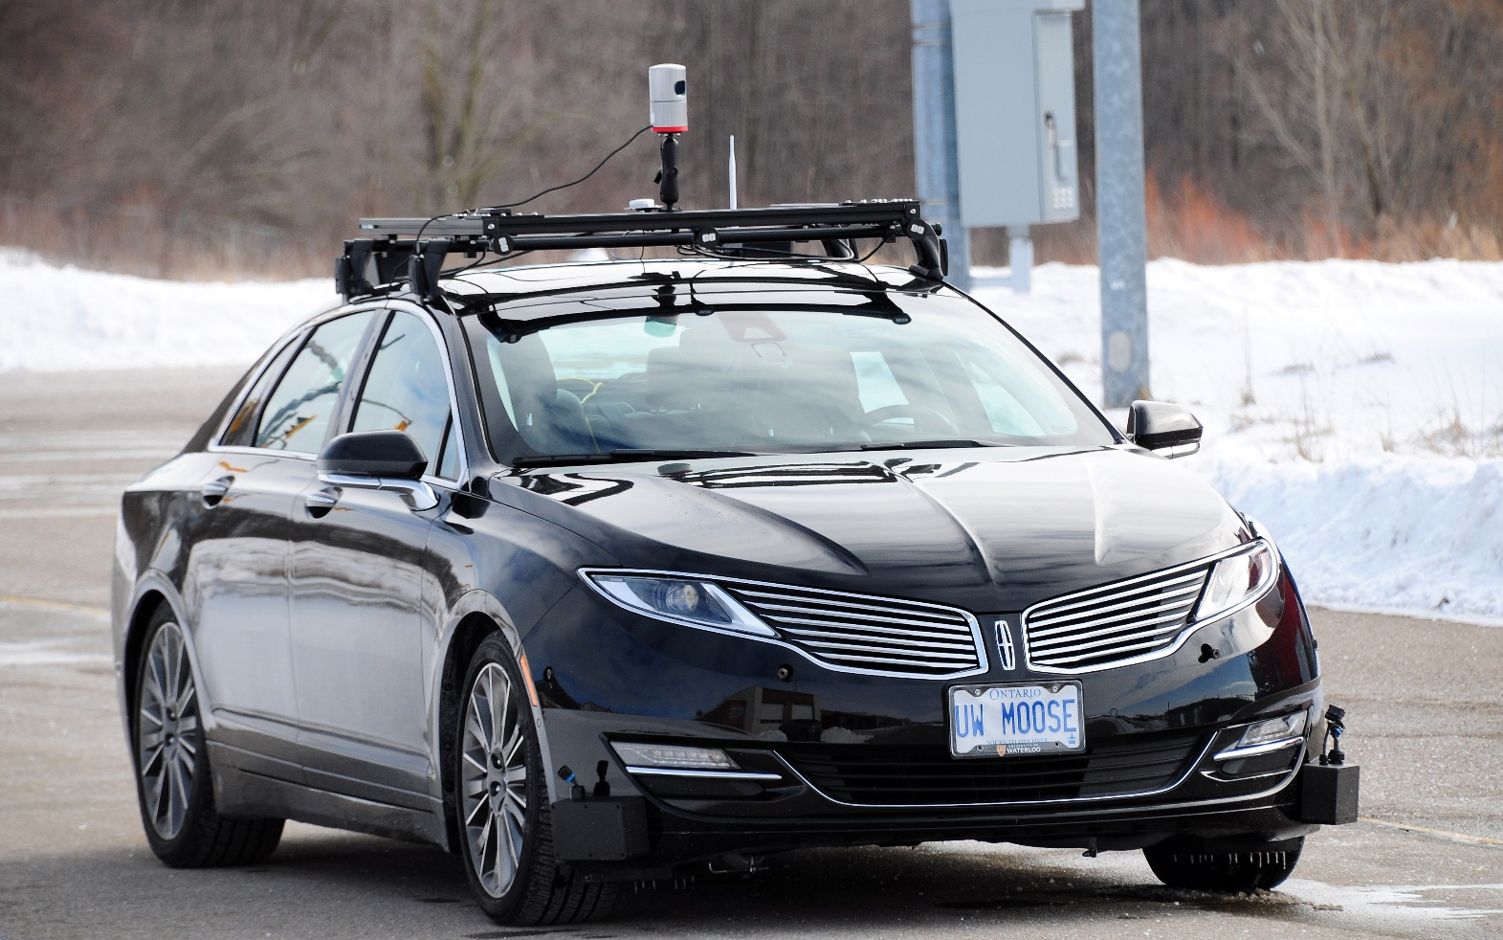
Outline
Overview
Geometry
Cameras – Part 1
Multi-view Geometry
Reprojection Error
Cameras – Part 2
Photometric Error
Application (SVO)

Slide 3
Overview
Residual
Difference between the observed value and estimated value
Cost/ Loss function is the function to be minimized
Generally a function of the residual
Camera residuals
Formulation depends on indirect vs direct methods
A value to be minimized, which can estimate the camera pose.

Slide 4
Geometry | Euclidean Space
Euclidean Space ($R^{3}$)
Euclidean geometry describes:
Lines
Circles
Angles
Issue: $\boxed{∞}$
How do we represent points at infinity?

Slide 5
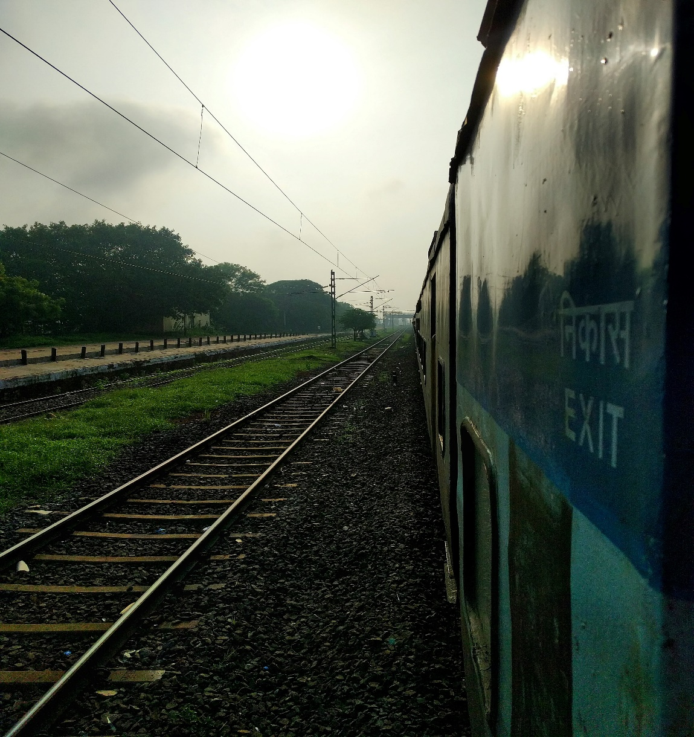
Geometry | Projective Space
Euclidean Space + ideal points
Ideal points: points at infinity.
Now, 2 lines always meet in a point!
Projective space is derived from Euclidean space by adding line @ infinity
Points at infinity can be described using homogeneous coordinates

Slide 6
Geometry | Homogeneous Coordinates
Homogeneous coordinates in $R^{n}$ written as an $n+1$ vector
$R^{2}:{\left(x, y, 1\right)}^{T}, R^{3}:{\left(x, y, z, 1\right)}^{T}$
Ideal points: ${\left(x, y, …, 0\right)}^{T}$
What about scaled points?
${\left(kx, ky, k\right)}^{T}$ is an equivalence class of ${\left(\frac{x}{k}, \frac{y}{k}, 1\right)}^{T}$ - (we’ll revisit why later!)
Euclidean space can be extended to projective space using homogeneous vectors

Slide 7
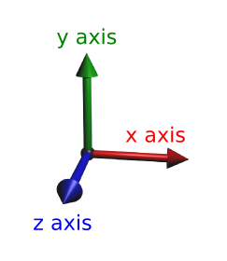
Geometry | Transformations
Euclidean Transform: Rotation + Translation
Affine transform: Rotation + Translation + Stretching (linear scaling)
For both Euclidean and Affine transforms, points at infinity remain at infinity
What about a projective transform?

Slide 8
Geometry | Projective Transformations
What properties of an object are preserved?
Shape?
Angles?
Lengths?
Distances?
Straightness?
Projective transformation is any mapping that preserves straight lines.

Slide 9
Geometry | Projective Transformations…cont
Projective transformation is a mapping of the homogeneous coordinates
Ideal points are not preserved
Points at infinity are mapped to arbitrary points
For computer vision, the projective space is convenient
Treat 3D space as $P^{3}$ instead of $R^{3}$
Images as $P^{2}$
Useful for practical applications – even though we know points at $∞$ are our own construct

Slide 10
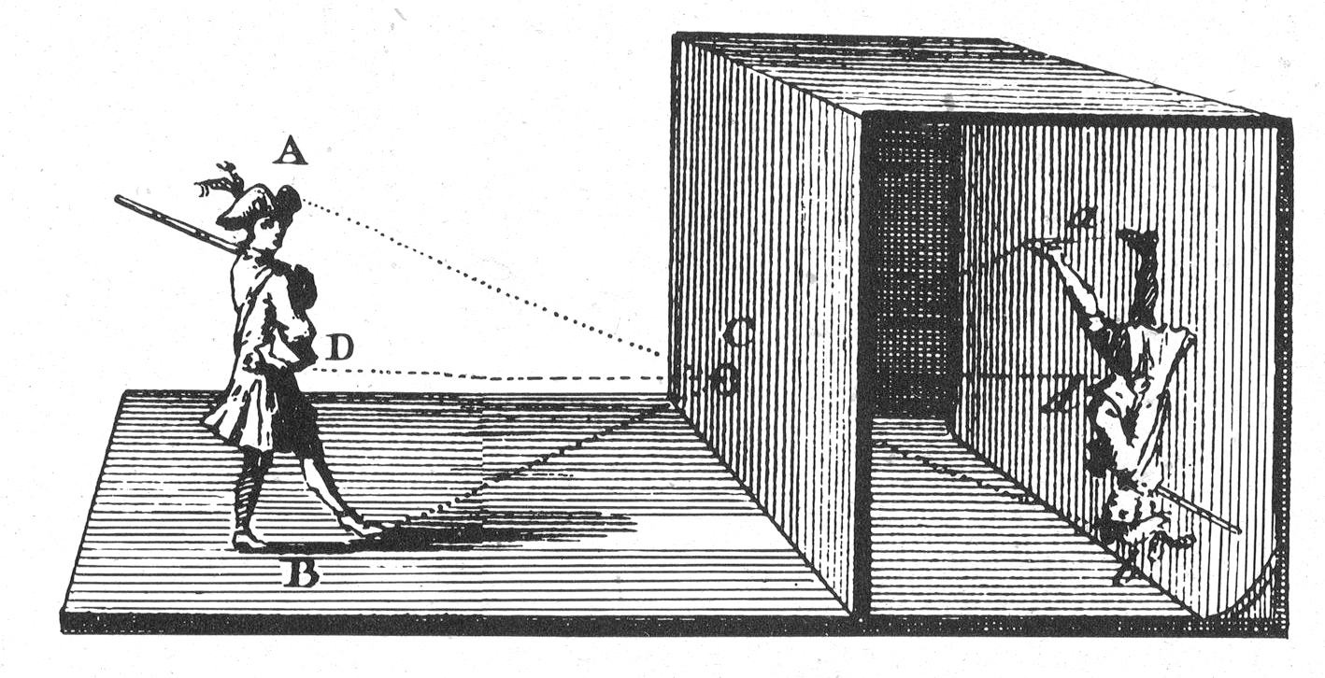
Cameras, Part 1 | Pinhole Camera
Also known as “camera obscura”
First type of camera
Light passes through an opening
Image is reflected on the other side

Slide 11
Cameras, Part 1 | Central Projection
Cameras are a map between the 3D world and 2D image
Projection: lose 1 dimension
Can be mapped via central projection
Ray from 3D point passes through camera center of projection (COP)
Intersects image plane
If 3D structure is planar, then there is no drop in dimension

Slide 12
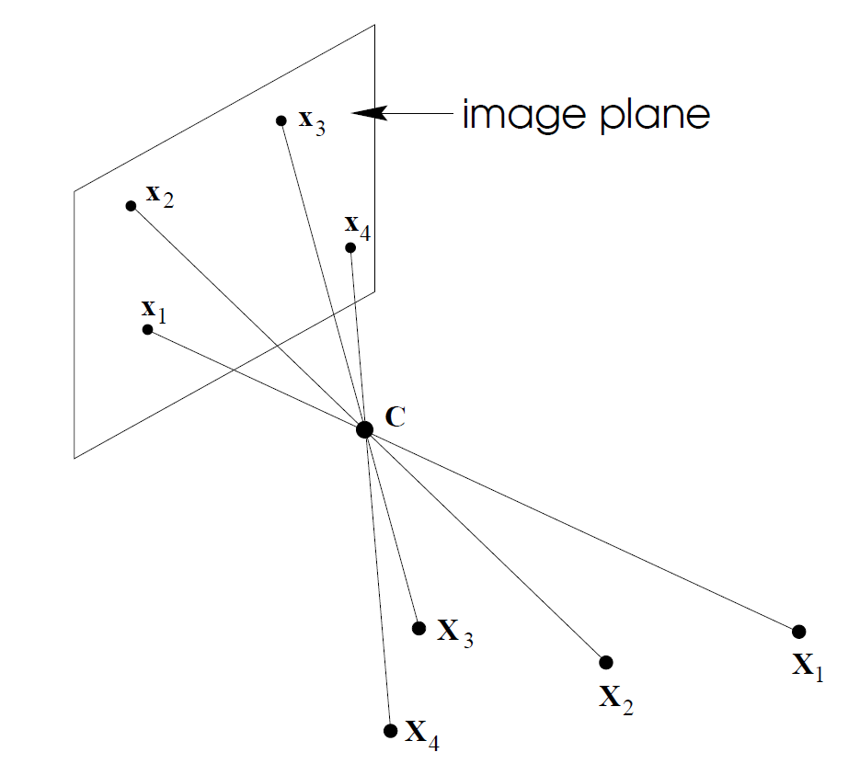
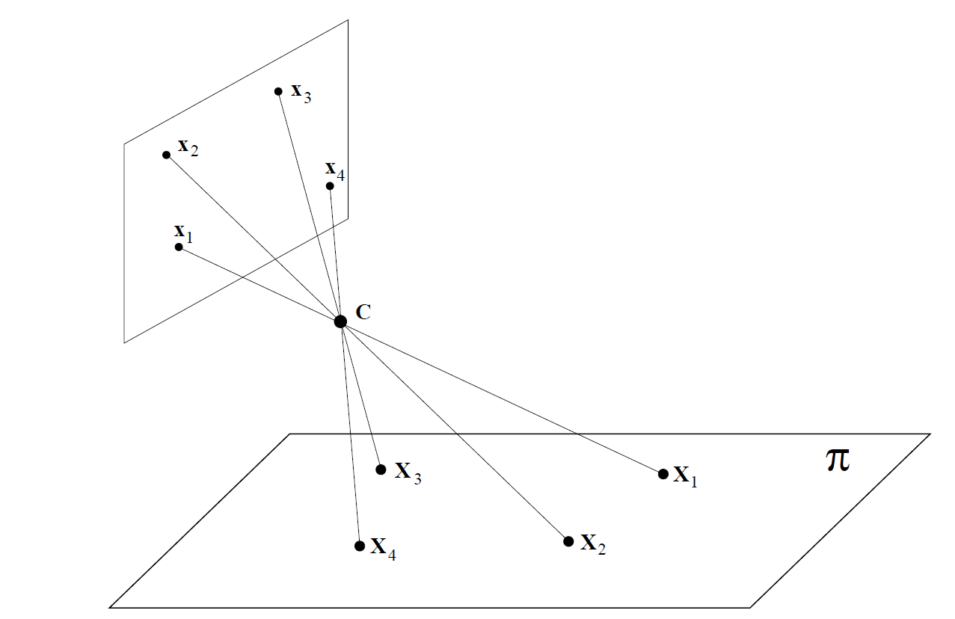
Cameras, Part 1 | Central Projection

Slide 13
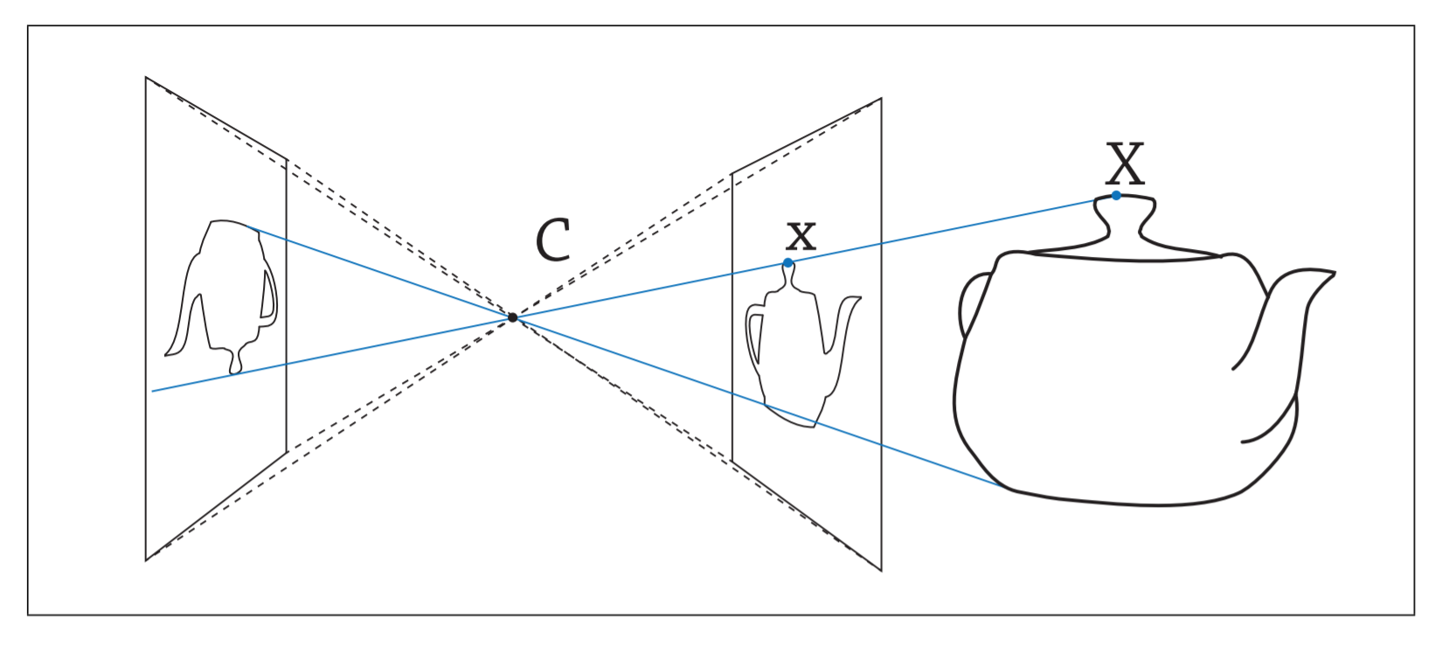
Cameras, Part 1 | Central Projection
For convenience: can place image plane in front of COP
Image Plane
$$f$$
$$f$$

Slide 14
Cameras, Part 1 | Central Projection
In essence, central projection is just mapping $P^{3}→P^{2}$
The camera matrix P is a 3x4 matrix of rank 3
$$\boxed{{\left(x, y, w\right)}^{T}=P{\left(X, Y, Z, T\right)}^{T}}$$
${\left(x,y, w\right)}^{T}$ are homogeneous coordinates of image space ($P^{2}$)
${\left(X, Y,Z,T\right)}^{T}$ are homogeneous coordinates of 3D world ($P^{3}$)

Slide 15
Cameras, Part 1 | Rays and Points
Ray passing through COP is a projected point in the image.
Therefore, all points on ray can be considered equal.
Rays are image points, and we can represent rays as homogeneous coordinates
Need calibration to express relative Euclidean geometry between image and world.
With a calibrated camera, can back-project 2 points in an image
Can then determine angle between two rays

Slide 16
Cameras, Part 1 | Matrix Derivation
Let’s derive the camera matrix.
Assumptions:
Center of projection is origin ($R^{3}$)
Using pinhole camera model:
By similar triangles:
$${\left(X, Y, Z\right)}^{T}→\left(\frac{fX}{Z},\frac{fY}{Z}, f\right)$$

Slide 17
Cameras, Part 1 | Pinhole
Recall: image plane is located at a distance equivalent to the focal length
$${\left(\frac{fX}{Z},\frac{fY}{Z}, f\right)}^{T}$$
$${\left(X, Y, Z, 1\right)}^{T}$$
$${\left(0, 0, 0\right)}^{T}$$

Slide 18
Cameras, Part 1 | Pinhole
Mapping from $P^{3}$ to $P^{2}$ using similar triangles
$${\left(X, Y, Z, 1\right)}^{T}$$
$${\left(\frac{fX}{Z},\frac{fY}{Z}, f\right)}^{T}$$
$${\left(0, 0, 0\right)}^{T}$$

Slide 19
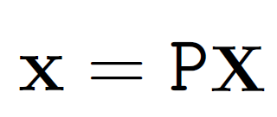
Cameras, Part 1 | Camera Matrix
With the Euclidean origin @ the COP:
Central projection just becomes a linear map b/w homogenous coordinates
Can be written as:

Slide 20
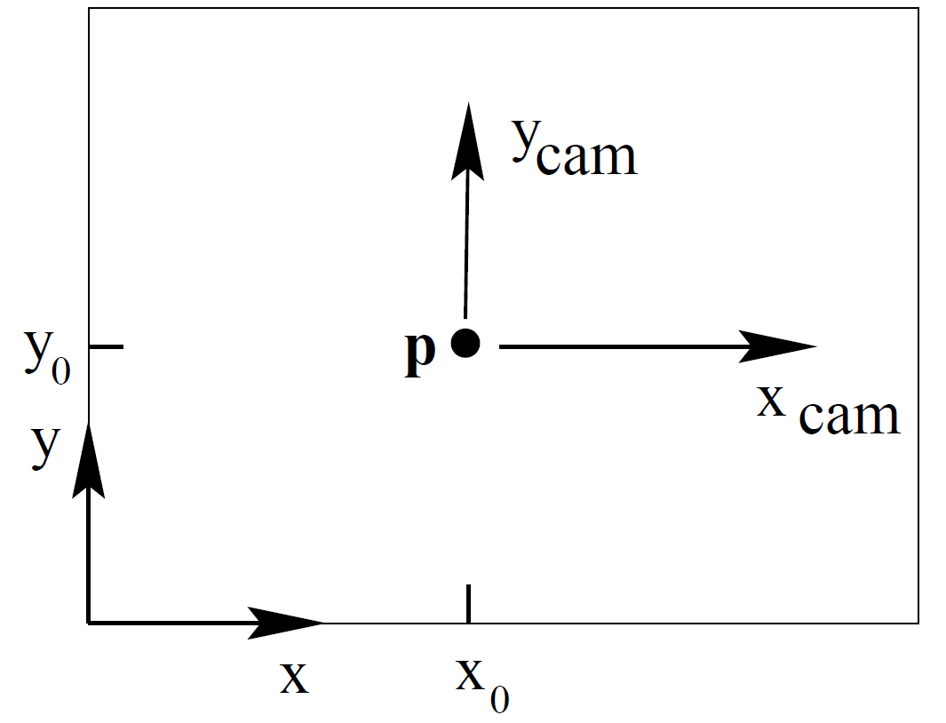
Cameras, Part 1 | Camera Matrix
The previous equation assumes image coordinates at the principal point.
A more generic mapping is:

Slide 21
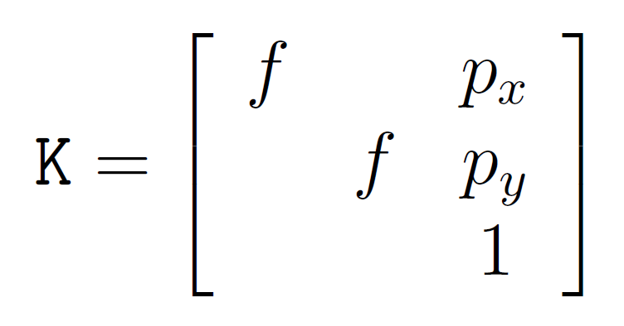
Cameras, Part 1 | Camera Matrix
$K$ is the camera calibration matrix
Can also add a skew parameter
Can then express
where $x_{cam}$ is ${\left(X, Y, Z, 1\right)}^{T}$, expressed in a coordinate frame at the COP.
s

Slide 22
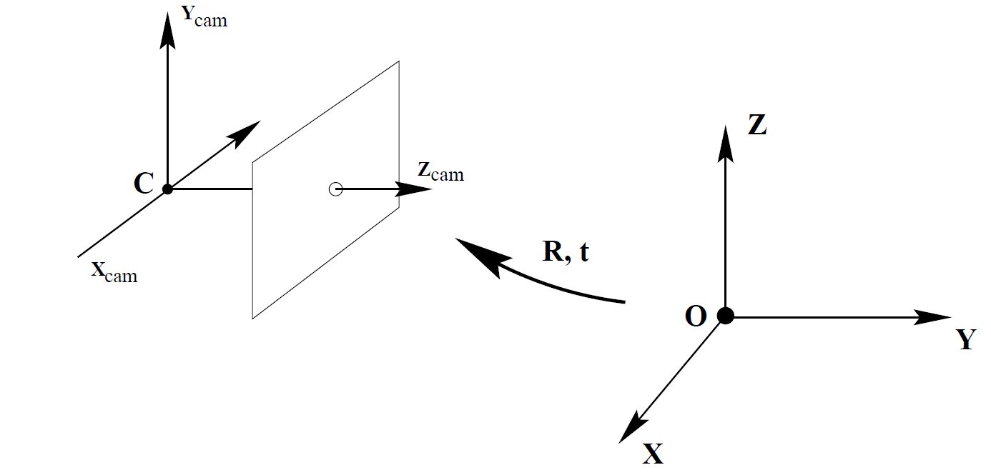
Cameras, Part 1 | Camera Matrix
The world coordinate frame is not always expressed at COP.
Example: a moving camera!
Coordinate frames related through a rotation and translation

Slide 23
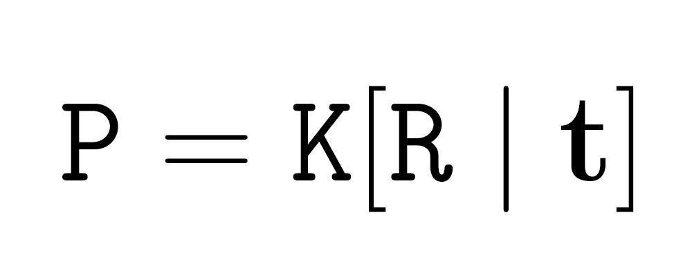
Cameras, Part 1 | Camera Matrix
The equation can now be expressed as:

Slide 24
Cameras, Part 1 | Projections
Forward projection: maps a point in 3D space to an image point
$x=PX$
Back projection: from a point $x$ in an image, we can determine the set of points that map to this point.
Ray in space passing through the space
How can we obtain the back projection?

Slide 25
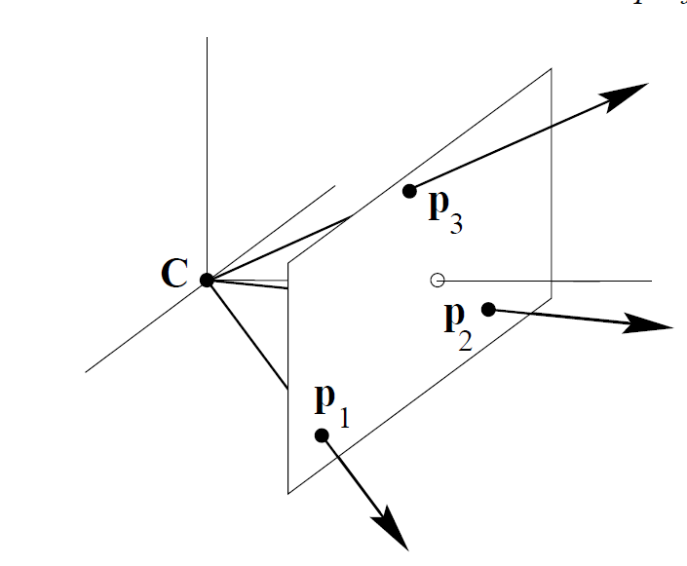
Cameras, Part 1 | Back Projection
Null space of C is the camera center
We know 2 points on each ray:
COP ($PC=0$)
Image point ${(P}^{+}x)$, $P^{+}=P^{T}{\left(PP^{T}\right)}^{−1}$
Why is $P^{+}x$ the second point?
It projects to x!
$P\left(P^{+}x\right)=Ix=x$
The ray is then the line connecting these two points.

Slide 26
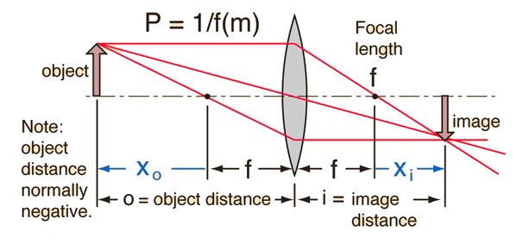
Cameras, Part 1 | Lenses
Pinhole camera is ideal
Not a true representation of a camera
Need to correct for distortions
Want images as if we were using a pinhole camera
Distortion can be radial or tangential

Slide 27
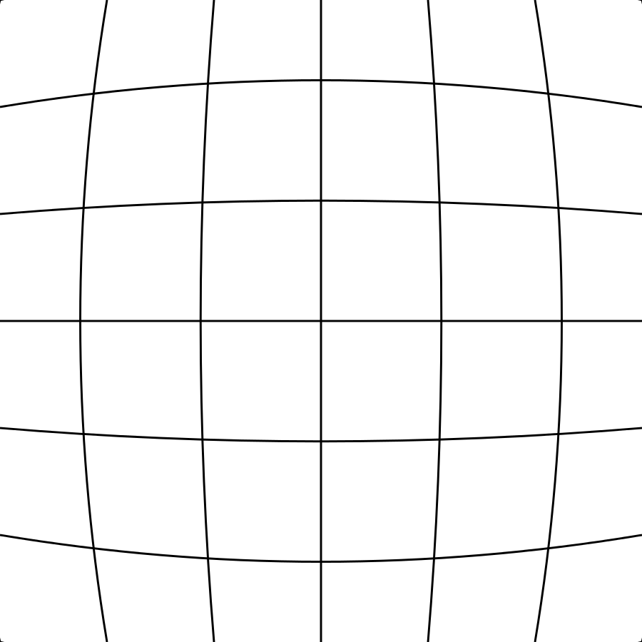
Cameras, Part 1 | Lens Distortion
Barrel Distortion Pincushion Distortion

Slide 28
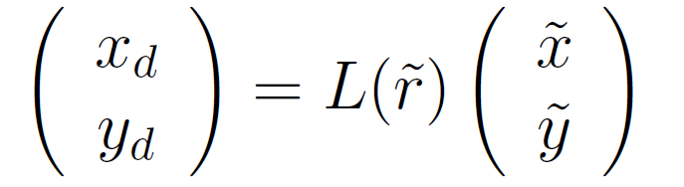
Cameras, Part 1 | Lens Correction
Lens distortion occurs during initial projection onto image plane
$\tilde{x}, \tilde{y}$ are ideal, $x_{d}, y_{d}$ are actual
$\tilde{r}$ is Euclidean distance
$L(\tilde{r})$ is the distortion factor.
Can be solved for through calibration

Slide 29
Multi-view Geometry | Epipolar Geometry
Motivation: to search for corresponding points in stereo matching
Baseline: Line joining camera centers
Epipole: point of intersection b/w baseline and image plane
Epipolar line: intersection of an epipolar plane with the image plane
Epipolar plane: plane containing the baseline

Slide 30
Multi-view Geometry | Epipolar constraints

Slide 31
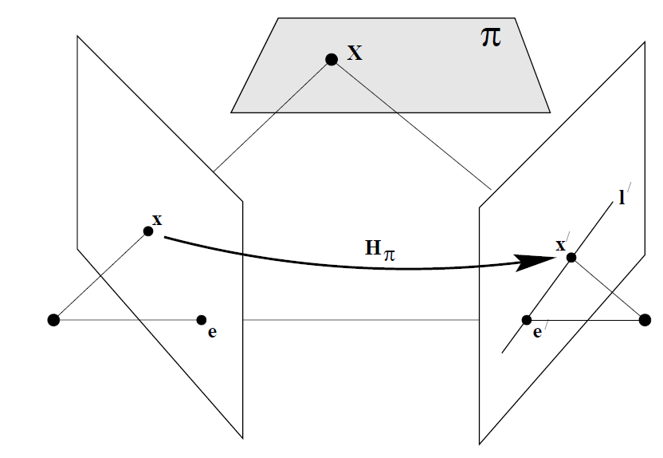
Multi-view Geometry | Fundamental Matrix
Algebraic representation of epipolar geometry
$F$ represents the mapping from $P^{2}→P$, through the epipolar lines.
Two steps:
Map point $x$ to $x’$
Obtain $l′$ from joining $x′$ to $e′$

Slide 32
Multi-view Geometry | Fundamental Matrix
Properties:
Correspondence: $x^{′T}Fx=0$
Transpose: If $F$ is the matrix for camera $P$, $F^{T}$ is the corresponding fundamental matrix for camera $P′$
Epipolar lines: $l^{′}=Fx, l=F^{T}x′$
$Fe=0, e^{′T}F=0$
Methods to solve: 7 point algorithm, 8 point algorithm, RANSAC…

Slide 33
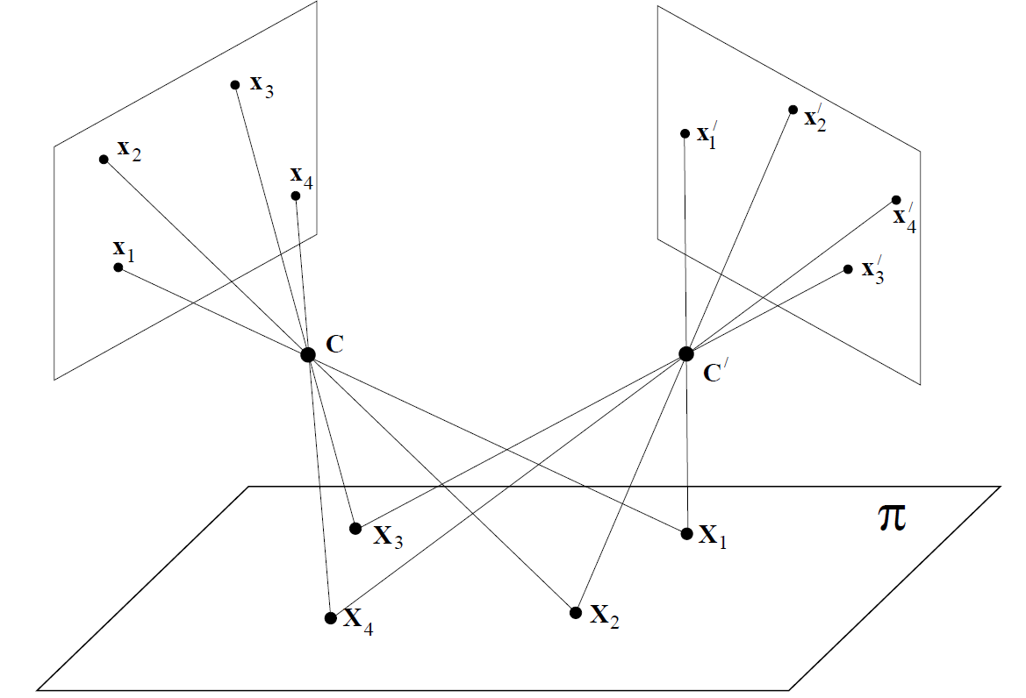
Multi-view Geometry | Stereo Cameras

Slide 34
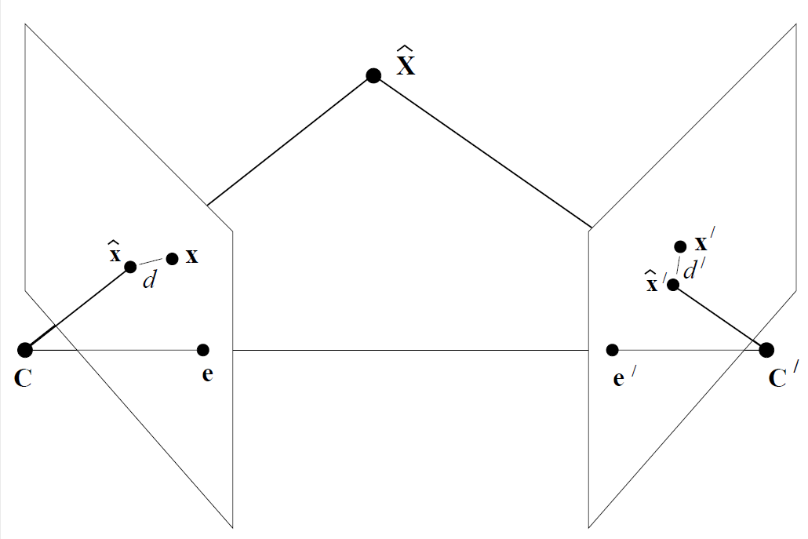
Reprojection Error
Summed squared distance between projections of $X$, and measured image points.
Euclidean distance
In 2 images

Slide 35
Reprojection Error | Applications
Fundamental matrix
MLE of $F$ (assuming Gaussian noise) minimizes reprojection error
$\hat{x}, \hat{x′}$ are ideal points, and obtained from $\hat{x}=PX$.
Both $P$ and $X$ can be modified to minimize this error.
Recall: , and $R, t$ represent the camera pose in the world frame!
Bundle adjustment
Similar, except the intrinsic parameters can also be modified.

Slide 36
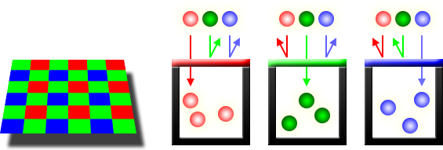
Cameras, Part 2 | Photosites
Camera sensors consist of photosites
Quantifies amount of light collected
The digitized information is a pixel
CCD (charge-coupled device), CMOS (complementary metal-oxide semiconductor)

Slide 37
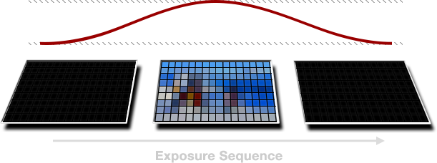
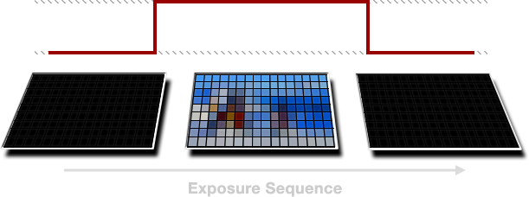
Cameras, Part 2 | Shutter
Soft Global Shutter
Rolling Shutter
Hard Global Shutter

Slide 38
Cameras, Part 2 | Intensity Image
The resulting information from the image capture is an intensity image.
Allows for use of the entire image, as opposed to just keypoints.
Becomes dense, so some direct methods only use patches of interest
Intensity image is defined as:
$Ω$ is image domain
Recall previously, images were $R^{3}→{ R}^{2}$

Slide 39
Photometric Error | SVO Notation
Notation (from SVO)
$I_{k−1}, I_{k}$: intensity images
$T_{k,k−1}$: frame transform
$u$: image coordinate
$p$: 3D point
$d_{u}$: depth
$π:R^{3}→R^{2}$: camera projection model
$π^{−1}$: inverse
$k$: camera frame of reference, or timestep $k$
$ξ$: twist coordinates, se(3)
Relationships

Slide 40
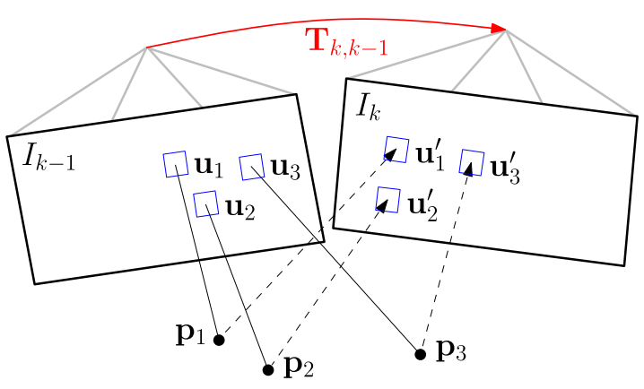
Photometric Error | Principles
Photometric error: intensity difference between pixels observing the same point in 2 scenes.

Slide 41
Photometric Error | Principles
Intensity residual can be computed by:
Back-projecting a 2D point from the previous image.
Reprojecting it into the current camera view.
Looking to minimize negative log-likelihood between camera poses, using intensity residual.

Slide 42
Photometric Error | Solving
Intensity residuals are normally distributed
The equation is nonlinear in $T_{k, k−1}$, can be solved via the Gauss-Newton algorithm
Incremental update: $T\left(ξ\right)$
${\hat{T}}_{k,k−1}$ is an estimate of the relative transformation
$ξ∈se(3)$

Slide 43
Camera Residual Terms
Reprojection error:
Binary factor between feature and camera pose
Photometric error:
Unary factor (at least in SVO)
No feature locations to estimate position of.

Slide 44
Application | SVO
Applications
Reprojection Error: Indirect VO/ SLAM
Photometric Error: Direct VO/SLAM
SVO (Semi-direct Visual Odometry) takes advantage of both.
Initial pose estimate using direct
Further refinement using indirect methods on keyframes

Slide 45
Application | SVO
Indirect methods extract features, match them, and then recover camera pose (+structure) using epipolar geometry and reprojection error
Pros: Robust matches even with high inter-image motion
Cons: Extraction, matching, correspondence…can be quite costly
Direct methods estimate camera pose (+structure) directly from intensity values and image gradients.
Pros: Can use all information in image. More robust to motion blur, defocus. Can outperform indirect methods.
Cons: Can also be costly, due to density.

Slide 46
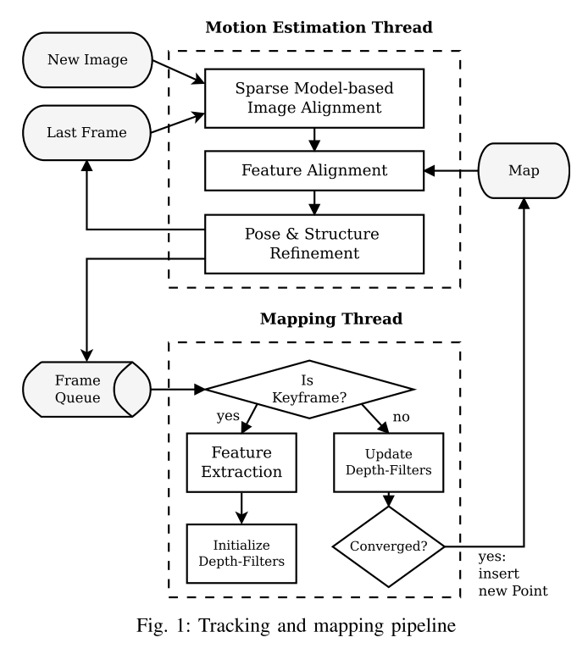
Application | SVO
SVO steps:
Initial pose estimate through minimizing photometric error.
Relaxation through feature alignment.
Further refinement through reprojection error.
In parallel:
Determine keyframes, extract features
Estimate depth through projection model

Slide 47
Application | SVO
Results:

Slide 48
Application | SVO 2.0
SVO 2.0:

Slide 49
References
R. Hartley and A. Zisserman, Multiple view geometry in computer vision. Cambridge university press, 2003.
C. Forster, M. Pizzoli, and D. Scaramuzza, “Svo: Fast semi-direct monocular visual odometry,” in Robotics and Automation (ICRA), 2014 IEEE International Conference on, pp. 15–22, IEEE, 2014.
C. Forster, Z. Zhang, M. Gassner, M. Werlberger, and D. Scaramuzza, “Svo: Semidirect visual odometry for monocular and multicamera systems,” IEEE Transactions on Robotics, 2016.

Slide 50
Image References
https://i.stack.imgur.com/SitTF.png Retrieved June 24 2017
http://www.red.com/learn/red-101/global-rolling-shutter Retrieved June 25 2017
https://en.wikipedia.org/wiki/Errors_and_residuals
https://en.wikipedia.org/wiki/Euclidean_space
https://en.wikipedia.org/wiki/Distortion_(optics)
http://www.cc.gatech.edu/~afb/classes/CS4495-Fall2013/slides/CS4495-05-CameraModel.pdf
https://en.wikipedia.org/wiki/Camera_obscura

