Slide 1

Homework|
Homework: Derive the following expression for the derivative of the inverse mapping
Arun Das | Waterloo Autonomous Vehicles Lab

Slide 2

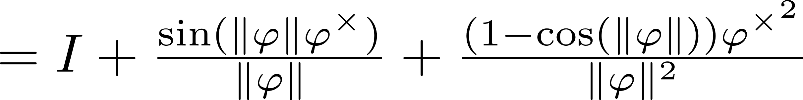
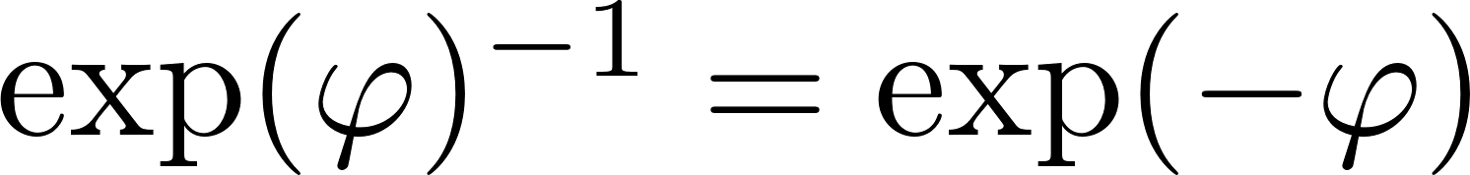
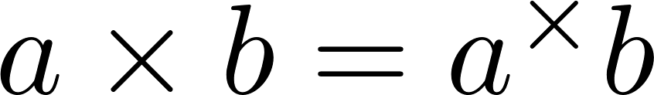
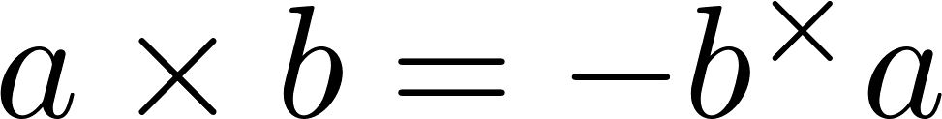
Differential Calculus| Important Expressions
(1) Box-plus and box-minus
(2) Rodriguez Formula
(3) Inverse Identity
(4) Adjoint Related Identity
(5) anticommutative
Arun Das | Waterloo Autonomous Vehicles Lab

Slide 3
Homework|
Homework: Derive the following expression for the derivative of the inverse mapping
Arun Das | Waterloo Autonomous Vehicles Lab

Slide 4
Homework|
Formulate a method to interpolate between two Transformation matrices.
Arun Das | Waterloo Autonomous Vehicles Lab

Slide 5
Homework|
Formulate a method to interpolate between two Transformation matrices.
Consider linear interpolation:
Can we do something similar for SO(3) or SE(3)?
Arun Das | Waterloo Autonomous Vehicles Lab

Slide 6
Homework|
Formulate a method to interpolate between two Transformation matrices.
Consider linear interpolation:
Can we do something similar for SO(3) or SE(3)?
Arun Das | Waterloo Autonomous Vehicles Lab

Slide 7
Homework|
Define the following interpolation scheme:
Note that:
Arun Das | Waterloo Autonomous Vehicles Lab

Slide 8
Homework|
Define the following interpolation scheme:
Note that:
Arun Das | Waterloo Autonomous Vehicles Lab

Slide 9
Homework|
Note that we always have closure with this scheme
Essentially interpolation on the Lie Algebra
Arun Das | Waterloo Autonomous Vehicles Lab

Slide 10

Homework |
Read and Summarize:
SURF Detector and Descriptor
ORB Detector and Descriptor
Jason Rebello | Waterloo Autonomous Vehicles Lab

Slide 11
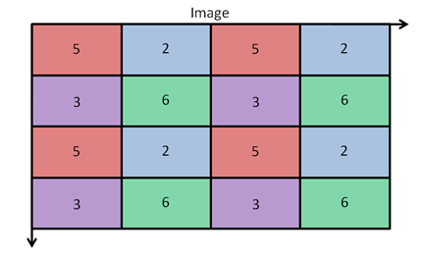
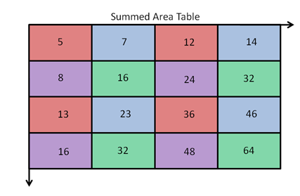
SURF Detector | Integral Image
Create: 16 + 12 - 7 + 3 = 24
Create: 16 + 23 - 13 + 6 = 32
Query: 64 + 5 - 14 - 16 = 39
same as 6+3+6+2+5+2+6+3+6 = 39
Jason Rebello | Waterloo Autonomous Vehicles Lab

Slide 12
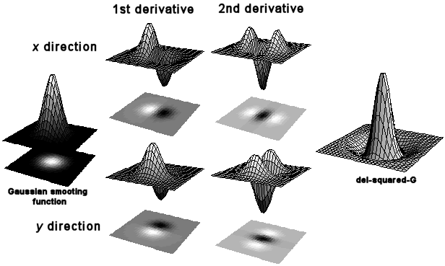
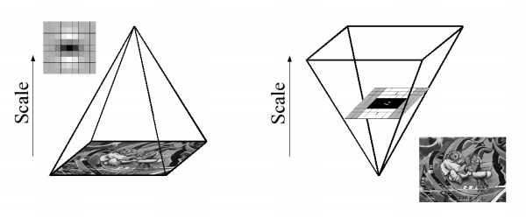
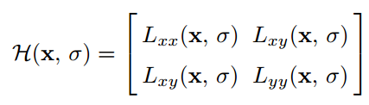
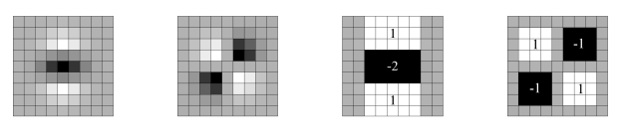

SURF Detector | Speeded Up Robust Features
Gaussian Partial Derivatives
Scale space analysis
L_{yy}
L_{xy}
D_{yy}
D_{xy}
Box Filter Approximations
Hessian Matrix and Determinant
Jason Rebello | Waterloo Autonomous Vehicles Lab

Slide 13

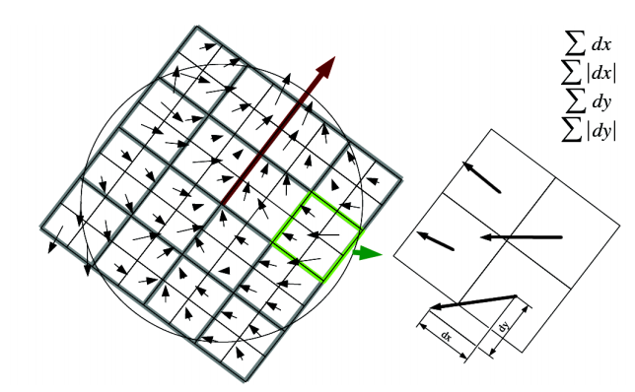
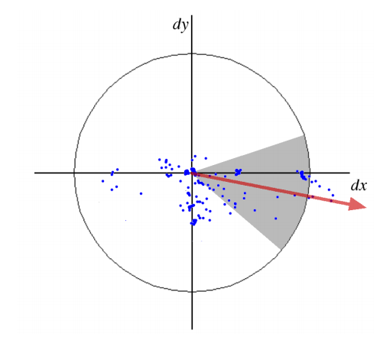
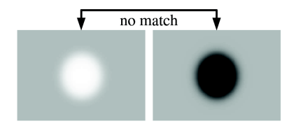
SURF Descriptor |
Each patch is 4 dimensional vector
16 Patches give 64 Dimensional Vector
Sign of Hessian Matrix for black vs white blobs
Haar Wavelets
SURF Descriptor
Dominant Orientation
Black vs White blobs
Jason Rebello | Waterloo Autonomous Vehicles Lab

Slide 14
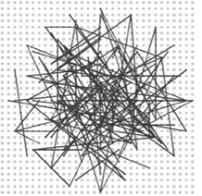
ORB Detector | Oriented fast and Robust Brief
FAST corner Detector
Harris Corner Measure
FAST detected at multiple levels in the Pyramid for Scale Invariance
BRIEF: Binary Robust Independent Elementary Features
Random Selection of pairs of Intensity Values
Fixed sampling Pattern of 128, 256 or 512 pairs
Hamming Distance to compare descriptors (XOR)
Jason Rebello | Waterloo Autonomous Vehicles Lab

Slide 15
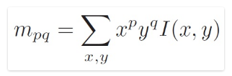
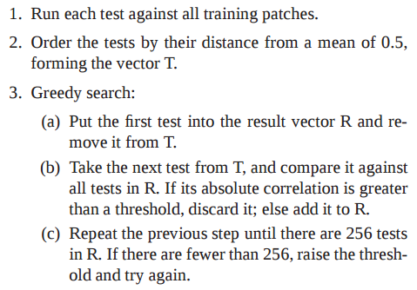
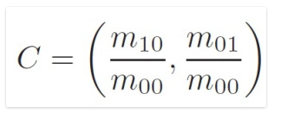
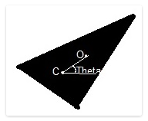

ORB Descriptor |
Learning the pairs
Patch moments
Center of Mass
300K Keypoints
205590 Possible Tests
256 dimensional descriptor
Orientation
Angle Calculation
Jason Rebello | Waterloo Autonomous Vehicles Lab

